Slide 1
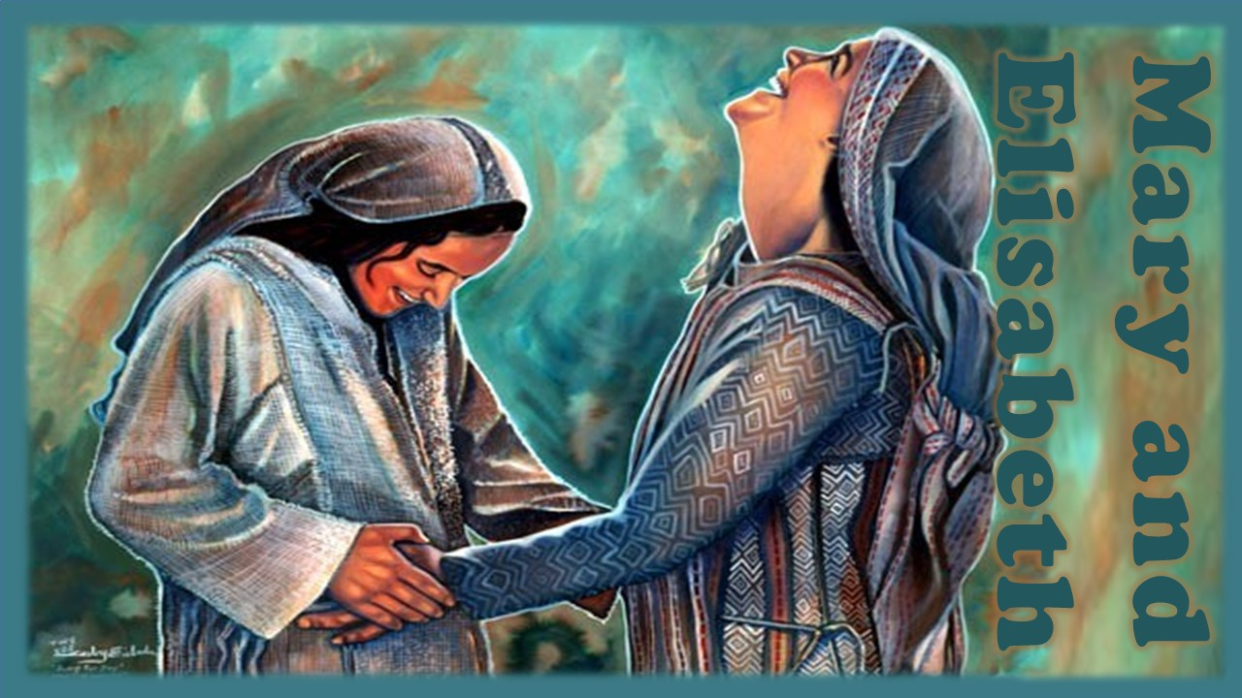

Slide 2
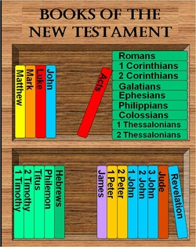
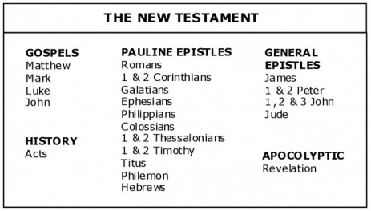
Lesson 2
My Soul Doth Magnify the Lord
Introduction

Slide 3
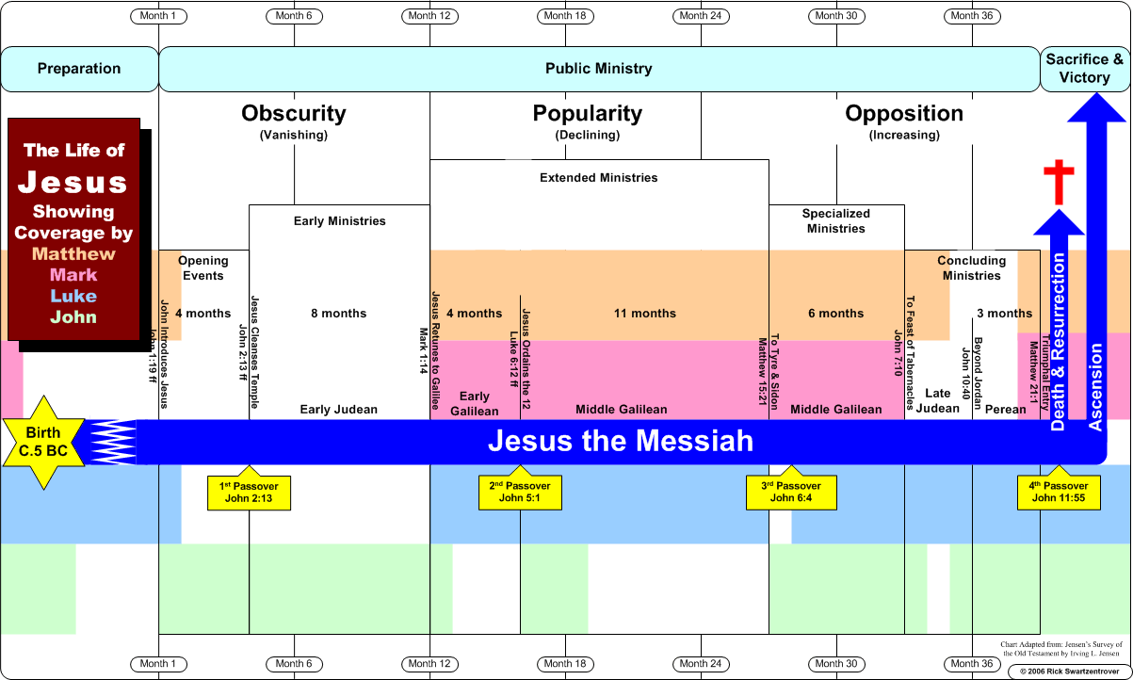

Slide 4
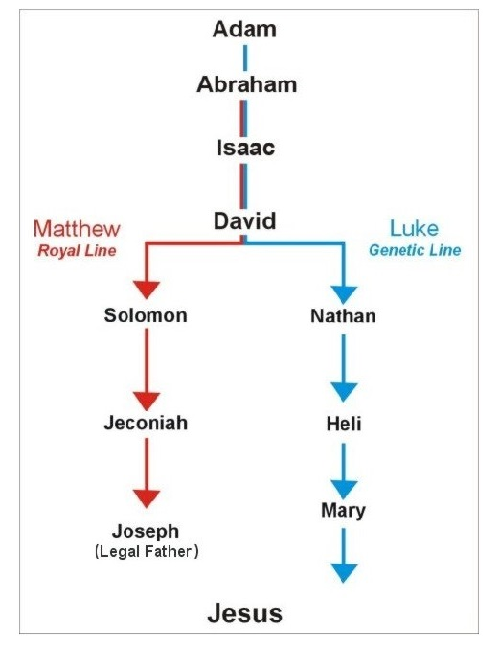
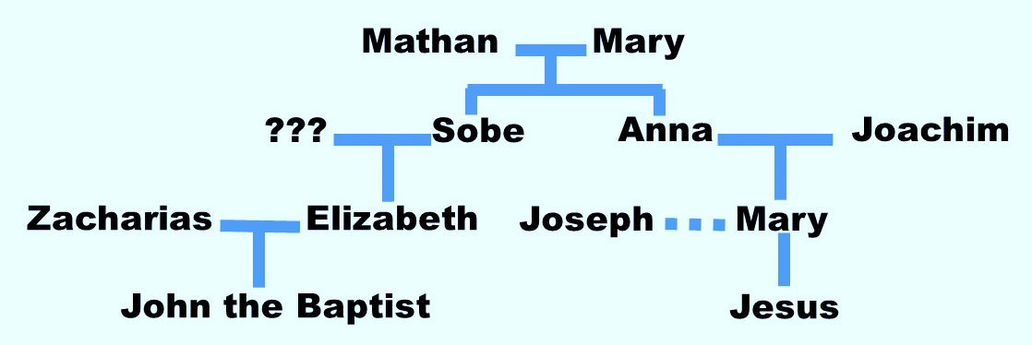
Lesson 2
My Soul Doth Magnify the Lord
Background

Slide 5
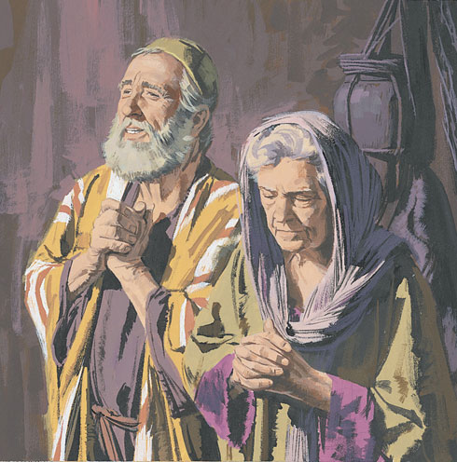
Lesson 2
My Soul Doth Magnify the Lord
Elisabeth & Zacharias
Luke 1: 6-9
⁶ And they were both righteous before God, walking in all the commandments and ordinances of the Lord blameless.
⁷ And they had no child, because that Elisabeth was barren, and they both were now well stricken in years.
⁸ And it came to pass, that while he executed the priest's office before God in the order of his course,
⁹ According to the custom of the priest's office, his lot was to burn incense when he went into the temple of the Lord.
1- John the Baptist is born

Slide 6
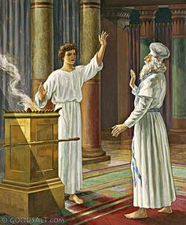
Lesson 2
My Soul Doth Magnify the Lord
Elisabeth & Zacharias
Luke 1: 11-13
¹¹ And there appeared unto him an angel of the Lord standing on the right side of the altar of incense.
¹² And when Zacharias saw him, he was troubled, and fear fell upon him.
¹³ But the angel said unto him, Fear not, Zacharias: for thy prayer is heard; and thy wife Elisabeth shall bear thee a son, and thou shalt call his name John.
1- John the Baptist is born

Slide 7
Lesson 2
My Soul Doth Magnify the Lord
Elisabeth & Zacharias
Luke 1: 11-13, 24-25
²⁴ And after those days his wife Elisabeth conceived, and hid herself five months, saying,
²⁵ Thus hath the Lord dealt with me in the days wherein he looked on me, to take away my reproach among men.
1- John the Baptist is born

Slide 8
Lesson 2
My Soul Doth Magnify the Lord
Elisabeth & Zacharias
Luke 1: 11-13, 24-25
²⁴ And after those days his wife Elisabeth conceived, and hid herself five months, saying,
²⁵ Thus hath the Lord dealt with me in the days wherein he looked on me, to take away my reproach among men.
Abrahamic promise
How can we remain faithful
when sincere prayers are not immediately answered?
1- John the Baptist is born

Slide 9
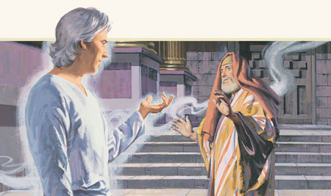
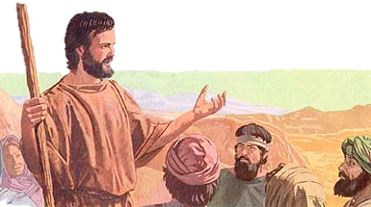
Lesson 2
My Soul Doth Magnify the Lord
Gabriel & Zacharias
Luke 1: 14-17
¹⁴ And thou shalt have joy and gladness; and many shall rejoice at his birth.
¹⁵ For he shall be great in the sight of the Lord, and shall drink neither wine nor strong drink; and he shall be filled with the Holy Ghost, even from his mother's womb.
¹⁶ And many of the children of Israel shall he turn to the Lord their God.
¹⁷ And he shall go before him in the spirit and power of Elias, to turn the hearts of the fathers to the children, and the disobedient to the wisdom of the just; to make ready a people prepared for the Lord.
John’s mission?
1- John the Baptist is born

Slide 10
Lesson 2
My Soul Doth Magnify the Lord
Gabriel & Zacharias
Luke 1: 14-17
¹⁴ And thou shalt have joy and gladness; and many shall rejoice at his birth.
¹⁵ For he shall be great in the sight of the Lord, and shall drink neither wine nor strong drink; and he shall be filled with the Holy Ghost, even from his mother's womb.
¹⁶ And many of the children of Israel shall he turn to the Lord their God.
¹⁷ And he shall go before him in the spirit and power of Elias, to turn the hearts of the fathers to the children, and the disobedient to the wisdom of the just; to make ready a people prepared for the Lord.
Last prophet of
Old Dispensation?
John’s mission?
1- John the Baptist is born

Slide 11
Lesson 2
My Soul Doth Magnify the Lord
Gabriel & Zacharias
Luke 1: 18-20
¹⁸ And Zacharias said unto the angel, Whereby shall I know this? for I am an old man, and my wife well stricken in years.
¹⁹ And the angel answering said unto him, I am Gabriel, that stand in the presence of God; and am sent to speak unto thee, and to shew thee these glad tidings.
²⁰ And, behold, thou shalt be dumb, and not able to speak, until the day that these things shall be performed, because thou believest not my words, which shall be fulfilled in their season.
1- John the Baptist is born

Slide 12
Lesson 2
My Soul Doth Magnify the Lord
Gabriel & Zacharias
Luke 1: 18-20
“How shall this be?”
¹⁸ And Zacharias said unto the angel, Whereby shall I know this? for I am an old man, and my wife well stricken in years.
¹⁹ And the angel answering said unto him, I am Gabriel, that stand in the presence of God; and am sent to speak unto thee, and to shew thee these glad tidings.
²⁰ And, behold, thou shalt be dumb, and not able to speak, until the day that these things shall be performed, because thou believest not my words, which shall be fulfilled in their season.
1- John the Baptist is born

Slide 13
Lesson 2
My Soul Doth Magnify the Lord
Gabriel & Zacharias
Luke 1: 59-63
⁵⁹ And it came to pass, that on the eighth day they came to circumcise the child; and they called him Zacharias, after the name of his father.
⁶⁰ And his mother answered and said, Not so; but he shall be called John.
⁶¹ And they said unto her, There is none of thy kindred that is called by this name.
⁶² And they made signs to his father, how he would have him called.
⁶³ And he asked for a writing table, and wrote, saying, His name is John. And they marvelled all.
John the Baptist
1- John the Baptist is born

Slide 14
Lesson 2
My Soul Doth Magnify the Lord
Gabriel & Zacharias
Luke 1: 59-63
⁵⁹ And it came to pass, that on the eighth day they came to circumcise the child; and they called him Zacharias, after the name of his father.
⁶⁰ And his mother answered and said, Not so; but he shall be called John.
⁶¹ And they said unto her, There is none of thy kindred that is called by this name.
⁶² And they made signs to his father, how he would have him called.
⁶³ And he asked for a writing table, and wrote, saying, His name is John. And they marvelled all.
John the Baptist
1- John the Baptist is born

Slide 15
Lesson 2
My Soul Doth Magnify the Lord
Gabriel & Zacharias
Luke 1: 80
⁸⁰ And the child grew, and waxed strong in spirit, and was in the deserts till the day of his shewing unto Israel.
John the Baptist
1- John the Baptist is born

Slide 16
Lesson 2
My Soul Doth Magnify the Lord
Gabriel & Zacharias
Luke 1: 80
⁸⁰ And the child grew, and waxed strong in spirit, and was in the deserts till the day of his shewing unto Israel.
“Waxed strong in spirit” - That is, in courage, understanding, and purposes of good, fitting him for his future work. The word "wax" means to "increase, to grow.” In the deserts of Hebron, and in the hill country where his father resided. He dwelt in obscurity, and was not known publicly.
Until the day of his showing - Until he entered on his public ministry- that is until he was about 30.
Barnes’ Notes on the Bible
What can we do to “wax strong” in the gospel?
John the Baptist
1- John the Baptist is born

Slide 17
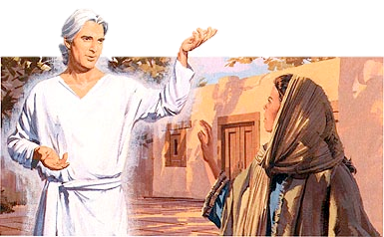
Lesson 2
My Soul Doth Magnify the Lord
Gabriel & Mary
Luke 1: 26-33
²⁶ And in the sixth month the angel Gabriel was sent from God unto a city of Galilee, named Nazareth,
²⁷ To a virgin espoused to a man whose name was Joseph, of the house of David; and the virgin's name was Mary.
³² He shall be great, and shall be called the Son of the Highest: and the Lord God shall give unto him the throne of his father David:
³³ And he shall reign over the house of Jacob for ever; and of his kingdom there shall be no end.
²⁸ And the angel came in unto her, and said, Hail, thou that art highly favoured, the Lord is with thee: blessed art thou among women.
²⁹ And when she saw him, she was troubled at his saying, and cast in her mind what manner of salutation this should be.
³⁰ And the angel said unto her, Fear not, Mary: for thou hast found favour with God.
³¹ And, behold, thou shalt conceive in thy womb, and bring forth a son, and shalt call his name Jesus.
2- Mary and Joseph learn they will be parents of Son of God

Slide 18
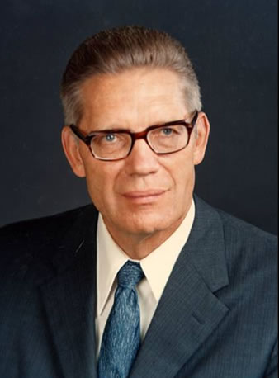
Lesson 2
My Soul Doth Magnify the Lord
Gabriel & Mary
Luke 1: 26-33
Speaking of Jesus Christ, Elder Bruce R. McConkie taught:
“God was his Father, from which Immortal Personage … he inherited
the power of immortality, which is the power to live forever; or, having
chosen to die, it is the power to rise again in immortality, thereafter to
live forever without again seeing corruption. …
“… Mary was his mother, from which mortal woman … he inherited the power of mortality, which is the power to die. …
“It was because of this … intermixture of the divine and the mortal in one person, that our Lord was able to work out the infinite and eternal atonement. Because God was his Father and Mary was his mother, he had power to live or to die, as he chose, and having laid down his life, he had power to take it again, and then, in a way incomprehensible to us, to pass on the effects of that resurrection to all men so that all shall rise from the tomb” (The Promised Messiah [1978], 470–71)
2- Mary and Joseph learn they will be parents of Son of God

Slide 19
Lesson 2
My Soul Doth Magnify the Lord
Gabriel & Mary
Luke 1: 38
³⁸ And Mary said, Behold the handmaid of the Lord; be it unto me according to thy word. And the angel departed from her.
Luke 1: 46-48
⁴⁶ And Mary said, My soul doth magnify the Lord,
⁴⁷ And my spirit hath rejoiced in God my Saviour.
⁴⁸ For he hath regarded the low estate of his handmaiden: for, behold, from henceforth all generations shall call me blessed.
2- Mary and Joseph learn they will be parents of Son of God

Slide 20
Lesson 2
My Soul Doth Magnify the Lord
Gabriel & Mary
Luke 1: 38
³⁸ And Mary said, Behold the handmaid of the Lord; be it unto me according to thy word. And the angel departed from her.
talking to Gabriel
Luke 1: 46-48
⁴⁶ And Mary said, My soul doth magnify the Lord,
⁴⁷ And my spirit hath rejoiced in God my Saviour.
⁴⁸ For he hath regarded the low estate of his handmaiden: for, behold, from henceforth all generations shall call me blessed.
Sweet Mary...
2- Mary and Joseph learn they will be parents of Son of God

Slide 21
Lesson 2
My Soul Doth Magnify the Lord
Gabriel & Mary
Luke 1: 38
³⁸ And Mary said, Behold the handmaid of the Lord; be it unto me according to thy word. And the angel departed from her.
talking to Gabriel
Luke 1: 46-48
⁴⁶ And Mary said, My soul doth magnify the Lord,
⁴⁷ And my spirit hath rejoiced in God my Saviour.
⁴⁸ For he hath regarded the low estate of his handmaiden: for, behold, from henceforth all generations shall call me blessed.
Sweet Mary...
talking to Elizabeth
2- Mary and Joseph learn they will be parents of Son of God

Slide 22
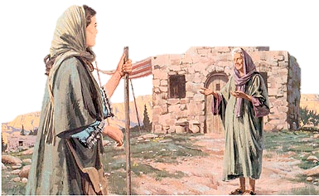
Lesson 2
My Soul Doth Magnify the Lord
Mary & Elizabeth
Luke 1: 39-42
³⁹ And Mary arose in those days, and went into the hill country with haste, into a city of Juda;
⁴⁰ And entered into the house of Zacharias, and saluted Elisabeth.
⁴¹ And it came to pass, that, when Elisabeth heard the salutation of Mary, the babe leaped in her womb; and Elisabeth was filled with the Holy Ghost:
⁴² And she spake out with a loud voice, and said, Blessed art thou among women, and blessed is the fruit of thy womb.
2- Mary and Joseph learn they will be parents of Son of God

Slide 23
Lesson 2
My Soul Doth Magnify the Lord
Mary & Elizabeth
Luke 1: 39-42
³⁹ And Mary arose in those days, and went into the hill country with haste, into a city of Juda;
⁴⁰ And entered into the house of Zacharias, and saluted Elisabeth.
⁴¹ And it came to pass, that, when Elisabeth heard
the salutation of Mary, the babe leaped in her womb; and Elisabeth was filled with the Holy Ghost:
⁴² And she spake out with a loud voice, and said, Blessed art thou among women, and blessed is the fruit of thy womb.
What was shared by these two cousins?
2- Mary and Joseph learn they will be parents of Son of God

Slide 24
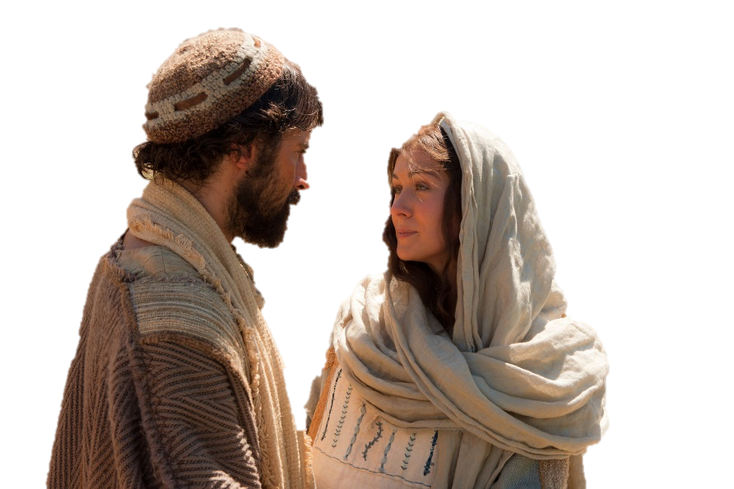
Lesson 2
My Soul Doth Magnify the Lord
Joseph & Mary
Matthew 1: 18-19
¹⁸ Now the birth of Jesus Christ was on this wise: When as his mother Mary was espoused to Joseph, before they came together, she was found with child of the Holy Ghost.
¹⁹ Then Joseph her husband, being a just man, and not willing to make her a public example, was minded to put her away privily.
2- Mary and Joseph learn they will be parents of Son of God

Slide 25
Lesson 2
My Soul Doth Magnify the Lord
Joseph & Mary
Matthew 1: 18-19
¹⁸ Now the birth of Jesus Christ was on this wise: When as his mother Mary was espoused to Joseph, before they came together, she was found with child of the Holy Ghost.
¹⁹ Then Joseph her husband, being a just man, and not willing to make her a public example, was minded to put her away privily.
>Formal ceremony
>Gift of a ring and other jewels
>Betrothal interval a whole year
>Bride-elect remained in her own home
>Communications conducted through “the friend of the bridegroom”
2- Mary and Joseph learn they will be parents of Son of God

Slide 26
Lesson 2
My Soul Doth Magnify the Lord
Joseph & Mary
Matthew 1: 18-19
¹⁸ Now the birth of Jesus Christ was on this wise: When as his mother Mary was espoused to Joseph, before they came together, she was found with child of the Holy Ghost.
¹⁹ Then Joseph her husband, being a just man, and not willing to make her a public example, was minded to put her away privily.
Joseph resolved to put her away without specifying the cause; for he was not willing to make her a public example. This is the meaning here of "privily." Both to Joseph and Mary this must have been a great trial.
2- Mary and Joseph learn they will be parents of Son of God

Slide 27
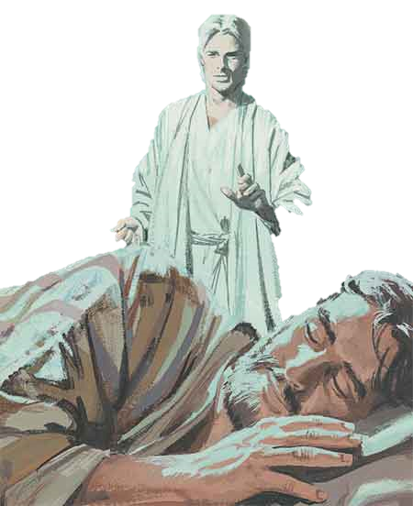
Lesson 2
My Soul Doth Magnify the Lord
Joseph & Mary
Matthew 1: 20-21
²⁰ But while he thought on these things, behold, the angel of the Lord appeared unto him in a dream, saying, Joseph, thou son of David, fear not to take unto thee Mary thy wife: for that which is conceived in her is of the Holy Ghost.
²¹ And she shall bring forth a son, and thou shalt call his name Jesus: for he shall save his people from their sins.
Let us reflect, with what wonder and pleasure he would receive the important message from the angel, which not only assured him of the unstained virtue of her he loved, and confirmed his choice of her, but brought him tidings of a divine Savior, who should save his people from their sins; and assured him, moreover, that the object of his affections, his beloved, espoused Mary, should, by a miraculous conception, be the happy mother of this heavenly offspring, and should therefore through all generations be entitled “blessed”.
Benson Commentary
Joseph & Gabriel
2- Mary and Joseph learn they will be parents of Son of God

Slide 28
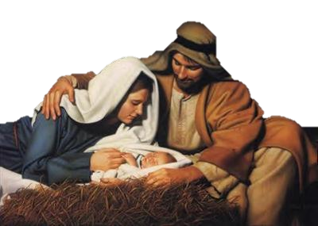
Lesson 2
My Soul Doth Magnify the Lord
Joseph & Mary
Matthew 1: 24-25
²⁴ Then Joseph being raised from sleep did as the angel of the Lord had bidden him, and took unto him his wife:
²⁵ And knew her not till she had brought forth her firstborn son: and he called his name Jesus.
What was the test for Joseph?
2- Mary and Joseph learn they will be parents of Son of God

Slide 29
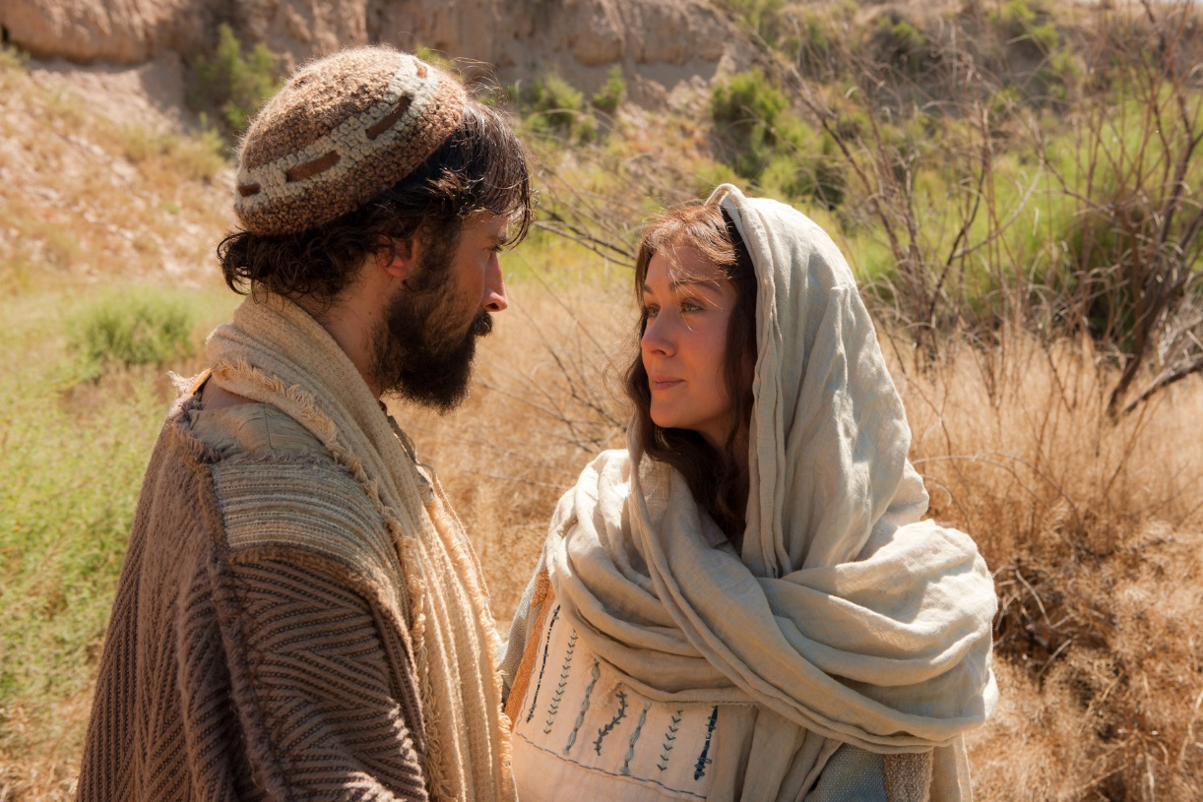
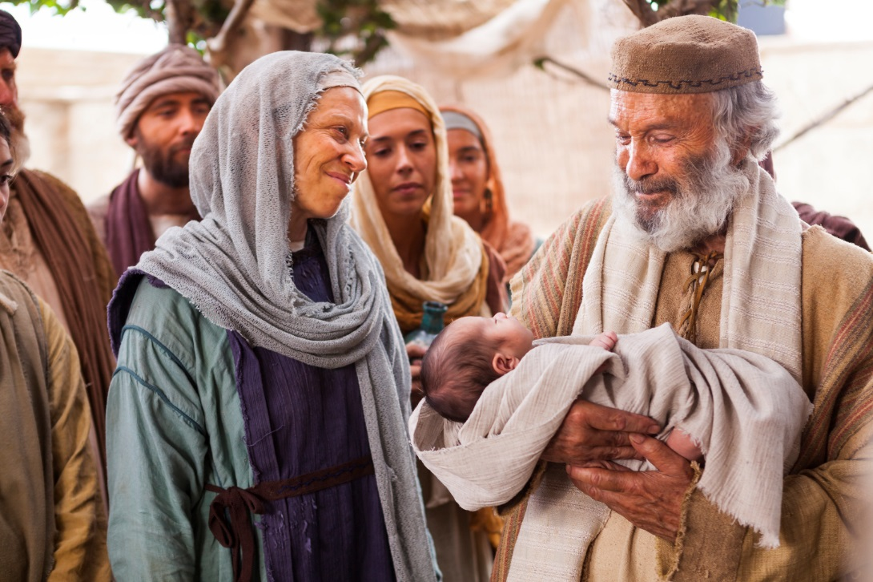
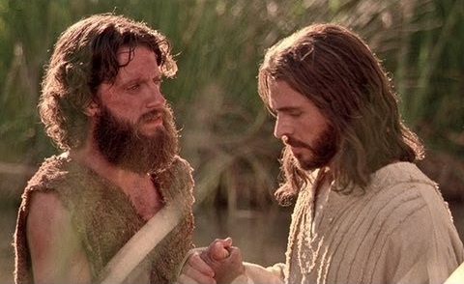
Lesson 2
My Soul Doth Magnify the Lord
Elizabeth & Zacharias
Joseph & Mary
Jesus & John the Baptist
Conclusion

