Slide 2
Lesson 4
Prepare Ye the Way of the Lord
John the Baptist
Baptism & Temptations
Birth
Introduction

Slide 3
Lesson 4
Prepare Ye the Way of the Lord
Matthew 3:1-12
1- John the Baptist prepares the way of the Lord Jesus Christ

Slide 4
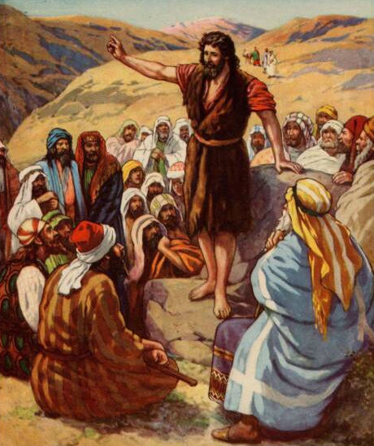
Lesson 4
Prepare Ye the Way of the Lord
Matthew 3:3-4
³ For this is he that was spoken of by the prophet Esaias, saying, The voice of one crying in the wilderness, Prepare ye the way of the Lord, make his paths straight.
⁴ And the same John had his raiment of camel's hair, and a leathern girdle about his loins; and his meat was locusts and wild honey.
1- John the Baptist prepares the way of the Lord Jesus Christ

Slide 5
Lesson 4
Prepare Ye the Way of the Lord
Matthew 3:3-4
³ For this is he that was spoken of by the prophet Esaias, saying, The voice of one crying in the wilderness, Prepare ye the way of the Lord, make his paths straight.
⁴ And the same John had his raiment of camel's hair, and a leathern girdle about his loins; and his meat was locusts and wild honey.
1- John the Baptist prepares the way of the Lord Jesus Christ

Slide 6
Lesson 4
Prepare Ye the Way of the Lord
Matthew 3:1-2
¹In those days came John the Baptist, preaching in the wilderness of Judaea,
² And saying, Repent ye: for the kingdom of heaven is at hand.
1- John the Baptist prepares the way of the Lord Jesus Christ

Slide 7
Lesson 4
Prepare Ye the Way of the Lord
Matthew 3:1-2
¹In those days came John the Baptist, preaching in the wilderness of Judaea,
² And saying, Repent ye: for the kingdom of heaven is at hand.
What & How? & Why?
a. Feeling godly sorrow for sin (2 Corinthians 7:9–10).
b. Confessing and forsaking sins (D&C 58:42–43).
c. Making amends, where possible, for wrongs done (Luke 19:8).
d. Obeying the commandments (D&C 1:31–32).
e. Turning to the Lord and serving him (Mosiah 7:33).
1- John the Baptist prepares the way of the Lord Jesus Christ

Slide 8
Lesson 4
Prepare Ye the Way of the Lord
Matthew 3:11
¹¹ I indeed baptize you with water unto repentance. but he that cometh after me is mightier than I, whose shoes I am not worthy to bear: he shall baptize you with the Holy Ghost, and with fire:
1- John the Baptist prepares the way of the Lord Jesus Christ

Slide 9
Lesson 4
Prepare Ye the Way of the Lord
Matthew 3:11
¹¹ I indeed baptize you with water unto repentance. but he that cometh after me is mightier than I, whose shoes I am not worthy to bear: he shall baptize you with the Holy Ghost, and with fire:
What & How? & Why?
“The gift of the Holy Ghost is the right to have, whenever one is worthy, the companionship of the Holy Ghost. … It acts as a cleansing agent to purify a person and sanctify him from all sin. Thus it is often spoken of as ‘fire’”
(Bible Dictionary, “Holy Ghost,” 704)
1- John the Baptist prepares the way of the Lord Jesus Christ

Slide 10
Lesson 4
Prepare Ye the Way of the Lord
Matthew 3:13-17
¹³ Then cometh Jesus from Galilee to Jordan unto John, to be baptized of him.
¹⁴ But John forbad him, saying, I have need to be baptized of thee, and comest thou to me?
¹⁵ And Jesus answering said unto him, Suffer it to be so now: for thus it becometh us to fulfil all righteousness. Then he suffered him.
¹⁶ And Jesus, when he was baptized, went up straightway out of the water: and, lo, the heavens were opened unto him, and he saw the Spirit of God descending like a dove, and lighting upon him:
¹⁷ And lo a voice from heaven, saying, This is my beloved Son, in whom I am well pleased.
Why?
2- Jesus is baptized by John the Baptist

Slide 11
Lesson 4
Prepare Ye the Way of the Lord
2- Jesus is baptized by John the Baptist

Slide 12
Lesson 4
Prepare Ye the Way of the Lord
D&C 20:37
37 And again, by way of commandment to the church concerning the manner of baptism—All those who humble themselves before God, and desire to be baptized, and come forth with broken hearts and contrite spirits, and witness before the church that they have truly repented of all their sins,
and are willing to take upon them the name of Jesus Christ,
having a determination to serve him to the end,
and truly manifest by their works that they have received of the Spirit of Christ unto the remission of their sins,
shall be received by baptism into his church.
2- Jesus is baptized by John the Baptist

Slide 13
Lesson 4
Prepare Ye the Way of the Lord
D&C 20:37
37 And again, by way of commandment to the church concerning the manner of baptism—All those who humble themselves before God, and desire to be baptized, and come forth with broken hearts and contrite spirits, and witness before the church that they have truly repented of all their sins,
and are willing to take upon them the name of Jesus Christ,
having a determination to serve him to the end,
and truly manifest by their works that they have received of the Spirit of Christ unto the remission of their sins,
shall be received by baptism into his church.
2- Jesus is baptized by John the Baptist

Slide 14
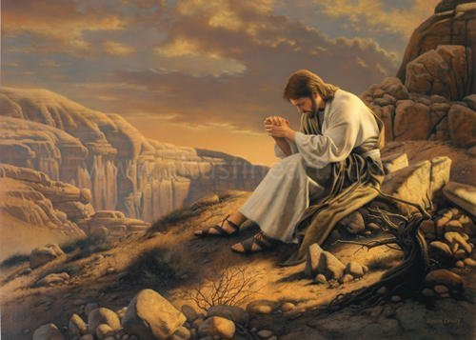
Lesson 4
Prepare Ye the Way of the Lord
Matthew 4:1
¹Then was Jesus led up of the Spirit into the wilderness to be tempted of the devil.
3- Jesus withstands Satan’s temptations

Slide 15
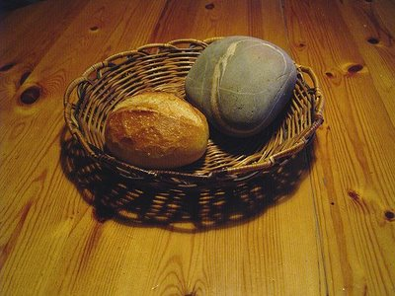
Lesson 4
Prepare Ye the Way of the Lord
² And when he had fasted forty days and forty nights, he was afterward an hungred.
³ And when the tempter came to him, he said, If thou be the Son of God, command that these stones be made bread.
Matthew 4:2-3,4
“It is written, Man shall not live by bread alone, but by every word that proceedeth out of the mouth of God.”
3- Jesus withstands Satan’s temptations

Slide 16
Lesson 4
Prepare Ye the Way of the Lord
Matthew 4:2-3,4
The temptation is not in the eating. He has eaten before,
he will soon eat again, and he must eat for the rest of his
mortal life. The temptation, at least the part I wish to focus on, is to do it this way, to get his bread—his physical satisfaction, relief for his human appetite--the easy way, by abuse of power and without a willingness to wait for the right time and the right way.
It is the temptation to be the convenient Messiah.
3- Jesus withstands Satan’s temptations

Slide 17
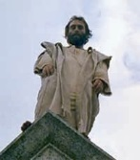
Lesson 4
Prepare Ye the Way of the Lord
⁵ Then the devil taketh him up into the holy city, and setteth him on a pinnacle of the temple,
⁶ And saith unto him, If thou be the Son of God, cast thyself down: for it is written, He shall give his angels charge concerning thee: and in their hands they shall bear thee up, lest at any time thou dash thy foot against a stone.
Matthew 4:5-6,7
“It is written again, Thou shalt not tempt the Lord thy God.”
3- Jesus withstands Satan’s temptations

Slide 18
Lesson 4
Prepare Ye the Way of the Lord
Matthew 4:5-6,7
The temptation here is even more subtle than the first. It
is a temptation of the spirit, of a private hunger more real
than the need for bread. Would God save him? Would he? …
And shouldn't Satan be silenced with his insidious "If, if, if"? Why not get spiritual confirmation, a loyal congregation, and an answer to this imp who heckles--all with one appeal to God's power? Right now. The easy way. But Jesus refuses the temptation of the spirit.
3- Jesus withstands Satan’s temptations

Slide 19
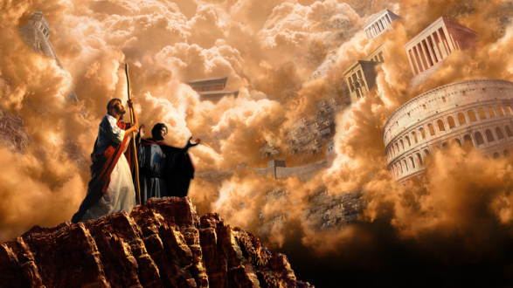
Lesson 4
Prepare Ye the Way of the Lord
⁸ Again, the devil taketh him up into an exceeding high mountain, and sheweth him all the kingdoms of the world, and the glory of them;
⁹ And saith unto him, All these things will I give thee, if thou wilt fall down and worship me.
Matthew 4:8-9,10
“Get thee hence, Satan: for it is written, Thou shalt worship the Lord thy God, and him only shalt thou serve.”
3- Jesus withstands Satan’s temptations

Slide 20
Lesson 4
Prepare Ye the Way of the Lord
Matthew 4:8-9,10
Now in some frustration Satan moves right to the point. If
he cannot tempt physically and cannot tempt spiritually, he
will simply make an outright proposition. From a high mountain
where they might overlook the kingdoms of the world, Satan says, "All these things will I give thee, if thou wilt fall down and worship me."
Satan makes up for lack of subtlety here with the grandeur of his offer. Satan is proceeding under his first article of faithlessness--the unequivocal belief that you can buy anything in this world for money.
3- Jesus withstands Satan’s temptations

Slide 21
Lesson 4
Prepare Ye the Way of the Lord
What can we learn from how Jesus responded to each temptation?
“It is written, Man shall not live by bread alone, but by every word that proceedeth out of the mouth of God.”
“It is written again, Thou shalt not tempt the Lord thy God.”
“Get thee hence, Satan: for it is written, Thou shalt worship the Lord thy God, and him only shalt thou serve.”
3- Jesus withstands Satan’s temptations

Slide 22
Lesson 4
Prepare Ye the Way of the Lord
Why did Satan question Jesus being the Son of God?
“If thou be the Son of God...”
3- Jesus withstands Satan’s temptations

Slide 23
Lesson 4
Prepare Ye the Way of the Lord
Does it help us to know Jesus faced temptations?
Physical Appetites
Pride
Worldly Riches
3- Jesus withstands Satan’s temptations

Slide 24
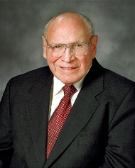
Lesson 4
Prepare Ye the Way of the Lord
Does it help us to know Jesus faced temptations?
Elder Joseph B. Wirthlin said:
“The Lord is well aware of our mortality.
He knows our weaknesses. He understands
the challenges of our everyday lives. He has great empathy for the temptations of earthly appetites and passions”
(in Conference Report, Apr. 1996, 46; or Ensign, May 1996, 34)
3- Jesus withstands Satan’s temptations

Slide 25
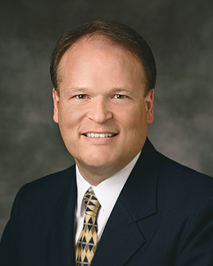
Lesson 4
Prepare Ye the Way of the Lord
Elder Marcus B. Nash
First Quorum of the Seventy
What did you learn?
How will it change you?
Conclusion

