Slide 2
Lesson 6
They Straightway Left Their Nets
Introduction

Slide 3
Lesson 6
They Straightway Left Their Nets
12 Disciples in
Order of Calling
1- Andrew
2- John
3- Peter
4- James the Greater
5- Philip
6- Nathaniel (Bartholomew)
7- Matthew
8- Thomas
9- James the Lesser
10- Simon the Zealot
11- Judas (Thaddeus)
12- Judas Iscariot
Introduction

Slide 4
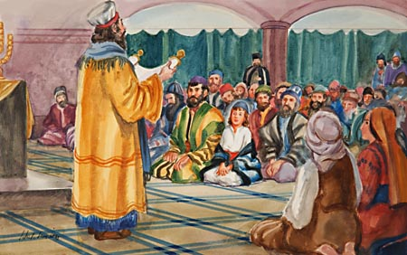
Lesson 6
They Straightway Left Their Nets
Jesus Reading
in the Synagogue
In ancient Israel it was customary in the Synagogue for a common Israelite to read from the Torah on the Sabbath Day. Those who read were expected to stand.
Not only priests and Levites but common Israelites were allowed to read the Scriptures publicly. Every Sabbath seven persons read : a priest, a Levite, and five ordinary Israelites. It appears that there was no appointed teacher in the synagogue, but that any person who considered himself qualified to preach was at liberty to do so.
[Scripture Manners and Customs]
Background

Slide 5
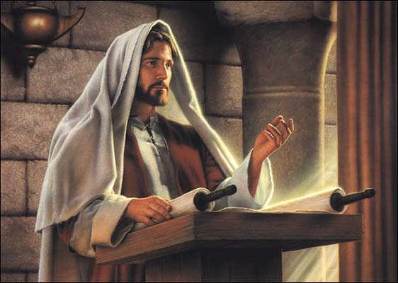
Lesson 6
They Straightway Left Their Nets
Jesus Reading
in the Synagogue
Jesus finishes reading the scripture from Isaiah.
Why were the eyes fastened on him? There was a part of the scripture he left out at the very end,
that he would give sight to the blind and he would help the oppressed and he would bring about the day of the Lord's vengeance, but he stopped and didn't read that part. He just finished with God healing and blessing the oppressed and then he sat down and everyone looked at him and thought, 'huh...I wonder why he didn't finish?'
Background

Slide 6
Lesson 6
They Straightway Left Their Nets
Luke 4: 16-19
¹⁶ And he came to Nazareth, where he had been brought up: and, as his custom was, he went into the synagogue on the sabbath day, and stood up for to read.
¹⁷ And there was delivered unto him the book of the prophet Esaias. And when he had opened the book, he found the place where it was written,
¹⁸ The Spirit of the Lord is upon me, because he hath anointed me to preach the gospel to the poor; he hath sent me to heal the brokenhearted, to preach deliverance to the captives, and recovering of sight to the blind, to set at liberty them that are bruised,
¹⁹ To preach the acceptable year of the Lord.
Isaiah 61:1-2
1- Jesus announces He is the Messiah

Slide 7
Lesson 6
They Straightway Left Their Nets
Luke 4: 21-22
²¹ And he began to say unto them, This day is this scripture fulfilled in your ears.
²² And all bare him witness, and wondered at the gracious words which proceeded out of his mouth. And they said, Is not this Joseph's son?
or
And all bare him witness, and wondered at the gracious words which proceeded out of his mouth.
And he began to say unto them, This day is this scripture fulfilled in your ears.
And they said, Is not this Joseph's son?
1- Jesus announces He is the Messiah

Slide 8
Lesson 6
They Straightway Left Their Nets
Luke 4: 24-27
²⁴ And he said, Verily I say unto you, No prophet is accepted in his own country.
²⁵ But I tell you of a truth, many widows were in Israel in the days of Elias, when the heaven was shut up three years and six months, when great famine was throughout all the land;
²⁶ But unto none of them was Elias sent, save unto Sarepta, a city of Sidon, unto a woman that was a widow.
²⁷ And many lepers were in Israel in the time of Eliseus the prophet; and none of them was cleansed, saving Naaman the Syrian.
1- Jesus announces He is the Messiah

Slide 9
Lesson 6
They Straightway Left Their Nets
Luke 4: 28-29, 30
²⁸ And all they in the synagogue, when they heard these things, were filled with wrath,
²⁹ And rose up, and thrust him out of the city, and led him unto the brow of the hill hereon their city was built, that they might cast him down headlong.
1- Jesus announces He is the Messiah

Slide 10
Lesson 6
They Straightway Left Their Nets
Luke 4: 28-29, 30
²⁸ And all they in the synagogue, when they heard these things, were filled with wrath,
²⁹ And rose up, and thrust him out of the city, and led him unto the brow of the hill hereon their city was built, that they might cast him down headlong.
What proof would I need to recognize the Christ?
³⁰ But he passing through the midst of them went his way,
1- Jesus announces He is the Messiah

Slide 11
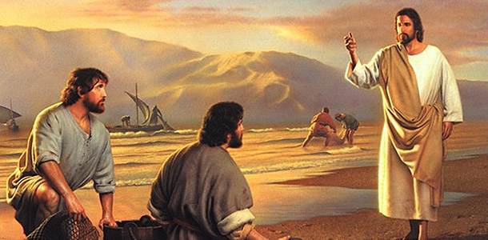
Lesson 6
They Straightway Left Their Nets
Calling the Twelve
Where did Jesus start?
2- Jesus calls his Twelve Apostles

Slide 12
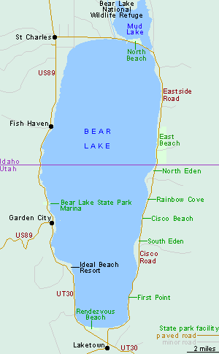
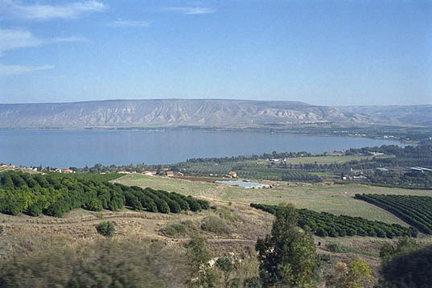
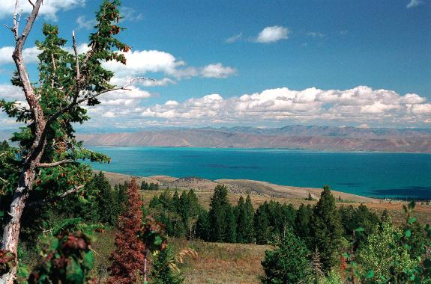
Lesson 6
They Straightway Left Their Nets
Sea of Galilee
Bear Lake
The Lake of Gennesaret
Sea of Tiberias
2- Jesus calls his Twelve Apostles

Slide 13
Lesson 6
They Straightway Left Their Nets
Luke 5: 1-2,3
¹And it came to pass, that, as the people pressed upon him to hear the word of God, he stood by the lake of Gennesaret,
² And saw two ships standing by the lake: but the fishermen were gone out of them, and were washing their nets.
³ And he entered into one of the ships, which was Simon's, and prayed him that he would thrust out a little from the land. And he sat down, and taught the people out of the ship.
2- Jesus calls his Twelve Apostles

Slide 14
Lesson 6
They Straightway Left Their Nets
^{Foreshadow?}
Luke 5: 5-7
⁵ And Simon answering said unto him, Master, we have toiled all the night, and have taken nothing: nevertheless at thy word I will let down the net.
⁶ And when they had this done, they inclosed a great multitude of fishes: and their net brake.
⁷ And they beckoned unto their partners, which were in the other ship, that they should come and help them. And they came, and filled both the ships, so that they began to sink.
fishermen disciples
Simon Peter
Andrew, Simon Peter's brother
James, one of the "sons of Zebedee")
John (one the "sons of Zebedee")
Nathaniel
Philip, the brother of Nathaniel
Thomas, called Didymus
Luke 5: 10-11
¹⁰ And so was also James, and John, the sons of Zebedee, which were partners with Simon. And Jesus said unto Simon, Fear not; from henceforth thou shalt catch men.
¹¹ And when they had brought their ships to land, they forsook all, and followed him.
2- Jesus calls his Twelve Apostles

Slide 15
Lesson 6
They Straightway Left Their Nets
Disciple
Mark 3:14
any follower of Jesus Christ (Bible Dictionary, “Disciple,” 657)
And he ordained twelve, that they should be with him, and that he might send them forth to preach
Apostle
In addition to serving as special witnesses of Jesus Christ to all the world (D&C 107:23), Apostles hold the keys of the priesthood--that is, the rights of presidency (Encyclopedia of Mormonism [1992], 1:59-60).
The members of the Quorum of the Twelve Apostles are sent forth to testify to the world that Jesus Christ is the Savior and Redeemer of mankind.
2- Jesus calls his Twelve Apostles

Slide 16
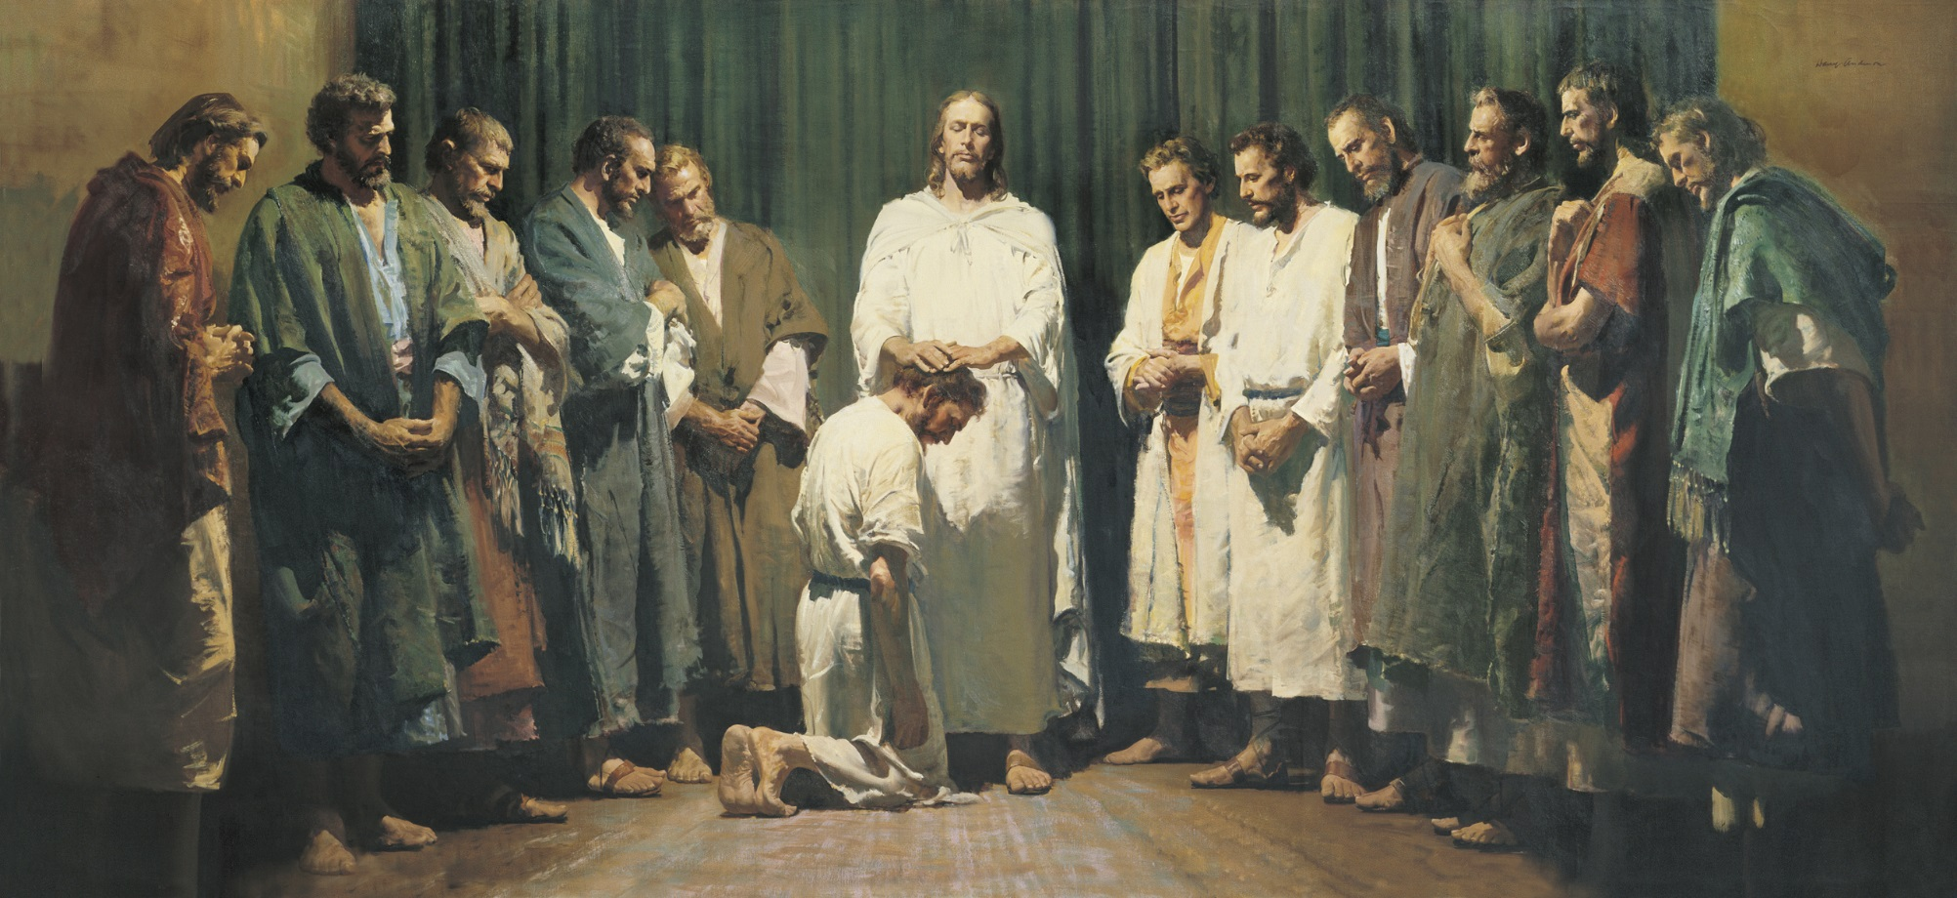
Lesson 6
They Straightway Left Their Nets
The members of the Quorum of the Twelve Apostles are sent forth to testify to the world that Jesus Christ is the Savior and Redeemer of mankind.
2- Jesus calls his Twelve Apostles

Slide 17
Lesson 6
They Straightway Left Their Nets
The members of the Quorum of the Twelve Apostles are sent forth to testify to the world that Jesus Christ is the Savior and Redeemer of mankind.
2- Jesus calls his Twelve Apostles

Slide 18
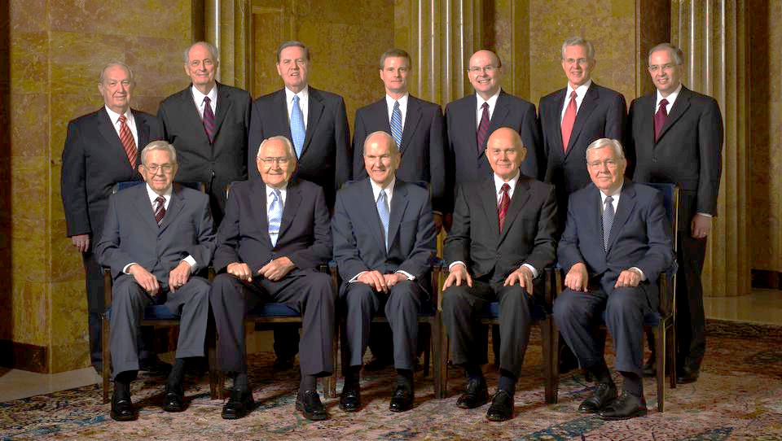
Lesson 6
They Straightway Left Their Nets
The members of the Quorum of the Twelve Apostles are sent forth to testify to the world that Jesus Christ is the Savior and Redeemer of mankind.
2- Jesus calls his Twelve Apostles

Slide 19
Lesson 6
They Straightway Left Their Nets
The members of the Quorum of the Twelve Apostles are sent forth to testify to the world that Jesus Christ is the Savior and Redeemer of mankind.
2- Jesus calls his Twelve Apostles

Slide 20
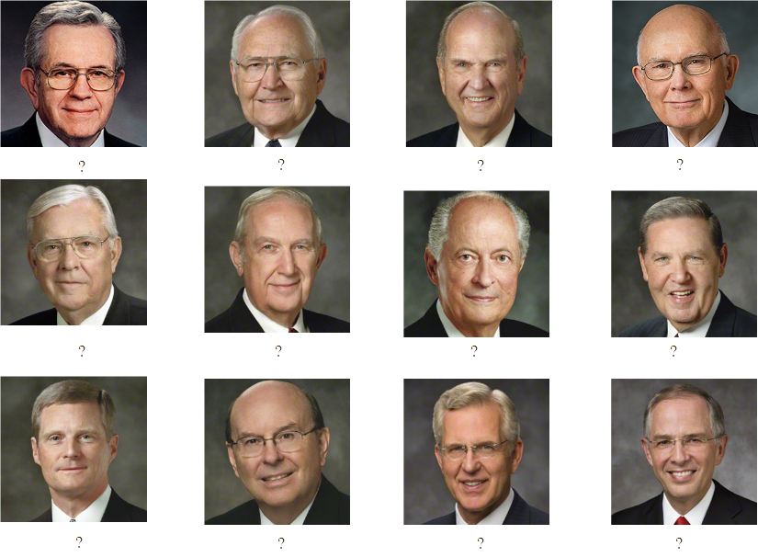
Boyd K. Packer L. Tom Perry Russell M. Nelson Dallin H. Oaks
M. Russell Ballard Richard G. Scott Robert D. Hales Jeffrey R. Holland
David A. Bednar Quentin L. Cook D. Todd Christofferson Neil L. Anderson

Slide 21
Lesson 6
They Straightway Left Their Nets
Powers & Responsibilities of Apostles
Matthew 10:1
¹And when he had called unto him his twelve disciples, he gave them power against unclean spirits, to cast them out, and to heal all manner of sickness and all manner of disease.
3- Jesus ordains the Twelve Apostles

Slide 22
Lesson 6
They Straightway Left Their Nets
Powers & Responsibilities of Apostles
Matthew 10:1
1- Heal
2- Preach
3- Bless
4- Seek
5- Teach
6- 100%
¹And when he had called unto him his twelve disciples, he gave them power against unclean spirits, to cast them out, and to heal all manner of sickness and all manner of disease.
3- Jesus ordains the Twelve Apostles

Slide 23
Lesson 6
They Straightway Left Their Nets
Powers & Responsibilities of Apostles
Matthew 10:6-7
1- Heal
2- Preach
3- Bless
4- Seek
5- Teach
6- 100%
⁶ But go rather to the lost sheep of the house of Israel.
⁷ And as ye go, preach, saying, The kingdom of heaven is at hand.
3- Jesus ordains the Twelve Apostles

Slide 24
Lesson 6
They Straightway Left Their Nets
Powers & Responsibilities of Apostles
Matthew 10:8
1- Heal
2- Preach
3- Bless
4- Seek
5- Teach
6- 100%
⁸ Heal the sick, cleanse the lepers, raise the dead, cast out devils: freely ye have received, freely give.
3- Jesus ordains the Twelve Apostles

Slide 25
Lesson 6
They Straightway Left Their Nets
Powers & Responsibilities of Apostles
Matthew 10:11-13
1- Heal
2- Preach
3- Bless
4- Seek
5- Teach
6- 100%
¹¹ And into whatsoever city or town ye shall enter, enquire who in it is worthy; and there abide till ye go thence.
¹² And when ye come into an house, salute it.
¹³ And if the house be worthy, let your peace come upon it: but if it be not worthy, let your peace return to you.
3- Jesus ordains the Twelve Apostles

Slide 26
Lesson 6
They Straightway Left Their Nets
Powers & Responsibilities of Apostles
Matthew 10:19-20
1- Heal
2- Preach
3- Bless
4- Seek
5- Teach
6- 100%
¹⁹ But when they deliver you up, take no thought how or what ye shall speak: for it shall be given you in that same hour what ye shall speak.
²⁰ For it is not ye that speak, but the Spirit of your Father which speaketh in you.
3- Jesus ordains the Twelve Apostles

Slide 27
Lesson 6
They Straightway Left Their Nets
Powers & Responsibilities of Apostles
Matthew 10:39
1- Heal
2- Preach
3- Bless
4- Seek
5- Teach
6- 100%
³⁹ He that findeth his life shall lose it: and he that loseth his life for my sake shall find it.
3- Jesus ordains the Twelve Apostles

Slide 28
Lesson 6
They Straightway Left Their Nets
Powers & Responsibilities of Apostles
1- Heal
2- Preach
3- Bless
4- Seek
5- Teach
6- 100%
3- Jesus ordains the Twelve Apostles

Slide 29
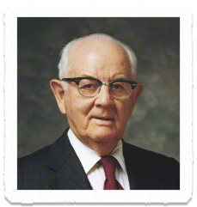
Lesson 6
They Straightway Left Their Nets
Elder Spencer W. Kimball said:
“No one in this Church will ever go far astray who ties himself securely to the Church Authorities whom the Lord has placed in his Church. This Church will never go astray; the Quorum of the Twelve will never lead you into bypaths; it never has and never will”
in Conference Report, Apr. 1951, 104
3- Jesus ordains the Twelve Apostles

Slide 30
Lesson 6
They Straightway Left Their Nets

