Slide 2
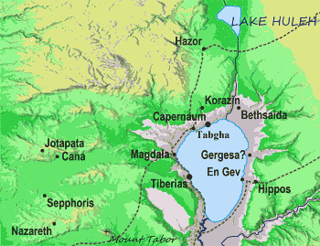
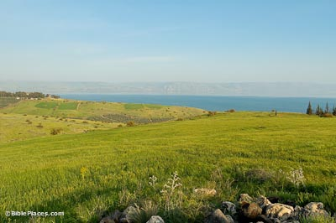
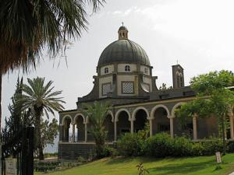
Lesson 8
Sermon on the Mount
Where?
The Church of the Beatitudes is an elegant octagonal building that was built in 1938 for a Franciscan order of nuns. The eight sides of the church represent the eight beatitudes,
Introduction

Slide 3
Lesson 8
Sermon on the Mount
Where?
For Whom?
The Savior never intended that the Sermon on the Mount be given to the multitudes. It was a special sermon for His most faithful disciples, given to those who had already demonstrated that they were willing to accept Him as Savior and Redeemer and enter into a covenant relationship with Him.
Introduction

Slide 4
Lesson 8
Sermon on the Mount
Matthew
5:3-12 - The Beatitudes 5:13-16 - Salt and Light 5:17-20 - Jesus fulfilled the Law 5:21-26 - Anger and Murder 5:27-30 - Lust and Adultery 5:31-32 - Divorce and Remarriage 5:33-37 - Oaths 5:38-42 - Eye for an Eye 5:43-48 - Love your enemies 6:1-4 - Give to the Needy 6:5-15 - How to Pray 6:16-18 - How to Fast 6:19-24 - Treasures in Heaven 6:25-34 - Do not worry 7:1-6 - Do not judge hypocritically 7:7-12 - Ask, Seek, Knock 7:13-14 - The Narrow Gate 7:15-23 - False Prophets 7:24-27 - The Wise Builder
7:28-29 concludes the Sermon on the Mount with the following statement: "When Jesus had finished saying these things, the crowds were amazed at His teaching, because He taught as one who had authority, and not as their teachers of the law."
1- Jesus teaches Beatitudes to His disciples

Slide 5
Lesson 8
Sermon on the Mount
Each Beatitude consists of two phrases: the condition and the result. In almost every case the condition is from familiar Old Testament context, but Jesus teaches a new interpretation.
Together, the Beatitudes present a new set of Christian ideals that focus on a spirit of love and humility different in orientation than the usual force and exaction taken.
The term beatitude comes from the Latin noun beātitūdō which means "happiness"
1- Jesus teaches Beatitudes to His disciples

Slide 6
Lesson 8
Sermon on the Mount
Each Beatitude consists of two phrases: the condition and the result. In almost every case the condition is from familiar Old Testament context, but Jesus teaches a new interpretation.
Each of the eight Beatitudes begins with:
Blessed are...
....the poor in spirit: for theirs is the kingdom of Heaven. (5:3)
....those who mourn: for they will be comforted. (5:4)
....the meek: for they will inherit the earth. (5:5)
....those who hunger and thirst for righteousness: for they will be filled. (5:6)
....the merciful: for they will be shown mercy. (5:7)
....the pure in heart: for they will see God. (5:8)
....the peacemakers: for they will be called children of God. (5:9)
....those who are persecuted for righteousness' sake: for theirs is the kingdom of heaven. (5:10)
1- Jesus teaches Beatitudes to His disciples

Slide 7
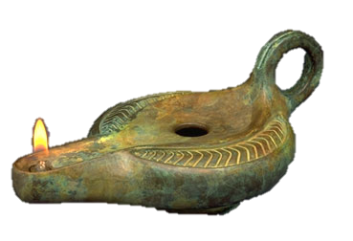
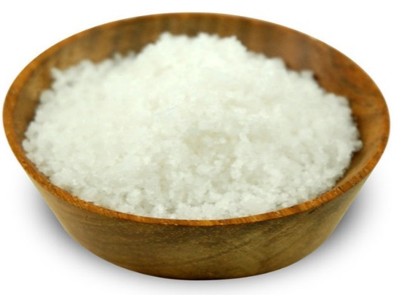
Lesson 8
Sermon on the Mount
Play church video “Jesus teaches the Beatitudes”
1- Jesus teaches Beatitudes to His disciples

Slide 8
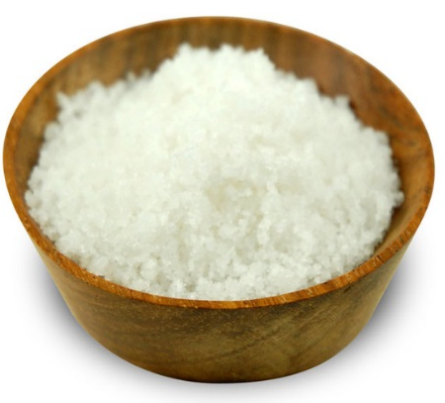
Lesson 8
Sermon on the Mount
Matthew 5:13
¹³ Ye are the salt of the earth: but if the salt have lost his savour, wherewith shall it be salted? it is thenceforth good for nothing, but to be cast out, and to be trodden under foot of men.
You are the salt of the earth
2- Jesus declares that his disciples are “the salt of the earth” and “the light of the world.”

Slide 9
Lesson 8
Sermon on the Mount
Matthew 5:13
¹³ Ye are the salt of the earth: but if the salt have lost his savour, wherewith shall it be salted? it is thenceforth good for nothing, but to be cast out, and to be trodden under foot of men.
You are the salt of the earth
D&C 101:39
³⁹ When men are called unto mine everlasting gospel, and covenant with an everlasting covenant, they are accounted as the salt of the earth and the savor of men;
2- Jesus declares that his disciples are “the salt of the earth” and “the light of the world.”

Slide 10
Lesson 8
Sermon on the Mount
Matthew 5:14-16
¹⁴ Ye are the light of the world. A city that is set on an hill cannot be hid.
¹⁵ Neither do men light a candle, and put it under a bushel, but on a candlestick; and it giveth light unto all that are in the house.
¹⁶ Let your light so shine before men, that they may see your good works, and glorify your Father which is in heaven.
You are the light of the world
2- Jesus declares that his disciples are “the salt of the earth” and “the light of the world.”

Slide 11
Lesson 8
Sermon on the Mount
2- Jesus declares that his disciples are “the salt of the earth” and “the light of the world.”

Slide 12
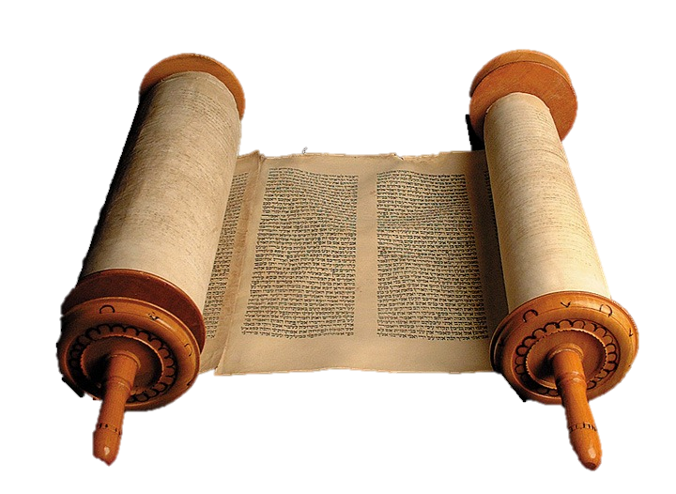
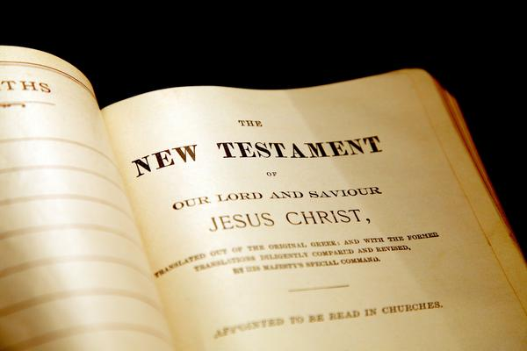
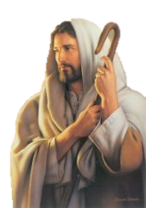
Lesson 8
Sermon on the Mount
Matthew 5:17-18
¹⁷ Think not that I am come to destroy the law, or the prophets: I am not come to destroy, but to fulfil.
¹⁸ For verily I say unto you, Till heaven and earth pass, one jot or one tittle shall in no wise pass from the law, till all be fulfilled.
3. Jesus teaches a higher law than the law of Moses.

Slide 13
Lesson 8
Sermon on the Mount
Matthew 5:17-18
¹⁷ Think not that I am come to destroy the law, or the prophets: I am not come to destroy, but to fulfil.
¹⁸ For verily I say unto you, Till heaven and earth pass, one jot or one tittle shall in no wise pass from the law, till all be fulfilled.
Play church video “Jesus teaches the Higher Law”
3. Jesus teaches a higher law than the law of Moses.

Slide 14
Lesson 8
Sermon on the Mount
Focused on...
outward appearance
Ignored...
inner faithfulness
Matthew 5:20
²⁰ For I say unto you, That except your righteousness shall exceed the righteousness of the scribes and Pharisees, ye shall in no case enter into the kingdom of heaven.
If they had observed the law as it was given, they would have recognized Jesus as the Messiah.
3. Jesus teaches a higher law than the law of Moses.

Slide 15
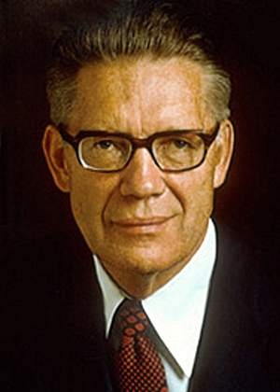
Lesson 8
Sermon on the Mount
Ye have heard...
But I say unto you...
Matthew 5:21 / thou shalt not kill
Matthew 5:22 / do not get angry
Elder Bruce R. McConkie said:
“Under the Mosaic law the taking of oaths was so
common and covered such a variety of circumstances that, in practice, little verity attended statements that were not made with an oath. … Under the perfect law of Christ every man’s word is his bond, and all spoken statements are as true as though an oath attended each spoken word” (The Mortal Messiah, 4 vols. [1979–81], 2:140).
Matthew 5:23 / gift to the alter
Matthew 5:23-24 / first be reconciled
Matthew 5:27 / not commit adultery
Matthew 5:28 / avoid lustful thoughts
Matthew 5:33 / perform oaths
Matthew 5:34-37 / keep your word
Matthew 5:38 / eye for an eye
Matthew 5:39-49 / turn other cheek
Matthew 5:43 / love neighbor & hate enemy
Matthew 5:39-49 / love enemies
3. Jesus teaches a higher law than the law of Moses.

Slide 16
Lesson 8
Sermon on the Mount
Matthew 5:48
⁴⁸ Be ye therefore perfect, even as your Father which is in heaven is perfect.
an alternate Greek translation
of the word perfect is
“complete, finished, fully developed”
Matthew 5:48
Footnote 48b
3. Jesus teaches a higher law than the law of Moses.

Slide 17
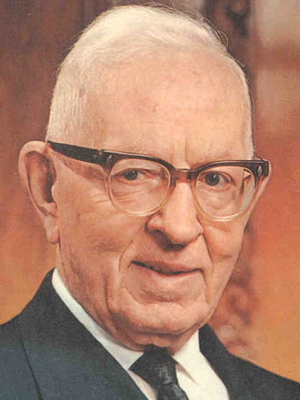
Lesson 8
Sermon on the Mount
Matthew 5:48
⁴⁸ Be ye therefore perfect, even as your Father which is in heaven is perfect.
an alternate Greek translation
of the word perfect is
“complete, finished, fully developed”
President Joseph Fielding Smith said:
“I believe the Lord meant just what he said: that we should be perfect, as our
Father in Heaven is perfect. That will not come all at once, but line upon line, and precept upon precept, example upon example, and even then not as long as we live in this mortal life, for we will have to go even beyond the grave before we reach that perfection and shall be like God.
But here we lay the foundation. Here is where we are taught these simple truths of the gospel of Jesus Christ, in this probationary state, to prepare us for that perfection. If we are keeping the commandments of the Lord, we are on that road to perfection”
(Doctrines of Salvation, comp. Bruce R. McConkie, 3 vols. [1954–56], 2:18–19
Matthew 5:48
Footnote 48b
3. Jesus teaches a higher law than the law of Moses.

Slide 18
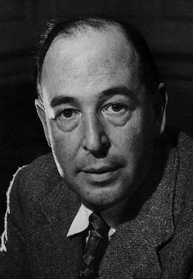
Lesson 8
Sermon on the Mount
Matthew 5:48
C.S. Lewis wrote this about seeking perfection:
"The command Be ye perfect is not idealistic gas. Nor is it a commandto do
the impossible. He [Christ] is going to make us creatures that can obey that
command. He said (in the Bible) that we were 'Gods' and He is going to make good His words. If we let Him, for we can prevent Him, if we choose, He will make the feeblest and filthiest of us into a god or goddess, a dazzling, radiant, immortal creature, pulsating all through with such energy and joy and wisdom and love as we cannot now imagine, a bright stainless mirror which reflects back to God perfectly (though, of course, on a smaller scale) His own boundless power and delight and goodness. The process will be long and in parts very painful; but that is what we are in for. Nothing less. He meant what He said"
(Mere Christianity, London: Fount Paperbacks, 1977, p. 172).
Conclusion.

Slide 19
Lesson 8
Sermon on the Mount
Conclusion.

