Slide 2
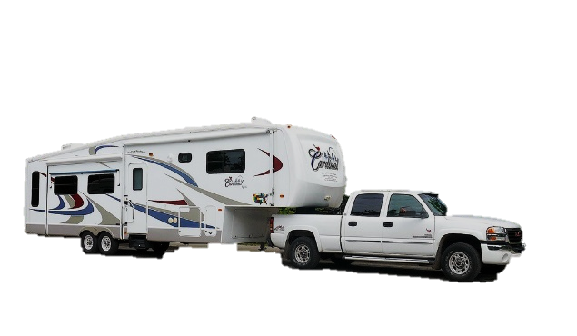
Lesson 10
“Take My Yoke Upon You, and Learn of Me”
Introduction

Slide 3
A great lesson on Stress Management
A young lady confidently walked around the room to an audience who each held a raised glass of water. Everyone knew she was going to ask the ultimate question, 'half empty or half full?' She fooled them all. "How heavy is this glass of water?" she inquired. Answers called out ranged from 8 oz. to 20 oz. She replied, “Absolute weight doesn't matter. What matters most is the relative weight that changes depending on how long I hold it. If I hold it for a minute, that's not a problem. If I hold it for an hour, I'll have an ache in my right arm. If I hold it for a day, you'll have to call an ambulance. In each case, it's the same weight, but the longer I hold it, the heavier it becomes." She continued, "If we carry our burdens all the time, sooner or later, as the burden becomes increasingly heavy, we won't be able to carry on."
Lesson 10
“Take My Yoke Upon You, and Learn of Me”
Background

Slide 4
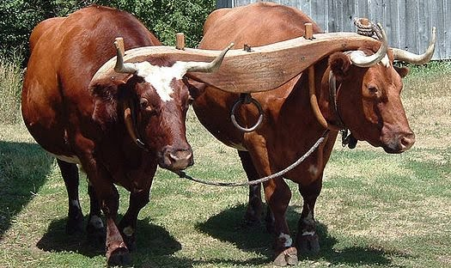
Matthew 11:28-30
²⁸ Come unto me, all ye that labour and are heavy laden, and I will give you rest.
²⁹ Take my yoke upon you, and learn of me; for I am meek and lowly in heart: and ye shall find rest unto your souls.
³⁰ For my yoke is easy, and my burden is light.
Lesson 10
“Take My Yoke Upon You, and Learn of Me”
1- Jesus invites us to take his yoke upon us

Slide 5
Matthew 11:28-30
²⁸ Come unto me, all ye that labour and are heavy laden, and I will give you rest.
²⁹ Take my yoke upon you, and learn of me; for I am meek and lowly in heart: and ye shall find rest unto your souls.
³⁰ For my yoke is easy, and my burden is light.
Lesson 10
“Take My Yoke Upon You, and Learn of Me”
1- Jesus invites us to take his yoke upon us

Slide 6
Matthew 11:28-30
²⁸ Come unto me, all ye that labour and are heavy laden, and I will give you rest.
²⁹ Take my yoke upon you, and learn of me; for I am meek and lowly in heart: and ye shall find rest unto your souls.
³⁰ For my yoke is easy, and my burden is light.
Lesson 10
“Take My Yoke Upon You, and Learn of Me”
1- Jesus invites us to take his yoke upon us

Slide 7
Matthew 12:1-2
¹ At that time Jesus went on the sabbath day through the corn; and his disciples were an hungred, and began to pluck the ears of corn and to eat.
² But when the Pharisees saw it,
they said unto him, Behold, thy disciples do that which is not lawful to do upon the sabbath day.
Lesson 10
“Take My Yoke Upon You, and Learn of Me”
2- Jesus declares that he is Lord of the Sabbath

Slide 8
Matthew 12:3-8
³ But he said unto them, Have ye not read what David did, when he was an hungred, and they that were with him;
⁴ How he entered into the house of God, and did eat the shewbread, which was not lawful for him to eat, neither for them which were with him, but only for the priests?
⁵ Or have ye not read in the law, how that on the sabbath days the priests in the temple profane the sabbath, and are blameless?
⁶ But I say unto you, That in this place is one greater than the temple.
⁷ But if ye had known what this meaneth, I will have mercy, and not sacrifice, ye would not have condemned the guiltless.
⁸ For the Son of man is Lord even of the sabbath day.
Lesson 10
“Take My Yoke Upon You, and Learn of Me”
2- Jesus declares that he is Lord of the Sabbath

Slide 9
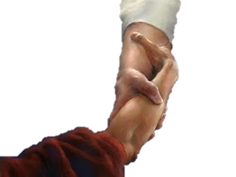
Matthew 12:10-13
¹⁰ And, behold, there was a man which had his hand withered. And they asked him, saying, Is it lawful to heal on the sabbath days? that they might accuse him.
¹¹ And he said unto them, What man shall there be among you, that shall have one sheep, and if it fall into a pit on the sabbath day, will he not lay hold on it, and lift it out?
¹² How much then is a man better than a sheep? Wherefore it is lawful to do well on the sabbath days.
¹³ Then saith he to the man, Stretch forth thine hand. And he
stretched it forth; and it was restored whole, like as the other.
Lesson 10
“Take My Yoke Upon You, and Learn of Me”
2- Jesus declares that he is Lord of the Sabbath

Slide 10
Luke 13:10-17
¹⁰ And he was teaching in one of the synagogues on the sabbath.
¹¹ And, behold, there was a woman which had a spirit of infirmity eighteen years, and was bowed together, and could in no wise lift up herself.
¹² And when Jesus saw her, he called her to him, and said unto her, Woman, thou art loosed from thine infirmity.
¹³ And he laid his hands on her: and immediately she was made straight, and glorified God.
¹⁴ And the ruler of the synagogue answered with indignation, because that Jesus had healed on the sabbath day, and said unto the people, There are six days in which men ought to work: in them therefore come and be healed, and not on the sabbath day.
Lesson 10
“Take My Yoke Upon You, and Learn of Me”
2- Jesus declares that he is Lord of the Sabbath

Slide 11
Luke 13:10-17
15 The Lord then answered him, and said, Thou hypocrite, doth not each one of you on the sabbath loose his ox or his ass from the stall, and lead him away to watering?
16 And ought not this woman, being a daughter of Abraham, whom Satan hath bound, lo, these eighteen years, be loosed from this bond on the sabbath day?
17 And when he had said these things, all his adversaries were ashamed: and all the people rejoiced for all the glorious things that were done by him.
Lesson 10
“Take My Yoke Upon You, and Learn of Me”
2- Jesus declares that he is Lord of the Sabbath

Slide 12
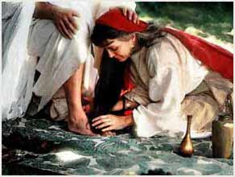
Luke 7:37-39
³⁷ And, behold, a woman in the city, which was a sinner, when she knew that Jesus sat at meat in the Pharisee's house, brought an alabaster box of ointment,
³⁸ And stood at his feet behind him weeping, and
began to wash his feet with tears, and did wipe them with the hairs of her head, and kissed his feet, and anointed them with the ointment.
³⁹ Now when the Pharisee which had bidden him saw it, he spake within himself, saying, This man, if he were a prophet, would have known who and what manner of woman this is that toucheth him: for she is a sinner.
Lesson 10
“Take My Yoke Upon You, and Learn of Me”
3- Jesus forgives a woman in the house of Simon

Slide 13
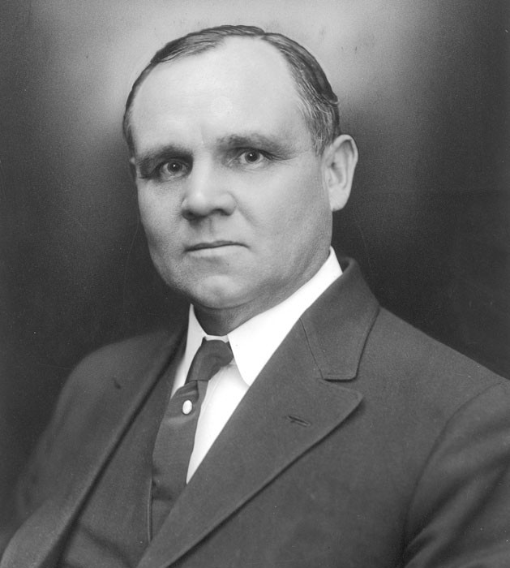
Luke 7:44-50
⁴⁴ And he turned to the woman, and said unto Simon, Seest thou this woman? I entered into thine house, thou gavest me no water for my feet: but she hath washed my feet with tears, and wiped them with the hairs of her head.
Elder James E. Talmage taught:
“It was a custom of the times to treat a distinguished guest with marked attention;
to receive him with a kiss of welcome, to provide water for washing the dust from his feet, and oil for anointing the hair of the head and the beard. All these courteous attentions were omitted by Simon”
(Jesus the Christ, 3rd ed. [1916], 261).
⁴⁵ Thou gavest me no kiss: but this woman since the
time I came in hath not ceased to kiss my feet.
⁴⁶ My head with oil thou didst not anoint: but this woman hath anointed my feet with ointment.
⁴⁷ Wherefore I say unto thee, Her sins, which are many, are forgiven; for she loved much: but to whom little is forgiven, the same loveth little.
⁴⁸ And he said unto her, Thy sins are forgiven.
Lesson 10
“Take My Yoke Upon You, and Learn of Me”
3- Jesus forgives a woman in the house of Simon

Slide 14
“Elder Bednar spoke to us recently and gave us our "Marching Orders" and thought I'd pass it along. They are found in D&C 6:36, which says:
"Look unto me in every thought; doubt not, fear not."
For me this is what it means: I should do my best, trusting in his ability to make up the difference, and then have faith that it will turn out alright. If I'm giving my best efforts--whatever areas I may be struggling in--and put my trust in Him, things will work out.
One of the reasons why I feel that we can "doubt not" and "fear not" if we put our trust in Him...and that is found in the following verse.
"Behold the wounds which pierced my side, and also the prints of the nails in my hands and feet;"
He has engraved us upon the palms of His hands and He won't abandon us or our best efforts!”
Jordan Fuller
Lesson 10
“Take My Yoke Upon You, and Learn of Me”
Conclusion

Slide 15
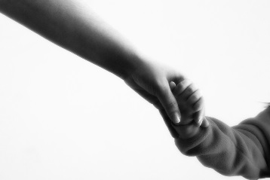
“Elder Bednar spoke to us recently and gave us our "Marching Orders" and thought I'd pass it along. They are found in D&C 6:36, which says:
"Look unto me in every thought; doubt not, fear not."
For me this is what it means: I should do my best, trusting in his ability to make up the difference, and then have faith that it will turn out alright. If I'm giving my best efforts--whatever areas I may be struggling in--and put my trust in Him, things will work out.
One of the reasons why I feel that we can "doubt not" and "fear not" if we put our trust in Him...and that is found in the following verse.
"Behold the wounds which pierced my side, and also the prints of the nails in my hands and feet;"
He has engraved us upon the palms of His hands and He won't abandon us or our best efforts!”
Lesson 10
“Take My Yoke Upon You, and Learn of Me”
Conclusion

