Slide 1
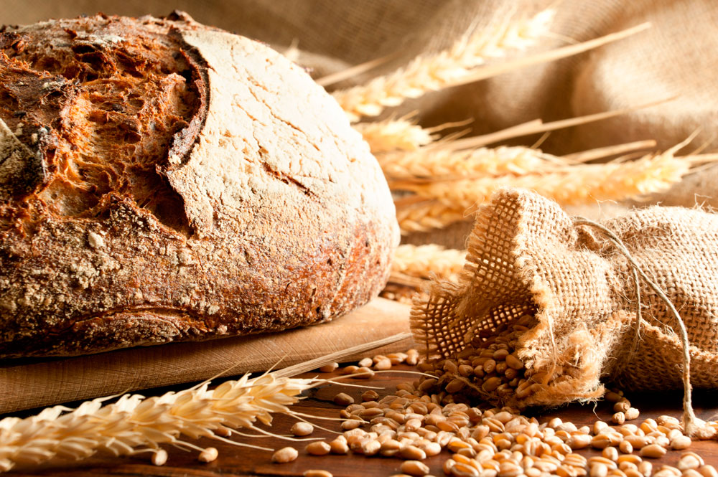
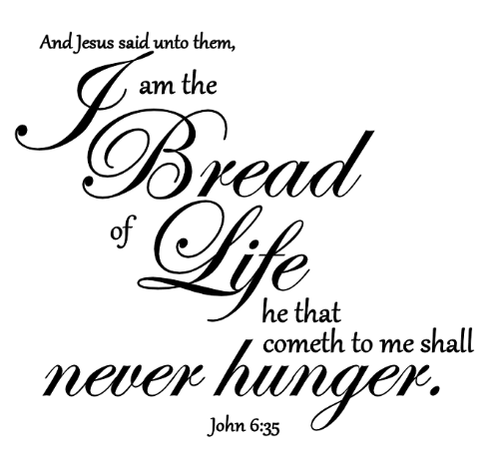

Slide 2
Insert Mormon Tabernacle Choir video

Slide 3
During 3rd & Final Passover
Jesus feeds 5000
Walks on water

Slide 4
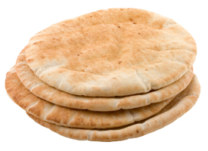
Lesson 12
1
In the East it has been estimated that three-fourths of the people live entirely upon either bread or upon that which is made from wheat or barley flour.
2
In the Bible such an expression as "eating bread" is often used when Occidentals say "eating a meal." When the Bible says, "The Egyptians might not eat bread with the Hebrews", it means they could not eat a meal with them.
3
The Palestinians are brought up thinking bread has a sacred meaning. In some places they have such a reverence for bread that they will not arise to salute a guest if they are in the midst of breaking bread together.
4
It may be said that this people has a religious attitude toward bread. Everything about bread from the sowing of the seed to the baking of the loaves is done in the name of GOD.
5
Instead of cutting bread, the custom of breaking bread is found throughout the Scriptures. To cut bread would be the cutting of life itself.
Background

Slide 5
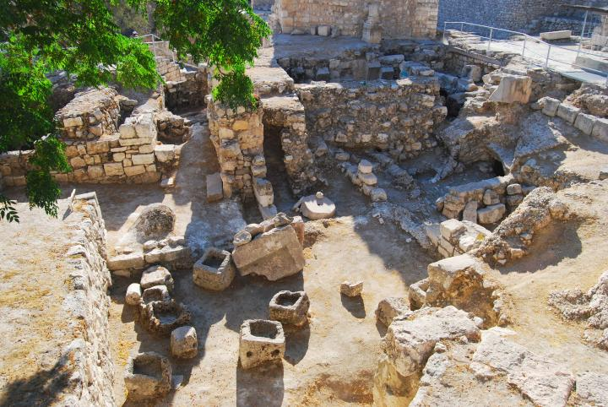
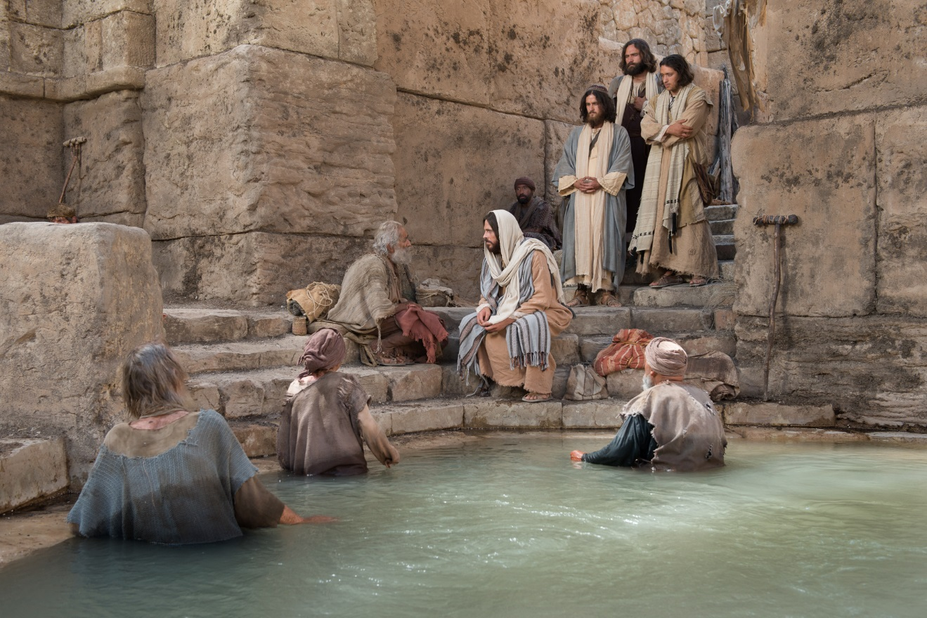
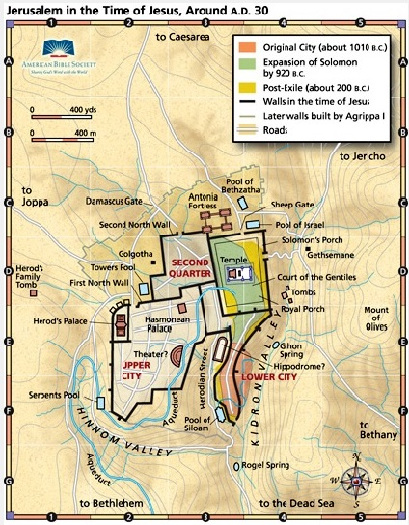
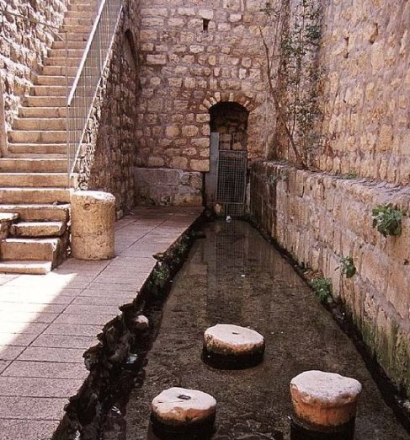
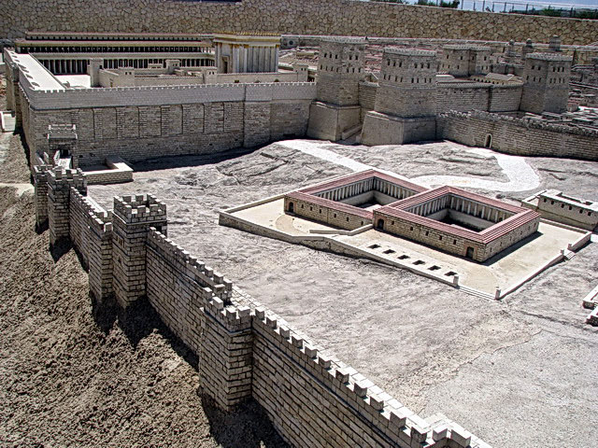
Lesson 12
Introduction

Slide 6
Lesson 12
John 5: 2-5
² Now there is at Jerusalem by the sheep market a pool, which is called in the Hebrew tongue Bethesda, having five porches.
³ In these lay a great multitude of impotent folk, of blind, halt, withered, waiting for the moving of the water.
⁴ For an angel went down at a certain season into the pool, and troubled the water: whosoever then first after the troubling of the water stepped in was made whole of whatsoever disease he had.
⁵ And a certain man was there, which had an infirmity thirty and eight years.
1- Jesus heals on Sabbath

Slide 7
Lesson 12
John 5: 6-8
⁶ When Jesus saw him lie, and knew that he had been now a long time in that case, he saith unto him, Wilt thou be made whole?
⁷ The impotent man answered him, Sir, I have no man, when the water is troubled, to put me into the pool: but while I am coming, another steppeth down before me.
⁸ Jesus saith unto him, Rise, take up thy bed, and walk.
1- Jesus heals on Sabbath

Slide 8
Lesson 12
John 5: 9-13
⁹ And immediately the man was made whole, and took up his bed, and walked: and on the same day was the sabbath.
¹⁰ The Jews therefore said unto him that was cured, It is the sabbath day: it is not lawful for thee to carry thy bed.
¹¹ He answered them, He that made me whole, the same said unto me, Take up thy bed, and walk.
¹² Then asked they him, What man is that which said unto thee, Take up thy bed, and walk?
¹³ And he that was healed wist not who it was: for Jesus had conveyed himself away, a multitude being in that place.
1- Jesus heals on Sabbath

Slide 9
Lesson 12
John 5: 9-13
⁹ And immediately the man was made whole, and took up his bed, and walked: and on the same day was the sabbath.
¹⁰ The Jews therefore said unto him that was cured, It is the sabbath day: it is not lawful for thee to carry thy bed.
¹¹ He answered them, He that made me whole, the same said unto me, Take up thy bed, and walk.
¹² Then asked they him, What man is that which said unto thee, Take up thy bed, and walk?
¹³ And he that was healed wist not who it was: for Jesus had conveyed himself away, a multitude being in that place.
Insert Jesus heals lame man on sabbath video
1- Jesus heals on Sabbath

Slide 10
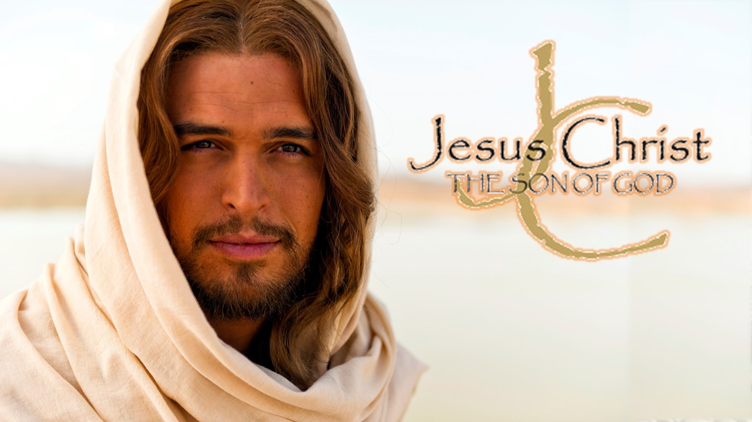
Lesson 12
John 5: 14-18
¹⁴ Afterward Jesus findeth him in the temple, and said unto him, Behold, thou art made whole: sin no more, lest a worse thing come unto thee.
¹⁵ The man departed, and told the Jews that it was Jesus, which had made him whole.
¹⁶ And therefore did the Jews persecute Jesus, and sought to slay him, because he had done these things on the sabbath day.
¹⁷ But Jesus answered them, My Father worketh hitherto, and I work.
¹⁸ Therefore the Jews sought the more to kill him, because he not only had broken the sabbath, but said also that God was his Father, making himself equal with God.
1- Jesus heals on Sabbath

Slide 11
Lesson 12
John 5: 20
²⁰ For the Father loveth the Son, and sheweth him all things that himself doeth: and he will shew him greater works than these, that ye may marvel.
1- Jesus heals on Sabbath

Slide 12
Lesson 12
John 5: 21-29
²¹ For as the Father raiseth up the dead, and quickeneth them; even so the Son quickeneth whom he will.
1-Resurrection
1- Jesus heals on Sabbath

Slide 13
Lesson 12
John 5: 21-29
²² For the Father judgeth no man, but hath committed all judgment unto the Son:
1-Resurrection
2-Jesus is Judge
1- Jesus heals on Sabbath

Slide 14
Lesson 12
John 5: 21-29
²⁴ Verily, verily, I say unto you, He that heareth my word, and believeth on him that sent me, hath everlasting life, and shall not come into condemnation; but is passed from death unto life.
1-Resurrection
2-Jesus is Judge
3-Everlasting Life
1- Jesus heals on Sabbath

Slide 15
Lesson 12
John 5: 39
³⁹ Search the scriptures; for in them ye think ye have eternal life: and they are they which testify of me.
1-Resurrection
2-Jesus is Judge
3-Everlasting Life
1- Jesus heals on Sabbath

Slide 16
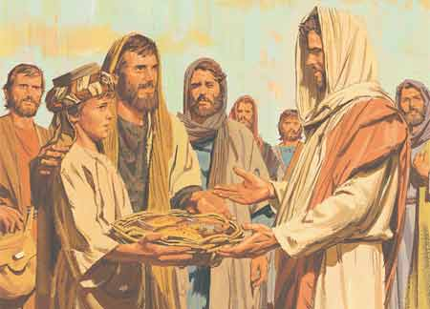
Lesson 12
John 6: 1-14
After these things Jesus went over the sea of Galilee, which is the sea of Tiberias.
² And a great multitude followed him, because they saw his miracles which he did on them that were diseased.
2- Jesus feeds the 5,000

Slide 17
Lesson 12
John 6: 1-14
After these things Jesus went over the sea of Galilee, which is the sea of Tiberias.
² And a great multitude followed him, because they saw his miracles which he did on them that were diseased.
Insert feeding the 5000 video
2- Jesus feeds the 5,000

Slide 18
Lesson 12
John 6: 8-9
⁸ One of his disciples, Andrew, Simon Peter's brother, saith unto him,
⁹ There is a lad here, which hath five barley loaves, and two small fishes: but what are they among so many?
How is this symbolic of our offerings to the Lord?
2- Jesus feeds the 5,000

Slide 19
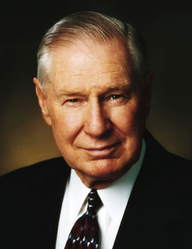
Lesson 12
John 6: 8-9
Elder James E. Faust said:
“Many nameless people with gifts equal only to five loaves and two small fishes
magnify their callings and serve without attention or recognition, feeding literally
thousands. … These are the hundreds of thousands of leaders and teachers in all of the auxiliaries and priesthood quorums, the home teachers, the Relief Society visiting teachers. These are the many humble bishops in the Church, some without formal training but greatly magnified, always learning, with a humble desire to serve the Lord and the people of their wards. …
“A major reason this church has grown from its humble beginnings to its current strength is the faithfulness and devotion of millions of humble and devoted people who have only five loaves and two small fishes to offer in the service of the Master. They have largely surrendered their own interests and in so doing have found ‘the peace of God, which passeth all understanding’ ”
(in Conference Report, Apr. 1994, 4–5; or Ensign, May 1994, 5–6)
⁸ One of his disciples, Andrew, Simon Peter's brother, saith unto him,
⁹ There is a lad here, which hath five barley loaves, and two small fishes: but what are they among so many?
How is this symbolic of our offerings to the Lord?
2- Jesus feeds the 5,000

Slide 20
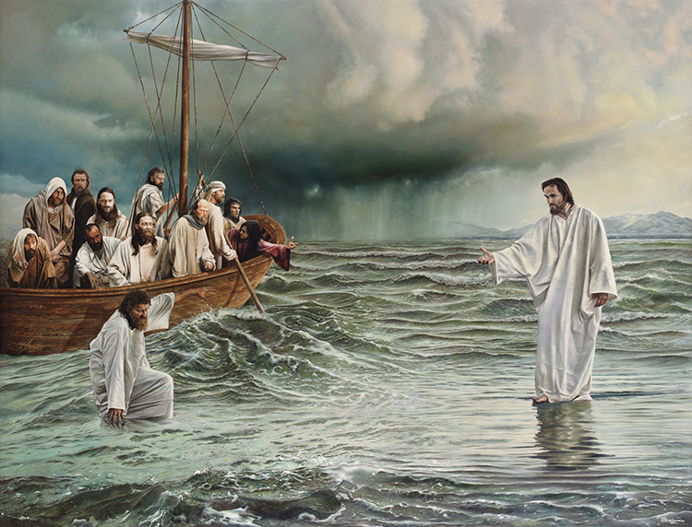
Lesson 12
John 6: 16-20
¹⁶ And when even was now come, his disciples went down unto the sea,
¹⁷ And entered into a ship, and went over the sea toward Capernaum. And it was now dark, and Jesus was not come to them.
¹⁸ And the sea arose by reason of a great wind that blew.
¹⁹ So when they had rowed about five and twenty or thirty furlongs, they see Jesus walking on the sea, and drawing nigh unto the ship: and they were afraid.
²⁰ But he saith unto them, It is I; be not afraid.
3- Jesus walks on the sea

Slide 21
Lesson 12
John 6: 16-20
¹⁶ And when even was now come, his disciples went down unto the sea,
¹⁷ And entered into a ship, and went over the sea toward Capernaum. And it was now dark, and Jesus was not come to them.
¹⁸ And the sea arose by reason of a great wind that blew.
¹⁹ So when they had rowed about five and twenty or thirty furlongs, they see Jesus walking on the sea, and drawing nigh unto the ship: and they were afraid.
²⁰ But he saith unto them, It is I; be not afraid.
Insert Wherefore didst thou doubt? video
3- Jesus walks on the sea

Slide 22
Lesson 12
John 6: 15-20
What did Peter do when he began to doubt?
1-
What did Christ do when Peter began to doubt?
2-
3- Jesus walks on the sea

Slide 23
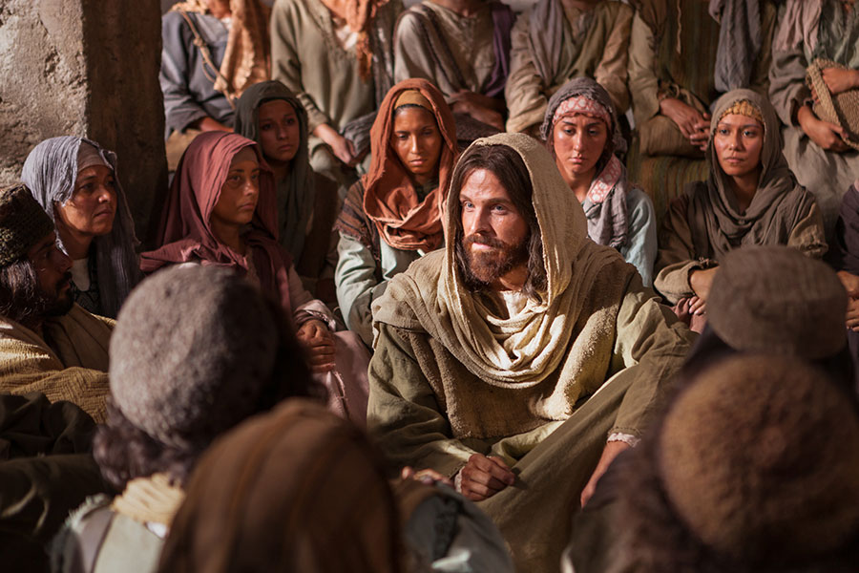
Lesson 12
John 6: 31-35
³¹ Our fathers did eat manna in the desert; as it is written, He gave them bread from heaven to eat.
³² Then Jesus said unto them, Verily, verily, I say unto you, Moses gave you not that bread from heaven; but my Father giveth you the true bread from heaven.
³³ For the bread of God is he which cometh down from heaven, and giveth life unto the world.
³⁴ Then said they unto him, Lord, evermore give us this bread.
³⁵ And Jesus said unto them, I am the bread of life: he that cometh to me shall never hunger; and he that believeth on me shall never thirst.
4- Jesus declares he is the bread of life

Slide 24
Lesson 12
John 6: 31-35
⁴¹ The Jews then murmured at him, because he said, I am the bread which came down from heaven.
⁴² And they said, Is not this Jesus, the son of Joseph, whose father and mother we know? how is it then that he saith, I came down from heaven?
⁴³ Jesus therefore answered and said unto them, Murmur not among yourselves.
4- Jesus declares he is the bread of life

Slide 25
Lesson 12
John 6: 31-35
⁴¹ The Jews then murmured at him, because he said, I am the bread which came down from heaven.
⁴² And they said, Is not this Jesus, the son of Joseph, whose father and mother we know? how is it then that he saith, I came down from heaven?
⁴³ Jesus therefore answered and said unto them, Murmur not among yourselves.
Elder Jeffrey R. Holland observed:
“During the Savior’s Galilean ministry,
He chided those who had heard of Him
feeding the 5,000 with only five barley loaves
and two fishes, and now flocked to Him expecting a free lunch. That food, important as it was, was incidental to the real nourishment He was trying to give them”
(in Conference Report, Oct. 1997, 87; or Ensign, Nov. 1997, 65).
4- Jesus declares he is the bread of life

Slide 26
Lesson 12
John 6: 35
³⁵ And Jesus said unto them, I am the bread of life: he that cometh to me shall never hunger; and he that believeth on me shall never thirst.
Why is “bread of life” an appropriate description of Christ?
1-
What does it mean to “never hunger” or “never thirst” ?
2-
4- Jesus declares he is the bread of life

Slide 27
