Slide 1
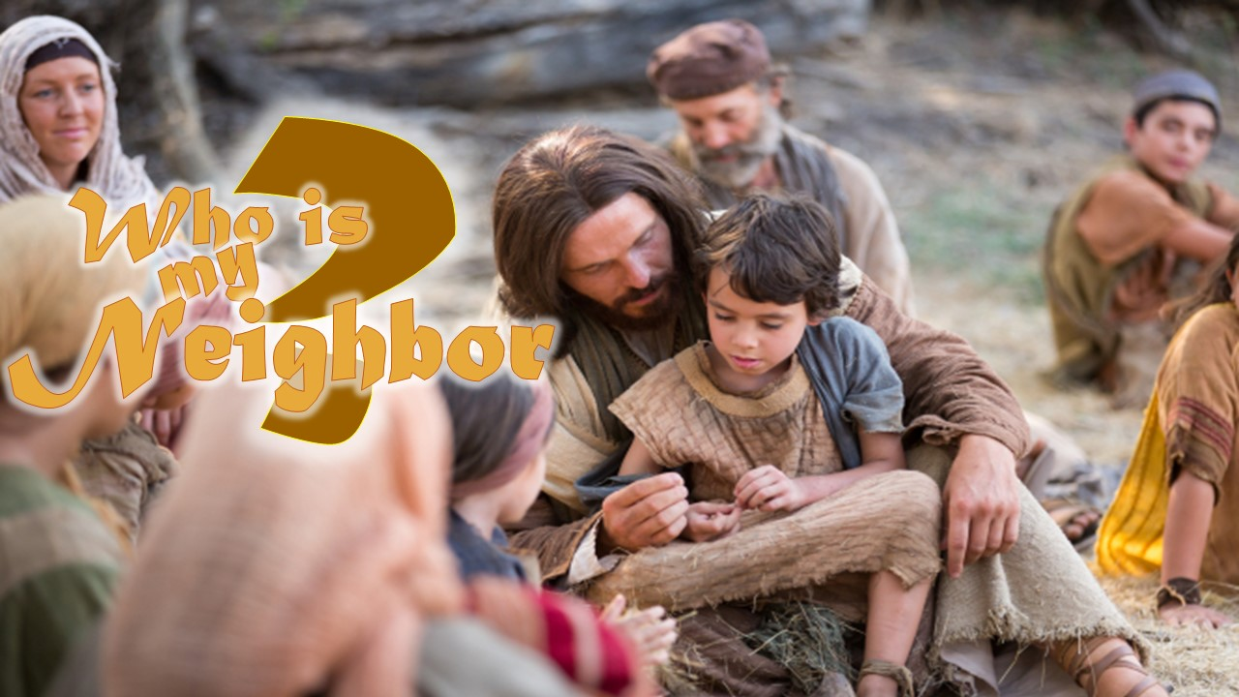

Slide 2
Introduction

Slide 3
Lesson 14
Who is my Neighbor?
Listovative
Top 10 Greatest Leaders
of All Time
Incredulist
Top 10 Most Powerful People
In History
10- Julius Caesar
9- Franklin D Roosevelt
8- Napoleon Bonaparte
7- George Washington
6- Adolf Hitler
5- Mao Zedong
4- Abraham Lincoln
3- Martin Luther King Jr.
2- Nelson Mandela
1- Mahatma Gandhi
10- Hitler
9- Alexander the Great
8- Joseph II
7- Qui Sin Haung
6- Caesar
5- Mahatma Gandhi
4- Peter the Great
3- Queen Elizabeth I
2- Napoleon Bonaparte
1- Abraham Lincoln
Introduction

Slide 4
Lesson 14
Who is my Neighbor?
Matthew 18: 1
¹ At the same time came the disciples unto Jesus, saying, Who is the greatest in the kingdom of heaven?
1- We must become as little children

Slide 5
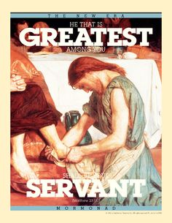
Lesson 14
Who is my Neighbor?
Matthew 18: 1
¹ At the same time came the disciples unto Jesus, saying, Who is the greatest in the kingdom of heaven?
Matthew 23:11
¹¹ But he that is greatest among you shall be your servant.
1- We must become as little children

Slide 6
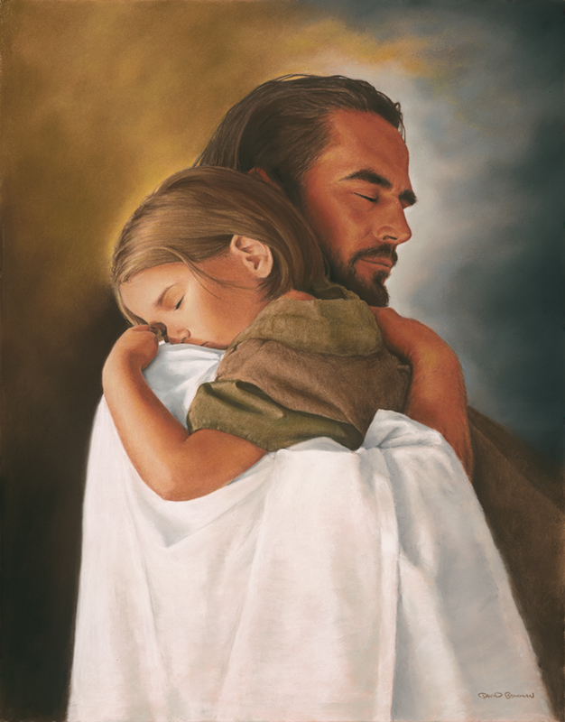
Lesson 14
Who is my Neighbor?
Matthew 18: 2-4
² And Jesus called a little child unto him, and set him in the midst of them,
³ And said, Verily I say unto you, Except ye be converted, and become as little children, ye shall not enter into the kingdom of heaven.
⁴ Whosoever therefore shall humble himself as this little child, the same is greatest in the kingdom of heaven.
1- We must become as little children

Slide 7
Lesson 14
Who is my Neighbor?
Matthew 18: 6
⁶ But whoso shall offend one of these little ones which believe in me, it were better for him that a millstone were hanged about his neck, and that he were drowned in the depth of the sea.
Matthew 18: 6a footnote
Offend = cause to stumble
1- We must become as little children

Slide 8
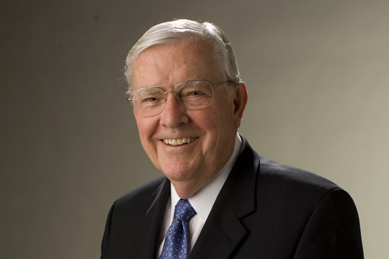
Lesson 14
Who is my Neighbor?
Matthew 18: 6
⁶ But whoso shall offend one of these little ones which believe in me, it were better for him that a millstone were hanged about his neck, and that he were drowned in the depth of the sea.
Elder M. Russell Ballard stated:
“We hear disturbing reports
of parents or guardians who are
so far removed from the Spirit of Christ that they abuse children. Whether this abuse is physical, verbal, or the less evident but equally severe emotional abuse, it is an abomination and a serious offense to God”
(in Conference Report, Apr. 1991, 107; or Ensign, May 1991, 80)
Matthew 18: 6a footnote
Offend = cause to stumble
1- We must become as little children

Slide 9
Lesson 14
Who is my Neighbor?
Matthew 18: 15
¹⁵ Moreover if thy brother shall trespass against thee, go and tell him his fault between thee and him alone: if he shall hear thee, thou hast gained thy brother.
Good practice???
2- Parable of unmerciful servant

Slide 10
Lesson 14
Who is my Neighbor?
Matthew 18: 21-22
²¹ Then came Peter to him, and said, Lord, how oft shall my brother sin against me, and I forgive him? till seven times?
²² Jesus saith unto him, I say not unto thee, Until seven times: but, Until seventy times seven.
2- Parable of unmerciful servant

Slide 11
Lesson 14
Who is my Neighbor?
Why did Jesus say 70x7 ?
What is the significance of that number?
It equals 490.
1- That is how many years Israel stayed in the land without
obeying the Sabbath year.
2- God forgave Israel 490 times before sending them to Babylon.
Also compare Daniel’s prophecy.
God is going to
forgive Israel
for 490 more years.
God does not ask us
to do anything
that He isn’t willing to do.
Background

Slide 12
Lesson 14
Who is my Neighbor?
Matthew 18: 21-22
²¹ Then came Peter to him, and said, Lord, how oft shall my brother sin against me, and I forgive him? till seven times?
²² Jesus saith unto him, I say not unto thee, Until seven times: but, Until seventy times seven.
Even if unsolicited, what does forgiving others do for us?.
2- Parable of unmerciful servant

Slide 13
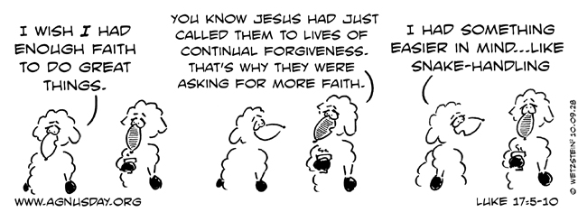
Lesson 14
Who is my Neighbor?
Matthew 18: 21-22
²¹ Then came Peter to him, and said, Lord, how oft shall my brother sin against me, and I forgive him? till seven times?
²² Jesus saith unto him, I say not unto thee, Until seven times: but, Until seventy times seven.
2- Parable of unmerciful servant

Slide 14
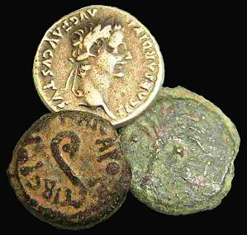
Lesson 14
Who is my Neighbor?
Matthew 18: 23-24
²³ Therefore is the kingdom of heaven likened unto a
certain king, which would take account of his servants.
²⁴ And when he had begun to reckon, one was
brought unto him, which owed him ten thousand talents.
What was the value of 10,000 talents?
1 talent = 20 years wages / Purchase a slave
10,000 talents = 200,000 years wages
2- Parable of unmerciful servant

Slide 15
Lesson 14
Who is my Neighbor?
Matthew 18: 25-27
²⁵ But forasmuch as he had not to pay, his lord commanded
him to be sold, and his wife, and children, and all that he had, and payment to be made.
²⁶ The servant therefore fell down, and worshipped him, saying, Lord, have patience with me, and I will pay thee all.
²⁷ Then the lord of that servant was moved with compassion, and loosed him, and forgave him the debt.
2- Parable of unmerciful servant

Slide 16
Lesson 14
Who is my Neighbor?
Matthew 18: 28-30
²⁸ But the same servant went out, and found one of his fellowservants, which owed him an hundred pence: and he laid hands on him, and took him by the throat, saying, Pay me that thou owest.
²⁹ And his fellowservant fell down at his feet, and besought him, saying, Have patience with me, and I will pay thee all.
³⁰ And he would not: but went and cast him into prison, till he should pay the debt.
What was the value of 10,000 talents?
1 talent = 20 years wages / Purchase a slave
10,000 talents = 200,000 years wages
What was the value of 100 pence?
4 months wages
2- Parable of unmerciful servant

Slide 17
Lesson 14
Who is my Neighbor?
Matthew 18: 31-33
³¹ So when his fellowservants saw what was done, they were very sorry, and came and told unto their lord all that was done.
³² Then his lord, after that he had called him, said unto him, O thou wicked servant, I forgave thee all that debt, because thou desiredst me:
³³ Shouldest not thou also have had compassion on thy fellowservant, even as I had pity on thee?
2- Parable of unmerciful servant

Slide 18
Lesson 14
Who is my Neighbor?
Matthew 18: 34-35
³⁴ And his lord was wroth, and delivered him to the tormentors, till he should pay all that was due unto him.
³⁵ So likewise shall my heavenly Father do also unto you, if ye from your hearts forgive not every one his brother their trespasses.
2- Parable of unmerciful servant

Slide 19
Lesson 14
Who is my Neighbor?
Matthew 18: 34-35
³⁴ And his lord was wroth, and delivered him to the tormentors, till he should pay all that was due unto him.
³⁵ So likewise shall my heavenly Father do also unto you, if ye from your hearts forgive not every one his brother their trespasses.
How can I ask for forgiveness for 10,000 things and refuse to forgive one thing?
What must we do to be forgiven?
2- Parable of unmerciful servant

Slide 20
Lesson 14
Who is my Neighbor?
Luke 10: 25-28
²⁵ And, behold, a certain lawyer stood up, and tempted him, saying, Master, what shall I do to inherit eternal life?
²⁶ He said unto him, What is written in the law? how readest thou?
²⁷ And he answering said, Thou shalt love the Lord thy God with all thy heart, and with all thy soul, and with all thy strength, and with all thy mind; and thy neighbour as thyself.
²⁸ And he said unto him, Thou hast answered right: this do, and thou shalt live.
3- The good Samaritan

Slide 21
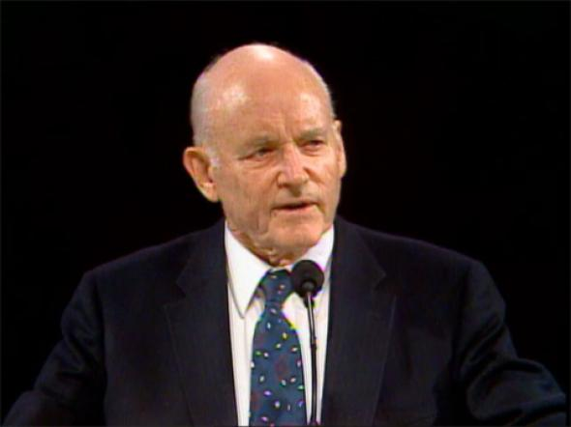
Lesson 14
Who is my Neighbor?
Luke 10: 29
²⁹ But he, willing to justify himself, said unto Jesus, And who is my neighbour?
President Howard W. Hunter said:
“We need to remember that though we make
our friends, God has made our neighbors—everywhere. Love should have no boundary; we should have no narrow loyalties”
(in Conference Report, Oct. 1986, 44; or Ensign, Nov. 1986, 35)
3- The good Samaritan

Slide 22
Lesson 14
Who is my Neighbor?
Luke 10: 30-32
Why don’t we always help others in need?
³⁰ And Jesus answering said, A certain man went down from Jerusalem to Jericho, and fell among thieves, which stripped him of his raiment, and wounded him, and departed, leaving him half dead.
³¹ And by chance there came down a certain priest that way: and when he saw him, he passed by on the other side.
³² And likewise a Levite, when he was at the place, came and looked on him, and passed by on the other side.
3- The good Samaritan

Slide 23
Lesson 14
Who is my Neighbor?
Luke 10: 33-35
³³ But a certain Samaritan, as he journeyed, came where he was: and when he saw him, he had compassion on him,
³⁴ And went to him, and bound up his wounds, pouring in oil and wine, and set him on his own beast, and brought him to an inn, and took care of him.
³⁵ And on the morrow when he departed, he took out two pence, and gave them to the host, and said unto him, Take care of him; and whatsoever thou spendest more, when I come again, I will repay thee.
What are some characteristics of a good neighbor?
3- The good Samaritan

Slide 24
Lesson 14
Who is my Neighbor?
Luke 10: 36-37
³⁶ Which now of these three, thinkest thou, was neighbour unto him that fell among the thieves?
³⁷ And he said, He that shewed mercy on him. Then said Jesus unto him, Go, and do thou likewise.
Personal examples?
3- The good Samaritan

Slide 25
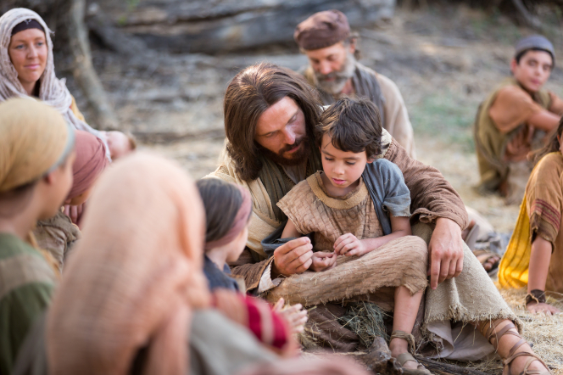
Lesson 14
Who is my Neighbor?
Luke 10: 36-37
³⁶ Which now of these three, thinkest thou, was neighbour unto him that fell among the thieves?
³⁷ And he said, He that shewed mercy on him. Then said Jesus unto him, Go, and do thou likewise.
Go, and do thou likewise.
Personal examples?
3- The good Samaritan

