Slide 1
Gospel Doctrine
Lesson 2: “My Soul Doth Magnify the Lord”

Slide 2
Purpose
Help class members develop greater faith in Jesus Christ through a study of the lives of Elisabeth, Zacharias, John the Baptist, Mary, and Joseph.

Slide 3
Summary
Gabriel foretells the birth of John.
The annunciation of Christ’s birth to Mary.
Joseph learns that Mary will give birth to the Savior.

Slide 4
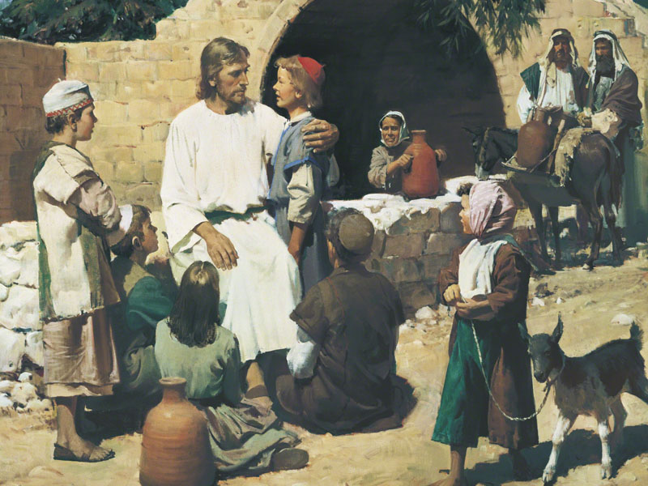

If you could meet anyone in the New Testament besides Jesus, whom would you want to meet?
Why?

Slide 5
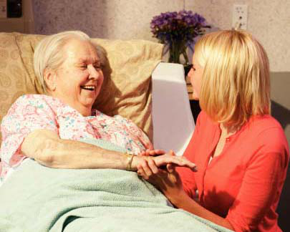
His Example
We are often drawn to righteous people because they follow the Savior and testify of him.
These people help us come to know the savior.

Slide 6
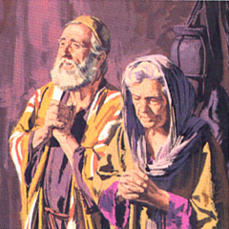
Zacharias & Elisabeth
Old and childless.
“Righteous before God, walking in all the commandments and ordinances of the Lord.” –Luke 1:6
Zacharias’ priestly duty was to burn incense in the temple.

Slide 7
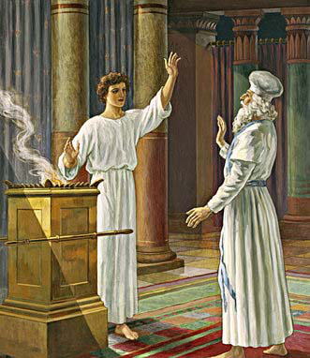
Gabriel & Zacharias
Gabriel appeared to Zacharias in the temple.
He foretold the birth of a son, claiming Zacharias’ prayer had been heard.
He instructs Zacharias to call his son ‘John.’

Slide 8
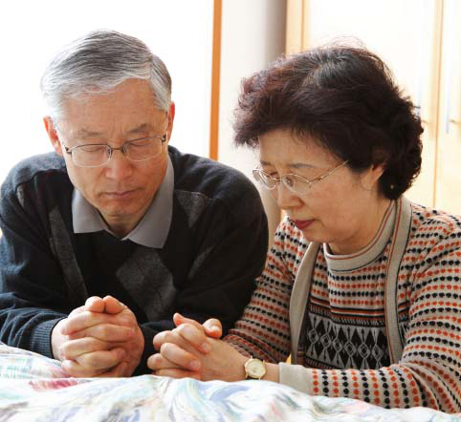
Sincere Prayer
Zacharias and Elisabeth likely prayed for many years that they would be blessed with a child.

Slide 9
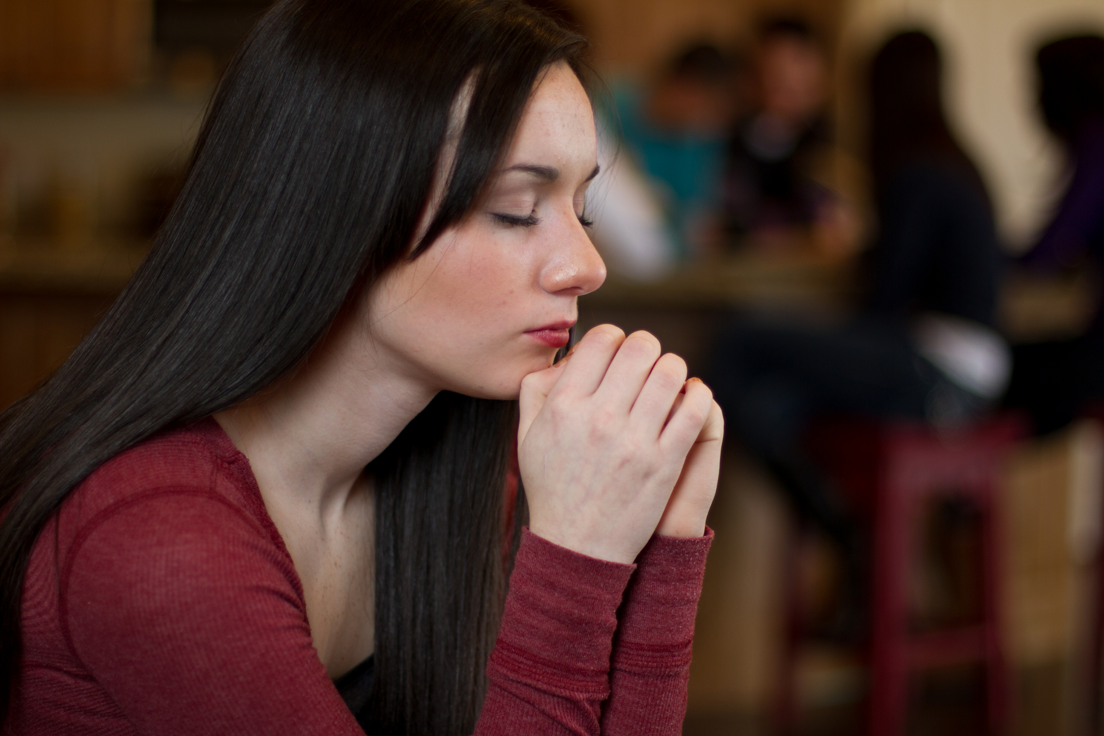
How can we remain faithful and avoid discouragement when our sincere prayers are not immediately answered in the way we desire?

Slide 10
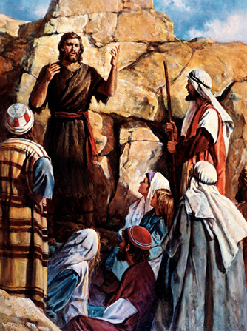
John’s Mission
John would “turn [many people] to the Lord their God” –Luke 1:16
He would “turn the hearts of the fathers to the children.” –Luke 1:17

Slide 11
John’s Mission
John would “turn the disobedient to the wisdom of the Just” –Luke 1:17
He would “make ready a people prepared for the Lord.” –Luke 1:17

Slide 12
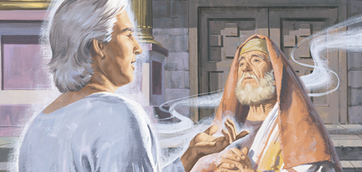
Zacharias’ Sign
Zacharias asked Gabriel for a sign.
Gabriel told him that he would be struck dumb until his words were fulfilled.

Slide 13
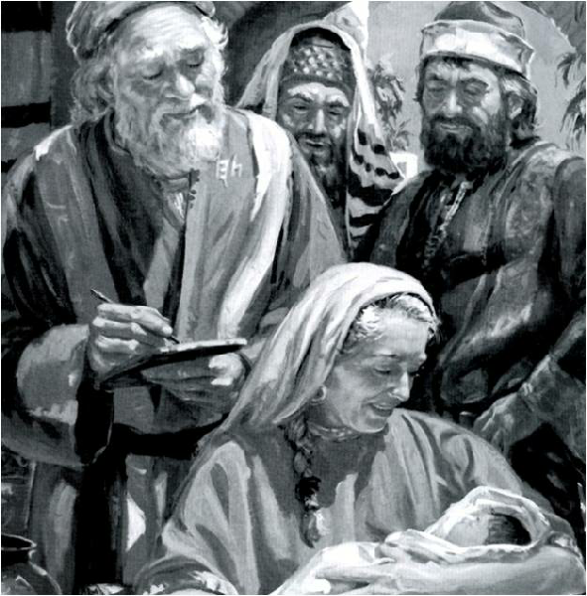
Birth of John
Elisabeth gives birth. Her neighbors and cousins call the babe Zacharias.
Elisabeth corrects them, “He shall be called John.”
They ask Zacharias who writes, “His name is John.”
Zacharias’ tongue is loosed.

Slide 14
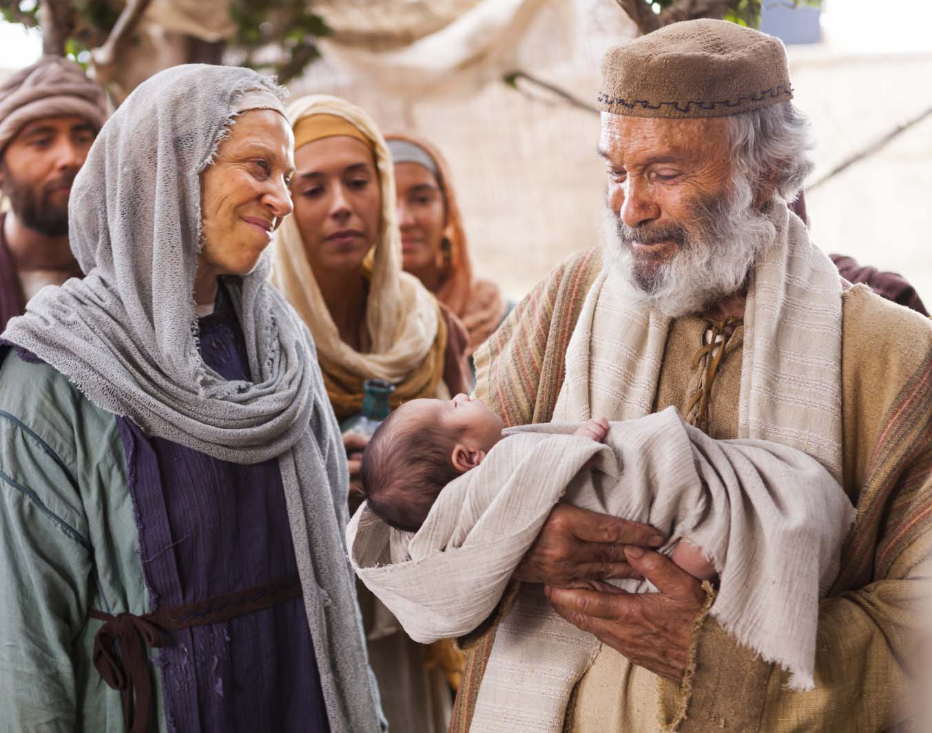
Zacharias’ Prophecy
“And thou, child, shalt be called the prophet of the Highest: for thou shalt go before the face of the Lord to prepare his ways;....
To give light to them that sit in darkness and in the shadow of death, to guide our feet into the way of peace.”
-Luke 1:76 & 79

Slide 15
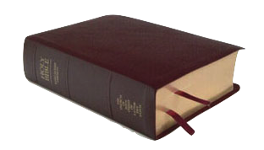
John 1:6-9
“There was a man sent from God, whose name was John.
The same came for a witness, to bear witness of the Light, that all men through him might believe.
He was not that Light, but was sent to bear witness of that Light.
That was the true Light, which lighteth every man that cometh into the world.”

Slide 16
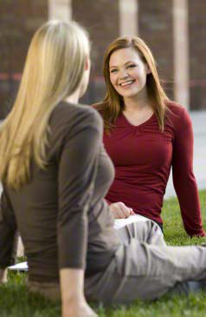
Light To Others
Like John the Baptist, we should focus our service on helping others come to Christ.

Slide 17

Luke 1:80
“And the child grew, and waxed strong in spirit, and was in the deserts till the day of his shewing unto Israel.”

Slide 18
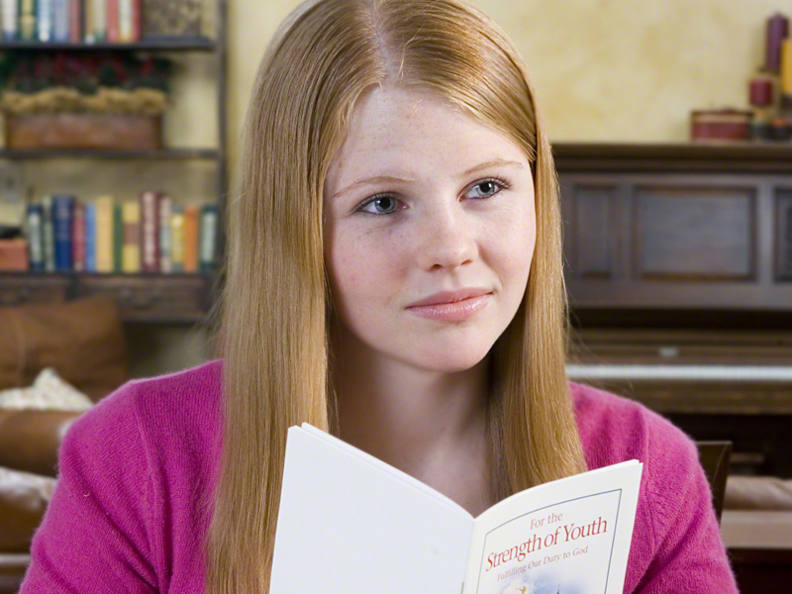
What can we do to wax strong in spirit?

Slide 19
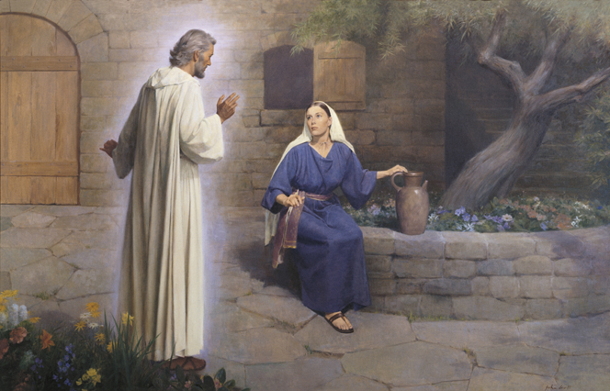
Announcement
Gabriel appeared to Mary to announce the birth of Christ
Video Presentation

Slide 20



Slide 21
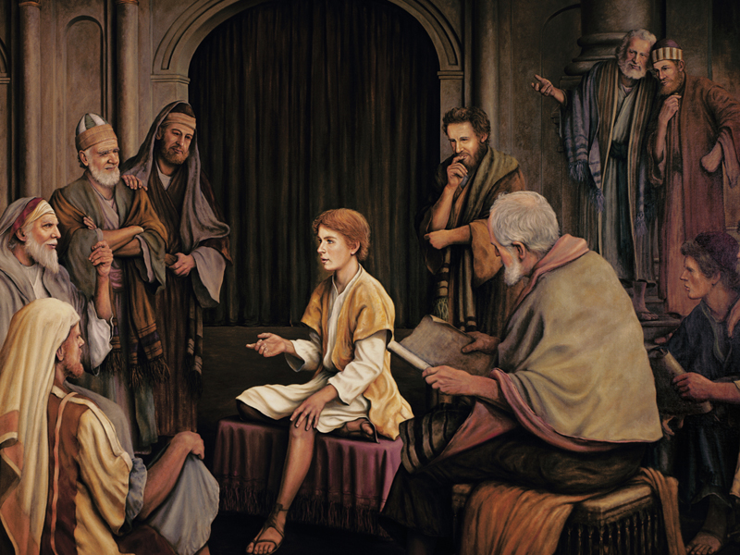
Why did the Savior need to be the son of a mortal mother and an immortal Father?

Slide 22
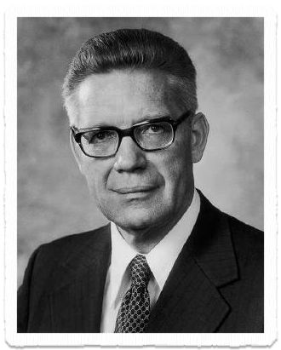
Mortal & Immortal
“Because God was his Father
and Mary was his mother,
He had power to live or to die,
as he chose, and having laid
down his life, He had power to
take it again, and then, in a way
incomprehensible to us, to pass
on the effects of that resurrection to all men so that all shall rise from the tomb”
-Bruce R. McConkie

Slide 23
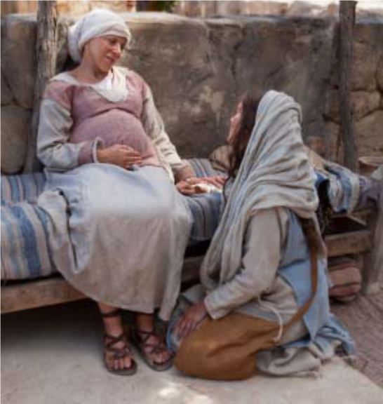
Mary’s Visit
Mary went to stay with Elisabeth for 3 months.
Upon arriving, the babe inside Elisabeth leaps for joy, and Elisabeth is filled with the Holy Ghost.
“And Mary said, My sould doth magnify the Lord, And my spirit hath rejoiced in God my Saviour.”
  Luke 1:46-47

Slide 24
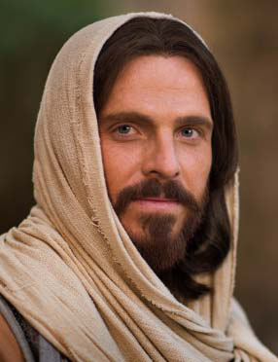
The Holy Ghost
One of the Holy Ghost’s principle roles is to testify of Jesus Christ.

Slide 25
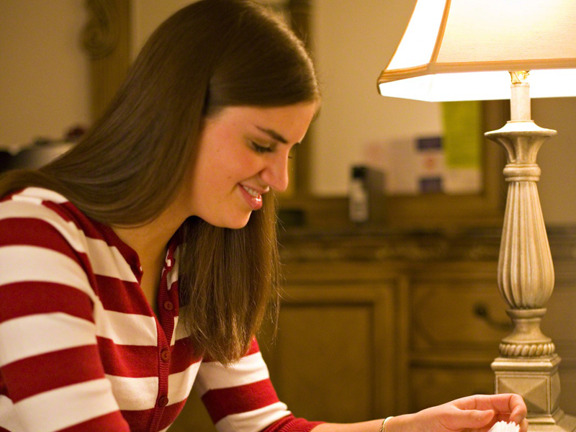
How has the Holy Ghost helped you gain a testimony of Jesus Christ?

Slide 26
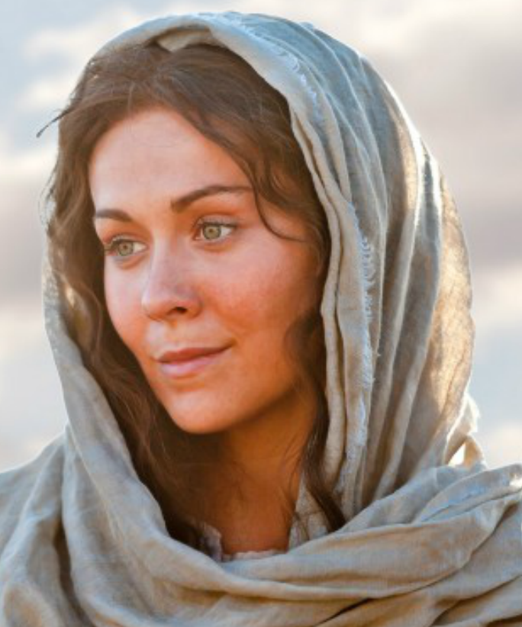
Example of Mary
Mary found favor with God.
She was worthy to have the Lord with her.
She was humble and submissive to the will of the Lord.
She rejoiced in her savior.

Slide 27
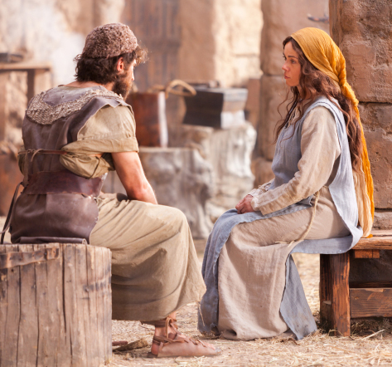
With Child
After returning from her visit to Elisabeth, Mary was 3 months pregnant.
Joseph was “minded to put her away privily.”

Slide 28
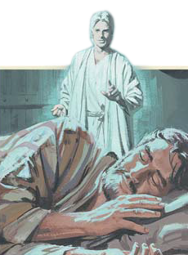
Joseph’s Dream
An angel appeared to Joseph in a dream telling him that the child was of the Holy Ghost and should be called ‘Jesus.’

Slide 29
Marriage
Joseph did as the angel told him and took Mary as his wife.
He “Knew her not till she had brought forth her first born son.”

Slide 30
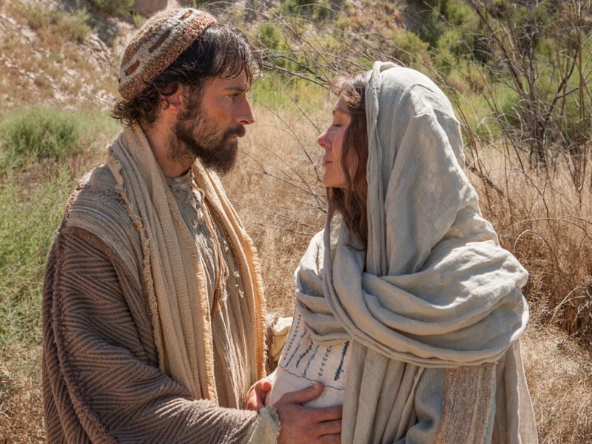

What does this response reveal about Joseph’s character?

Slide 31
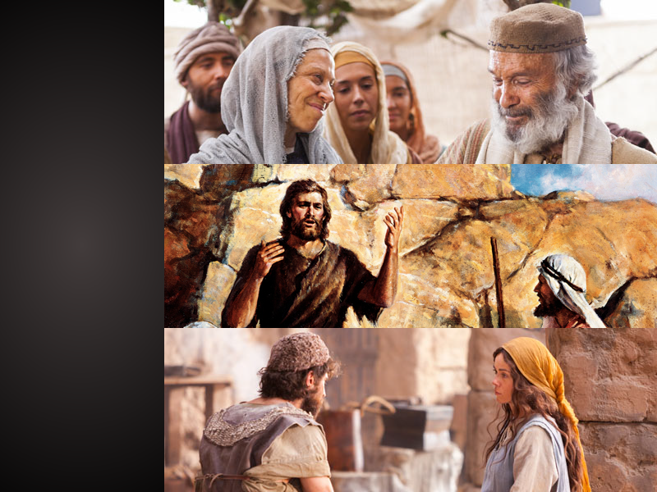
How do the examples of these people help you see the Savior’s greatness and increase your faith in him?

Slide 32


Slide 34


Authored by Dan Oakey
This work is licensed under a Creative Commons Attribution-NonCommercial-ShareAlike 4.0 International License.
Royalty free Images were used from the LDS media library

