Slide 1
Gospel Doctrine
Lesson 4: “Prepare Ye the Way of the Lord”

Slide 2
Purpose
Inspire class members to draw near to the Savior by repenting of their sins, keeping their baptismal covenants, and withstanding temptation.

Slide 3
Summary
John the Baptist prepared the way of the Lord.
John baptized Jesus.
Jesus withstood temptation.

Slide 4

What does it mean?

Slide 5
Hebrew: “Messiah”
Messiah: Anointed
Greek “Messiah” - Christ

Slide 6
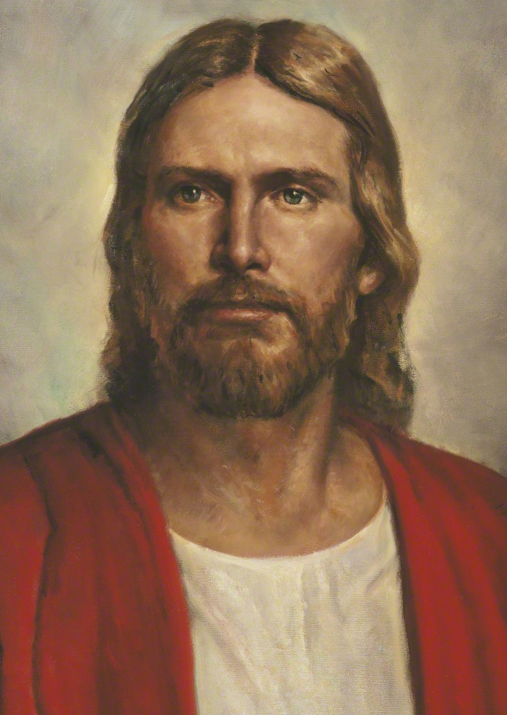
Jesus Is The Messiah
John the Baptist was the prophet sent to prepare the way for Jesus Christ.

Slide 7
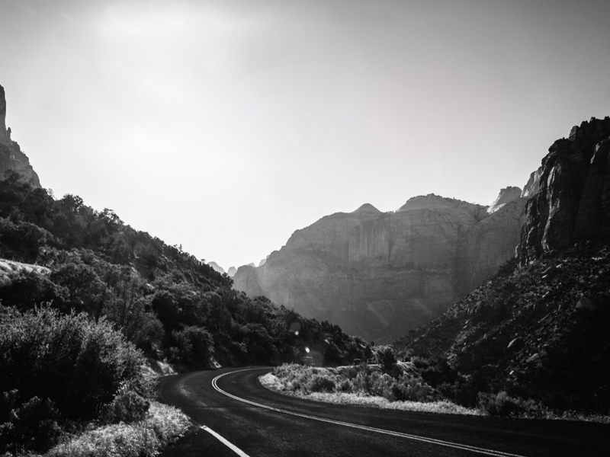
Why do you think it was important that someone prepare the way of the Lord?

Slide 8
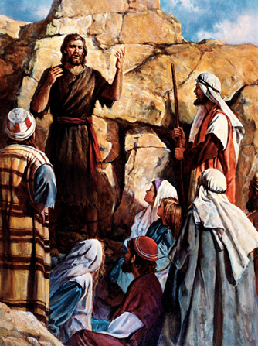
John The Baptist
John was born about six months before Jesus.
To escape Herod, John was taken into the mountains where he fed on locusts and honey.
“Among those that are born of women there is not a greater prophet than John the Baptist.”
  Luke 7:28

Slide 9
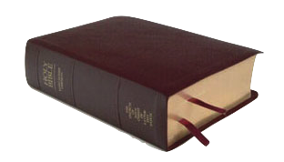
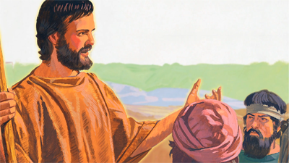
Matthew 3:1-3
“In those days came John the Baptist, preaching in the wilderness of Judæa, And saying, Repent ye: for the kingdom of heaven is at hand. For this is he that was spoken of by the prophet Esaias, saying, The voice of one crying in the wilderness, Prepare ye the way of the Lord, make his paths straight.”

Slide 10
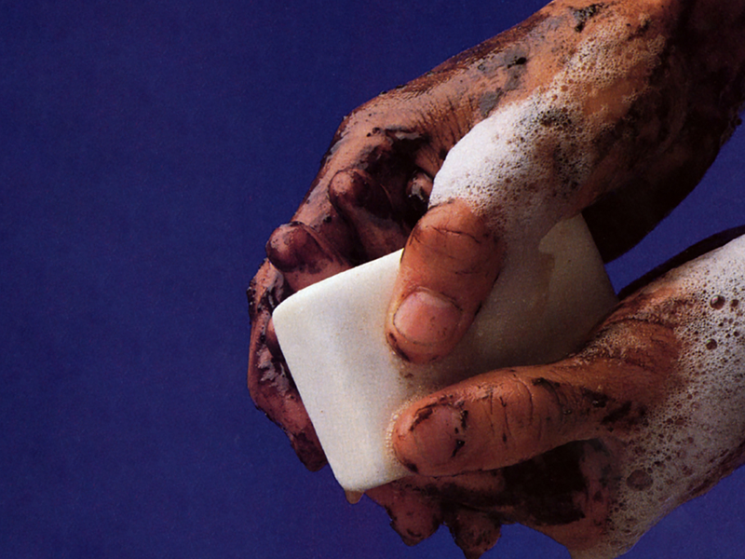
What does it mean to repent?

Slide 11

Godly Sorrow
“For godly sorrow worketh repentance to salvation.”
-2 Corinthians 7:10

Slide 12
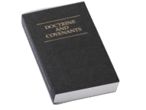
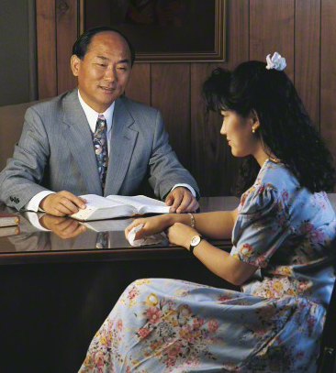
Confess & Forsake
“By this ye may know if a man repenteth of his sins—behold, he will confess them and forsake them.”
-D&C 58:43

Slide 13
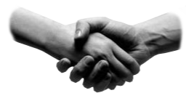
Make Amends
“And Zaccheus stood, and said unto the Lord; Behold, Lord, the half of my goods I give to the poor; and if I have taken any thing from any man by false accusation, I restore him fourfold.
And Jesus said unto him, This day is salvation come to this house, forsomuch as he also is a son of Abraham.”
-Luke 19:8-9

Slide 14
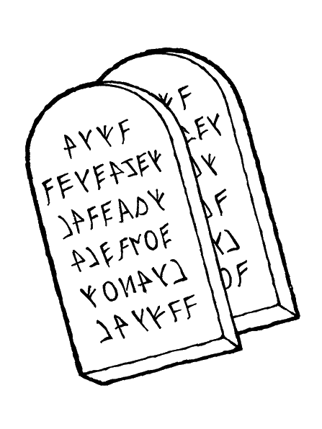
Obey
“For I the Lord cannot look upon sin with the least degree of allowance; Nevertheless, he that repents and does the commandments of the Lord shall be forgiven;”
-D&C 1:31-32

Slide 15
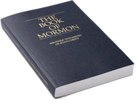
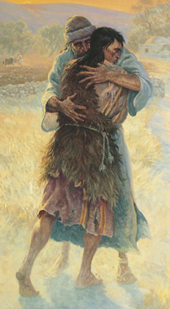
Turn To The Lord
“But if ye will turn to the Lord with full purpose of heart, and put your trust in him, and serve him with all diligence of mind, if ye do this, he will, according to his own will and pleasure, deliver you out of bondage.”
-Mosiah 7:33

Slide 16
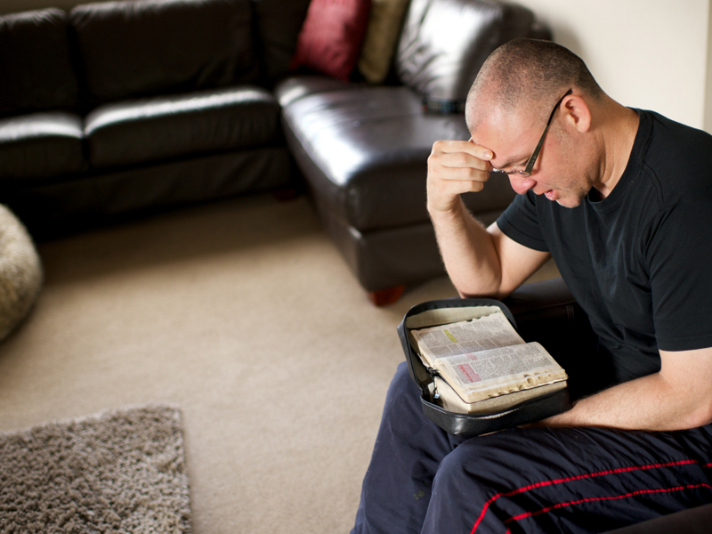

How does repentance help us prepare to dwell with Heavenly Father and
Jesus Christ?

Slide 17
Fruits of Repentance
The Pharisees and Sadducees chose not to be baptized.
John rebuked them.
“Repent, therefore, and bring forth fruits meet for repentance;”
  JST Matthew 3:35

Slide 18

What are the fruits of repentance?

Slide 19


Fruits of Repentance
Fruits
Baptism
Remission of Sins
Meekness
Lowliness of Heart
Visitations of the Holy Ghost
Hope & Perfect Love
-See Moroni 8:25-26

Slide 20
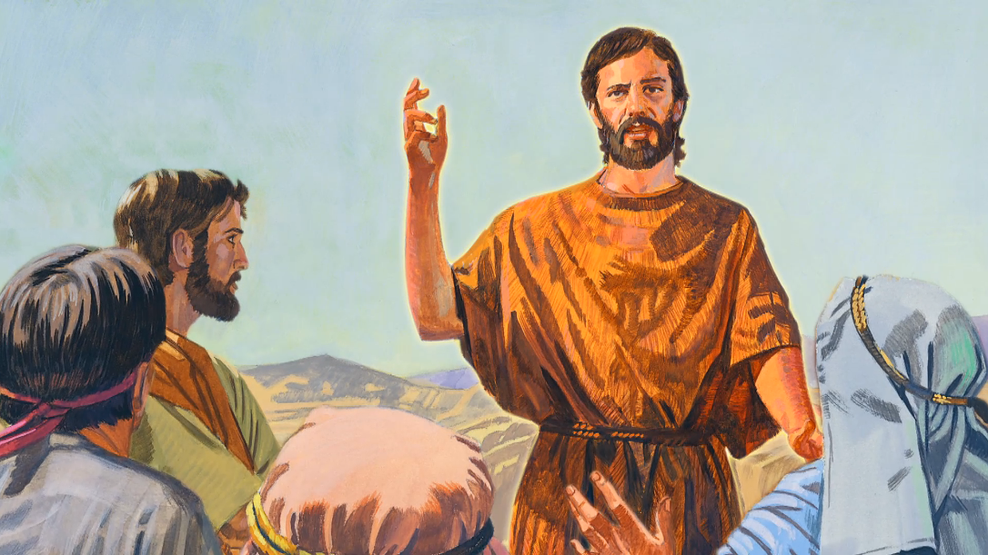
Matthew 3:11
“I indeed baptize you with water unto repentance: but he that cometh after me is mightier than I, whose shoes I am not worthy to bear: he shall baptize you with the Holy Ghost, and with fire.”

Slide 21

What does it mean to be baptized with the Holy Ghost,
and with
fire?

Slide 22
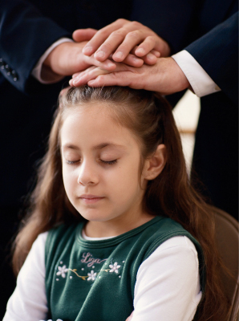
Confirmation
We are baptized with the Holy Ghost and with fire when we receive the gift of the Holy Ghost by the laying on of hands

Slide 23

Holy Ghost
“The gift of the Holy Ghost is the right to have, whenever one is worthy, the companionship of the Holy Ghost. … It acts as a cleansing agent to purify a person and sanctify him from all sin. Thus it is often spoken of as ‘fire’”
-Bible Dictionary “Holy Ghost”

Slide 24
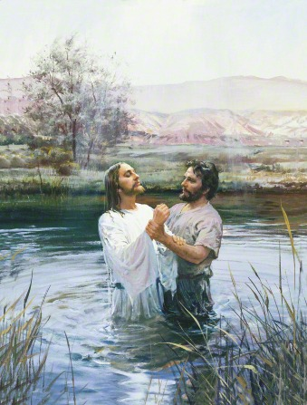
Jesus Is Baptized
Video Presentation

Slide 25



Slide 26
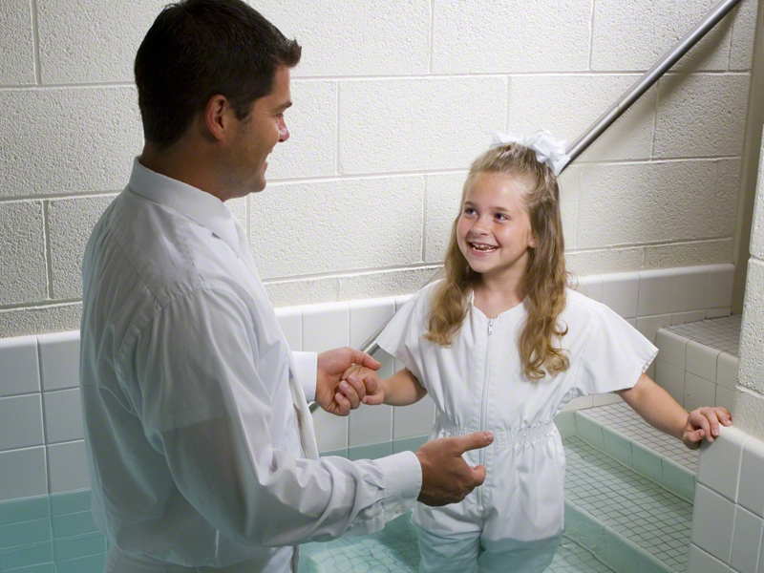
What covenants do we make when we are baptized?

Slide 27
D&C 20:37
“All those who humble themselves before God, and desire to be baptized, and come forth with broken hearts and contrite spirits, and witness before the church that they have truly repented of all their sins, and are willing to take upon them the name of Jesus Christ, having a determination to serve him to the end, and truly manifest by their works that they have received of the Spirit of Christ unto the remission of their sins, shall be received by baptism into his church.”

Slide 28
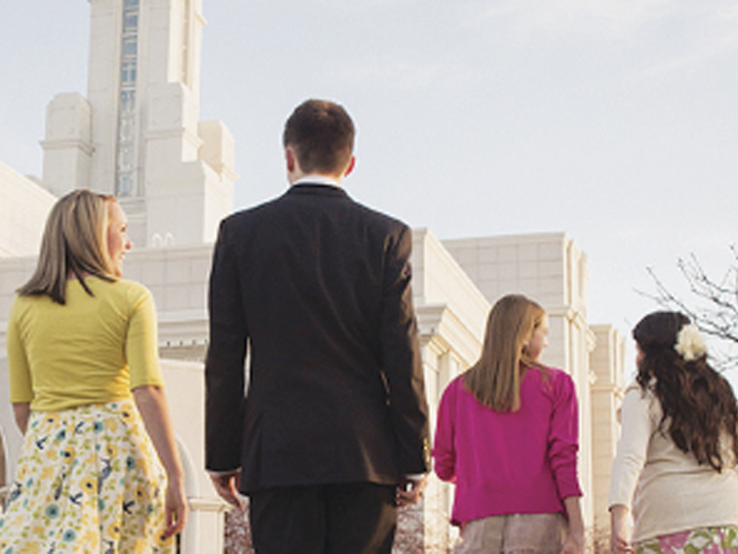
How should these covenants affect our daily actions?

Slide 29
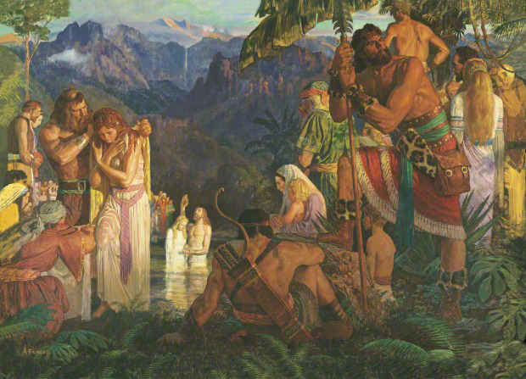
Mosiah 18:8-10
Bear one another’s burdens.
Mourn with those that mourn.
Comfort those that stand in need of comfort.
Stand as witnesses of God at all times.

Slide 30
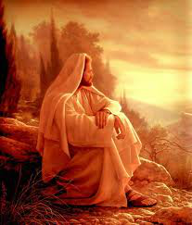
Jesus Fasted
Soon after Jesus was baptized, the Spirit led him into the wilderness to be with God.
  See JST Matthew 4:1
He Fasted 40 days.
Satan came to tempt him.

Slide 31

How do fasting, prayer, and being “led … of the Spirit”
fortify us against temptation?

Slide 32
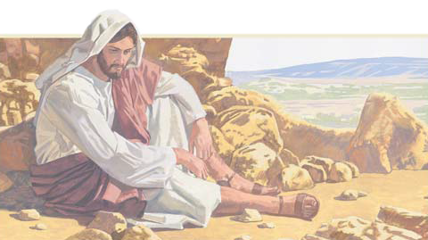
Bread
“And when the tempter came to him, he said, If thou be the Son of God, command that these stones be made bread. But he answered and said, It is written, Man shall not live by bread alone, but by every word that proceedeth out of the mouth of God.”
-Matthew 4:3-4

Slide 33

How does Satan tempt us to give in to physical appetites?
How can we recognize and resist these temptations?

Slide 34
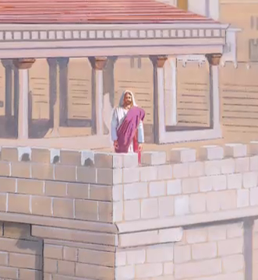
Pride
Jesus was at the pinnacle of the temple.
Satan - “If thou be the Son of God, cast thyself down… and [angels] shall bear thee up.”
Jesus – “It is written again, Thou shalt not tempt the Lord thy God.”
  Matthew 4:6-7

Slide 35


How does Satan try to appeal to our pride?
How can we recognize and withstand temptations to gratify prideful desires?

Slide 36
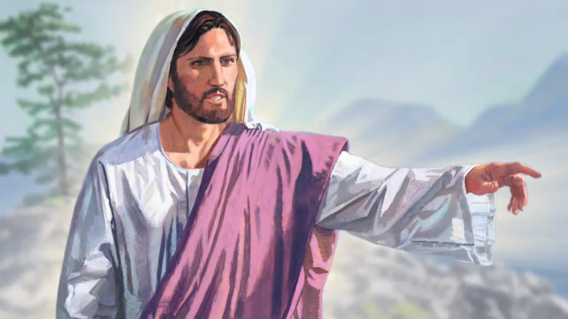
Riches and Power
Satan offers Jesus all the kingdoms of the world if Jesus would worship him.
Jesus – “Get thee hence, Satan: for it is written, Thou shalt worship the Lord thy God, and him only shalt thou serve.”
  Matthew 4:10

Slide 37
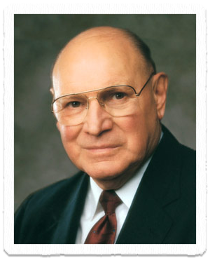
Temptation
“The Lord is well aware of our mortality. He knows our weaknesses. He understands the challenges of our everyday lives. He has great empathy for the temptations of earthly appetites and passions”
-Joseph B. Wirthlin

Slide 38
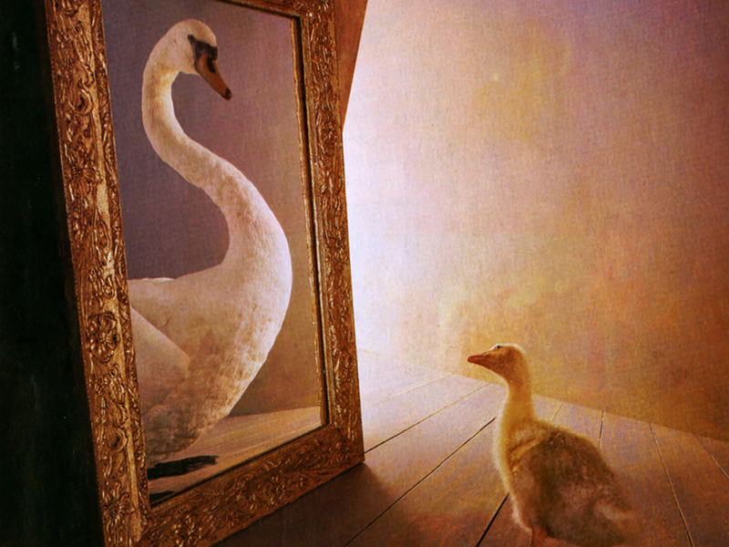
Why did Satan question whether Jesus was the Son of God?
How does it help to know that we are children of God?

Slide 39
Disciples
John encouraged his disciples to follow Jesus.
“They said unto [Jesus], Rabbi, where dwellest thou?”
“He saith unto them, Come and see.”
  John 1:38-39

Slide 40
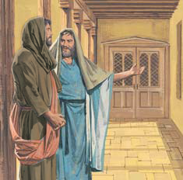
Invitation
When Andrew recognized the messiah, he invited Peter to go and meet Him.
Philip invited Nathanael, who said, “Can there any good thing come out of Nazareth? Philip saith unto him, Come and see.”
  John 1:46

Slide 41
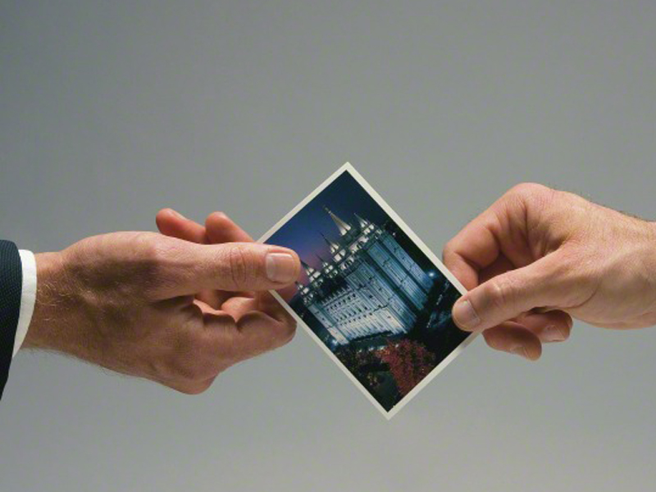
What can we do to invite others to “come and see” the Savior?

Slide 42


Slide 44


Authored by Dan Oakey
This work is licensed under a Creative Commons Attribution-NonCommercial-ShareAlike 4.0 International License.
Royalty free Images were used from the LDS media library

