Slide 1
Gospel Doctrine
Lesson 5: "Born again"

Slide 2
Purpose
Help class members understand that to receive everlasting life, we must be “born again” and continue to follow Jesus Christ.

Slide 3
Summary
Jesus teaches Nicodemus about being born again.
Jesus teaches a Samaritan woman about living water.

Slide 4
Living Water
We die without water.
Our spirits die without the living water that Christ offers.

Slide 5
Jesus and Nicodemus
Jesus teaches Nicodemus, a Pharisee and Jewish community leader.
Video Presentation

Slide 7
What does
it mean
to be
born again?

Slide 8
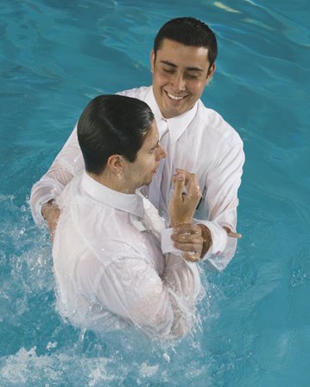
Baptism By Immersion
Being immersed in the water symbolizes the death or burial of our past sins.
When we rise out of the water, we start a new life.

Slide 9
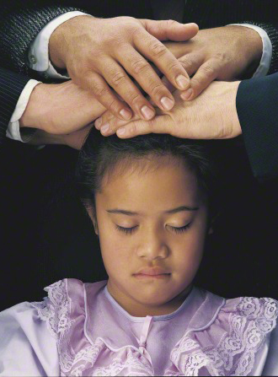
Confirmation
When we receive the gift of the Holy Ghost we are born of the spirit.
The Gift of the Holy Ghost is the right to have the companionship of the Holy Ghost whenever one is worthy.

Slide 10
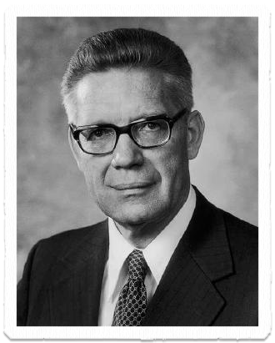
Born Again
“Church members are not born again by the mere fact of baptism alone.”
-Bruce R. McConkie
What else is needed?

Slide 11
Born Again
Belief in Jesus Christ
John 3:18
Experiencing a mighty change of heart, having no more disposition to do evil but to do good continually.
Mosiah 5:2
Repenting so our “garments are purified until they are cleansed from all stain through the blood of [Christ]”
Alma 5:21

Slide 12
Born Again
Being born again “doesn’t happen in an instant. [It] is a process.”
-Bruce R. McConkie

Slide 13
What can we do to continue this process throughout our lives?

Slide 14
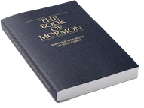
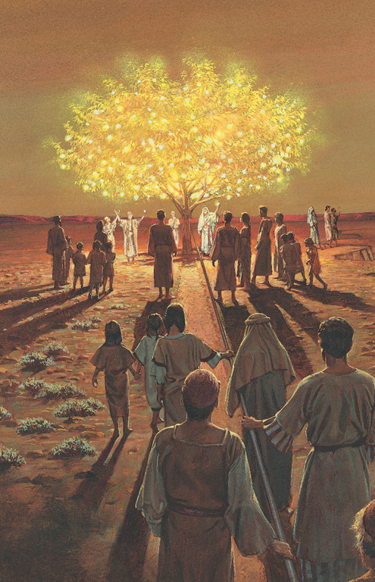
2nd Nephi 31:20
“Wherefore, ye must press forward with a steadfastness in Christ, having a perfect brightness of hope, and a love of God and of all men. Wherefore, if ye shall press forward, feasting upon the word of Christ, and endure to the end, behold, thus saith the Father: Ye shall have eternal life.”

Slide 15
How can we
OVERCOME
discouragement or
setbacks
in our
spiritual progress?

Slide 16
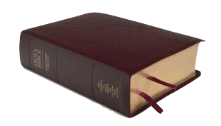
John 3:20-21
“For every one that doeth evil hateth the light, neither cometh to the light, lest his deeds should be reproved. But he that doeth truth cometh to the light, that his deeds may be made manifest, that they are wrought in God.”

Slide 17
Why do some choose DARKNESS
over
light?

Slide 18
What can we do to love the Light
And shun the DARKNESS?

Slide 19
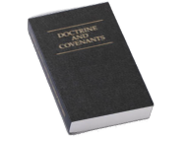
D&C 88:67
“And if your eye be single to my glory, your whole bodies shall be filled with light, and there shall be no darkness in you; and that body which is filled with light comprehendeth all things.”

Slide 20
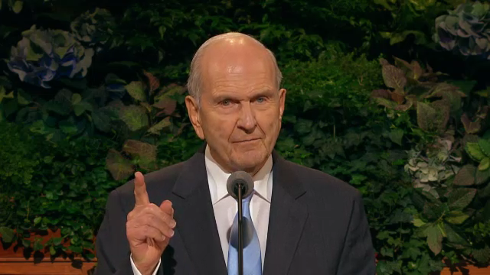
Decisions For Eternity
How do we Change?
Elder Russell M. Nelson

Slide 21
Decisions For Eternity
How do we Change?
Elder Russell M. Nelson

Slide 22
Decisions For Eternity
Our desires can change.
Permanent change comes through the atonement.
Power comes through exact obedience.

Slide 23
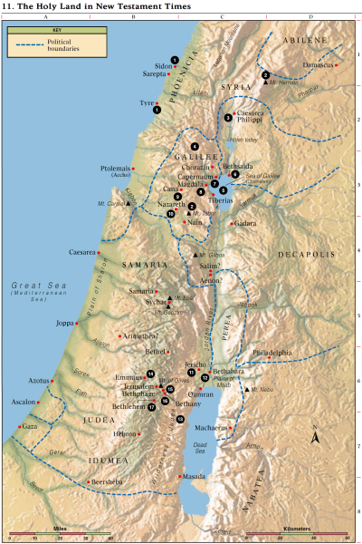
Ancient Israel
Ancient Israel covered a wide territory.

Slide 24
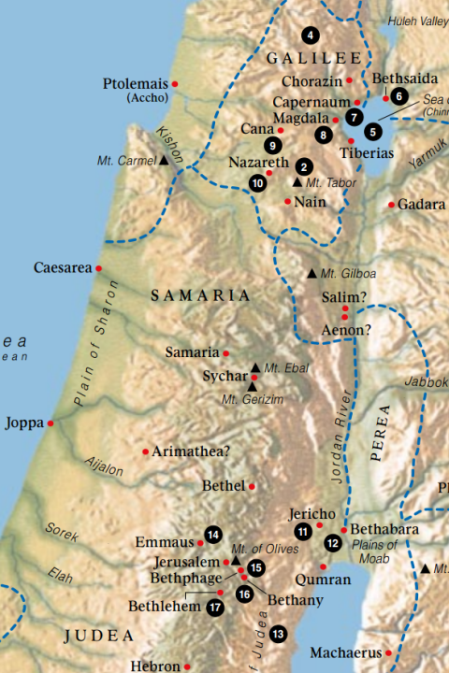
Ancient Israel
The Jews had “no dealings with the Samaritans” and usually avoided Samaria when traveling.
Samaritans were mixed-bloods who had apostatized after Assyrian takeover.

Slide 25
Ancient Israel
Jesus deliberately went through Samaria when traveling.
He stopped to rest at Jacob’s Well
While Jesus sat by the well, a Samaritan woman came to draw water.

Slide 26
What do we learn from Jesus’ decision to travel through Samaria?

Slide 27
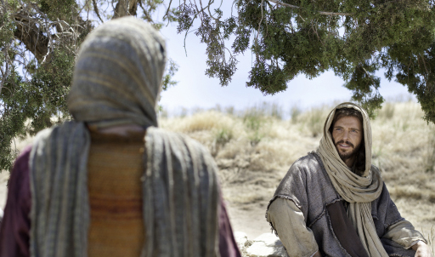
Woman At The Well
Jesus teaches about living water.
Video Presentation

Slide 29
What do you think “living water” means?
How can we obtain living water?

Slide 30
John 4:28-29
“The woman then left her waterpot, and went her way into the city, and saith to the men,
Come, see a man, which told me all things that ever I did: is not this the Christ?”

Slide 31
What do we learn from this woman’s example?

Slide 32
How have you been blessed or seen others blessed for believing in the Lord?

Slide 35
Authored by Dan Oakey
This work is licensed under a Creative Commons Attribution-NonCommercial-ShareAlike 4.0 International License.
Royalty free Images were used from the LDS media library

