Slide 1
Gospel Doctrine
Lesson 6: “They Straightway Left Their Nets.”

Slide 2
Purpose
Help class members understand that Apostles are called to be special witnesses of Jesus Christ and that we are blessed when we sustain and follow them.

Slide 3
Summary
Jesus announces that he is the long-awaited messiah.
Jesus calls the 12 apostles to help spread His message.

Slide 4
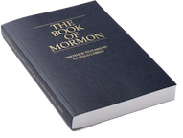
Mosiah 27:31
“Yea, every knee shall bow, and every tongue confess before him. Yea, even at the last day, when all men shall stand to be judged of him, then shall they confess that he is God”

Slide 5
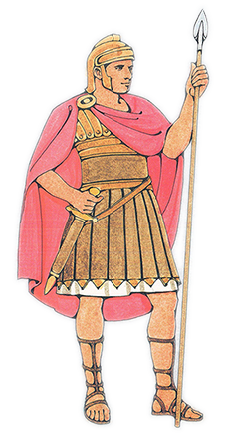
Rejection
At Jesus’ 2nd coming, all will recognize Him as the Savior.
Jesus did not free the Jews from Roman control. They thought the messiah would be a warrior.
Many rejected him and his message.

Slide 6
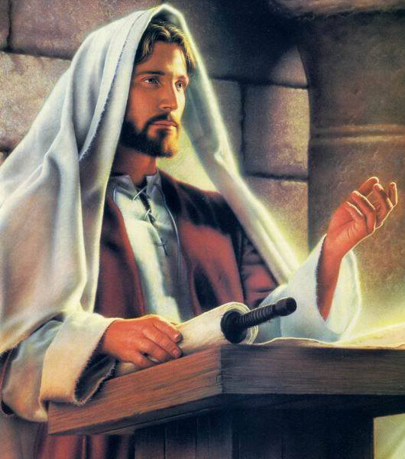
Luke 14:14-15
“And Jesus returned in the power of the Spirit into Galilee: and there wet out a fame of him through all the region round about. And he taught in their synagogues, being glorified of all.”

Slide 7
Declaration
Video Presentation

Slide 9
Why do you think some people have difficulty accepting Jesus Christ?

Slide 10
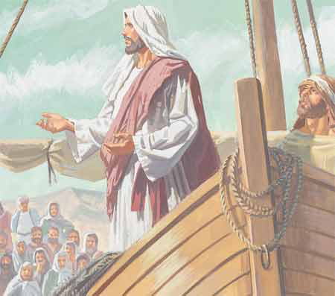
Boat Lesson
Jesus was teaching near Gennesaret.
He entered Peter’s boat and taught the people on the shore.
After teaching, Jesus told Peter to launch into the deep and let down the nets for fish.

Slide 11
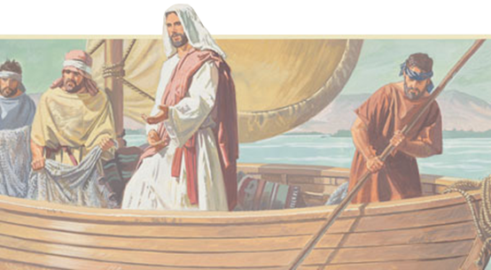
Boat Lesson
Peter – “Master, we have toiled all the night, and have taken nothing: nevertheless at thy word I will let down the net.”
Many fish are caught. The net breaks and the boat begins to sink.

Slide 12
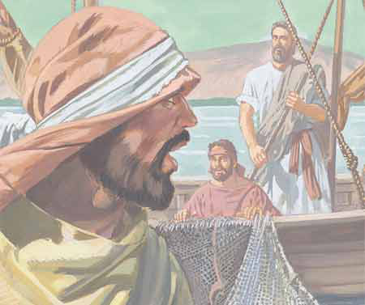
Boat Lesson
They call their friends in another boat to help them.
“When Simon Peter saw it, he fell down at Jesus’ knees, saying, Depart from me; for I am a sinful man, O Lord.”

Slide 13
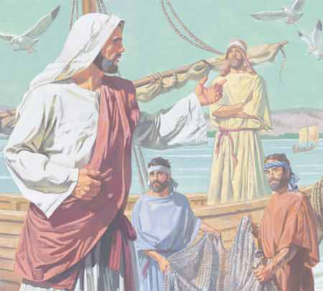
Fishers of Men
“And Jesus said unto Simon, Fear not; from henceforth thou shalt catch men…. And when they had brought their ships to land, they forsook all, and followed him.”
-Luke 5

Slide 14
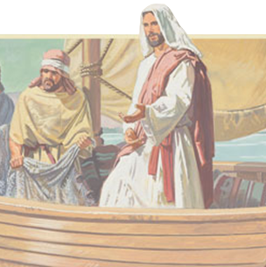
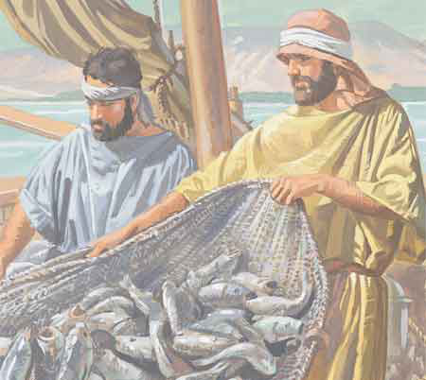
Foreshadowing
As apostles, Peter James and John would have similar experiences.
They would work where Jesus directed them.
They would find many people who would accept the gospel.
They would call others to assist in the work.

Slide 15
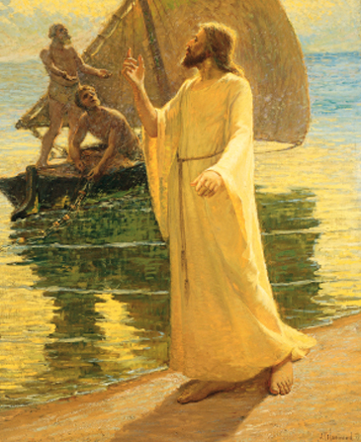
Called as Disciples
Disciple
Pupil, Learner
Follower of Christ
Apostle
“One sent forth”
Special witness of Christ
Sent to testify to the world that Jesus is the Savior and Redeemer of mankind

Slide 16
Why was it important that Jesus call Apostles? Why are they important today?

Slide 17
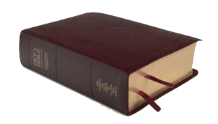
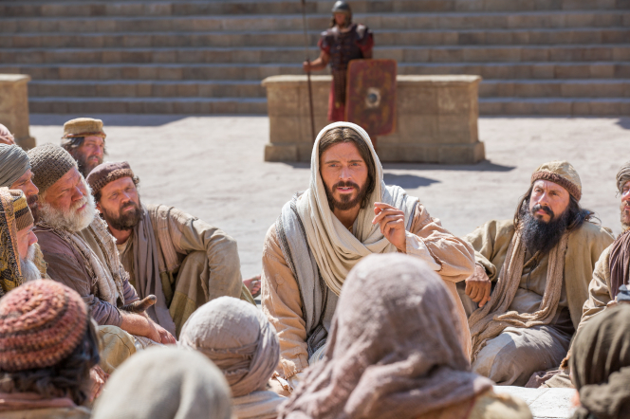
Ephesians 4:12, 14
“And he gave some, apostles; and some, prophets; and some, evangelists; and some, pastors and
teachers; For the perfecting of the saints, for the work of the ministry....That we henceforth be no more children, tossed to and fro, and carried about with every wind of doctrine.”

Slide 18
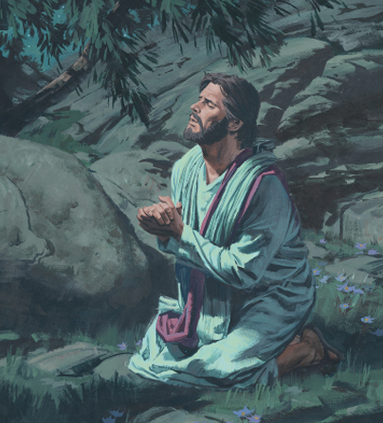
Choosing the 12
“And it came to pass in those days, that he went out into a mountain to pray, and continued all night in prayer to God.
And when it was day, he called unto him his disciples: and of them he chose twelve, whom also he named apostles;”
-Luke 6:12-13

Slide 19
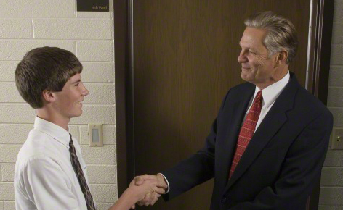
Callings Today
Like Jesus, Church leaders pray and seek inspiration to know whom the Lord would have serve in each calling.

Slide 20
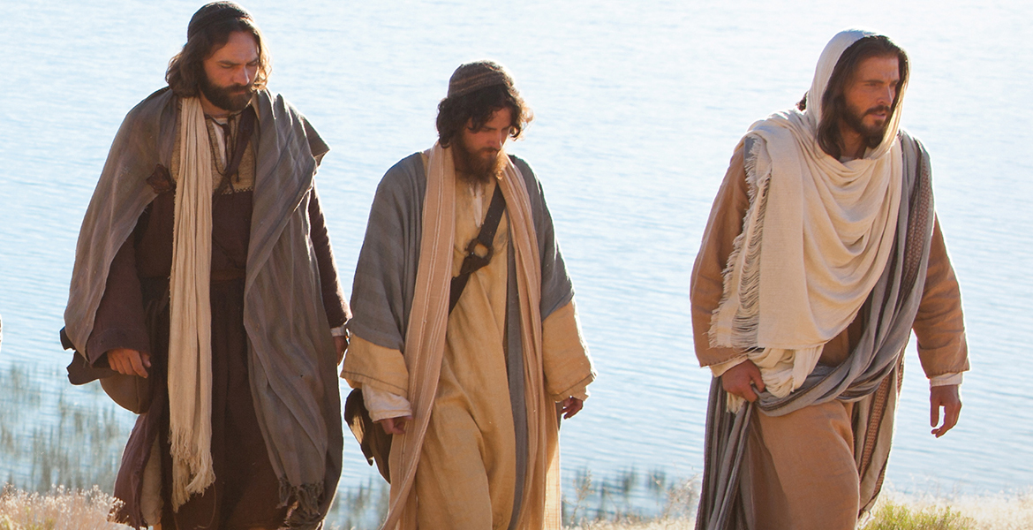
Matthew 10:37
“He that loveth father or mother more than me is not worthy of me: and he that loveth son or daughter more than me is not worthy of me.”

Slide 21
What do the scriptures tell us about the background and character of the men whom Jesus called as Apostles?

Slide 22
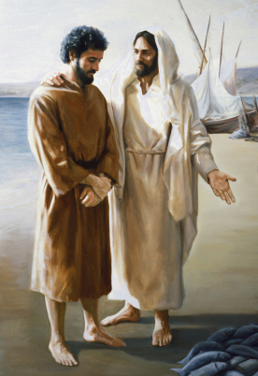
Apostles, Simple Men
No formal training for the ministry
fishers
Humble
“I am a sinful man…”
Obedient & Hardworking
“Toiled all the night… at thy word I will let down the net.”
Willing to sacrifice everything to follow the Lord.
“they forsook all”

Slide 23
What does this suggest about how a person becomes qualified to serve the Lord?

Slide 25
Names of the 12
“Now the names of the twelve apostles are these; The first, Simon, who is called Peter¹, and Andrew² his brother; James³ the son of Zebedee, and John⁴ his brother;
Philip⁵, and Bartholomew⁶; Thomas⁷, and Matthew⁸ the publican; James⁹ the son of Alphæus, and Lebbæus¹⁰, whose surname was Thaddæus;
Simon¹¹ the Canaanite, and Judas¹² Iscariot, who also betrayed him.”
-Matt 10:2-4

Slide 26
FYI
Simon the Caananite ‘The Zealot’
Lebbaus = Judas (not Iscariot)
Matthew = Levi
Thomas = Didymus (‘Twin’)
Bartholomew = Nathanael

Slide 27
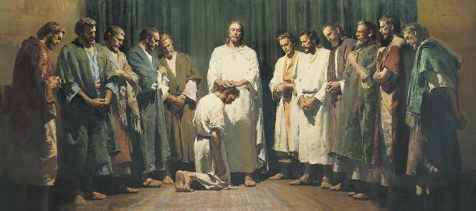
Ordaining the 12
After Jesus called the Twelve Apostles, he gave them priesthood power and instructed them in their responsibilities.
Video Presentation

Slide 29
Duties of the 12
Heal spiritually and physically
Sent to Israel to preach that the kingdom of heaven is at hand.
Use priesthood power to bless and heal people.
Teach as guided by the spirit.
Give their lives entirely to the Savior’s work.

Slide 30
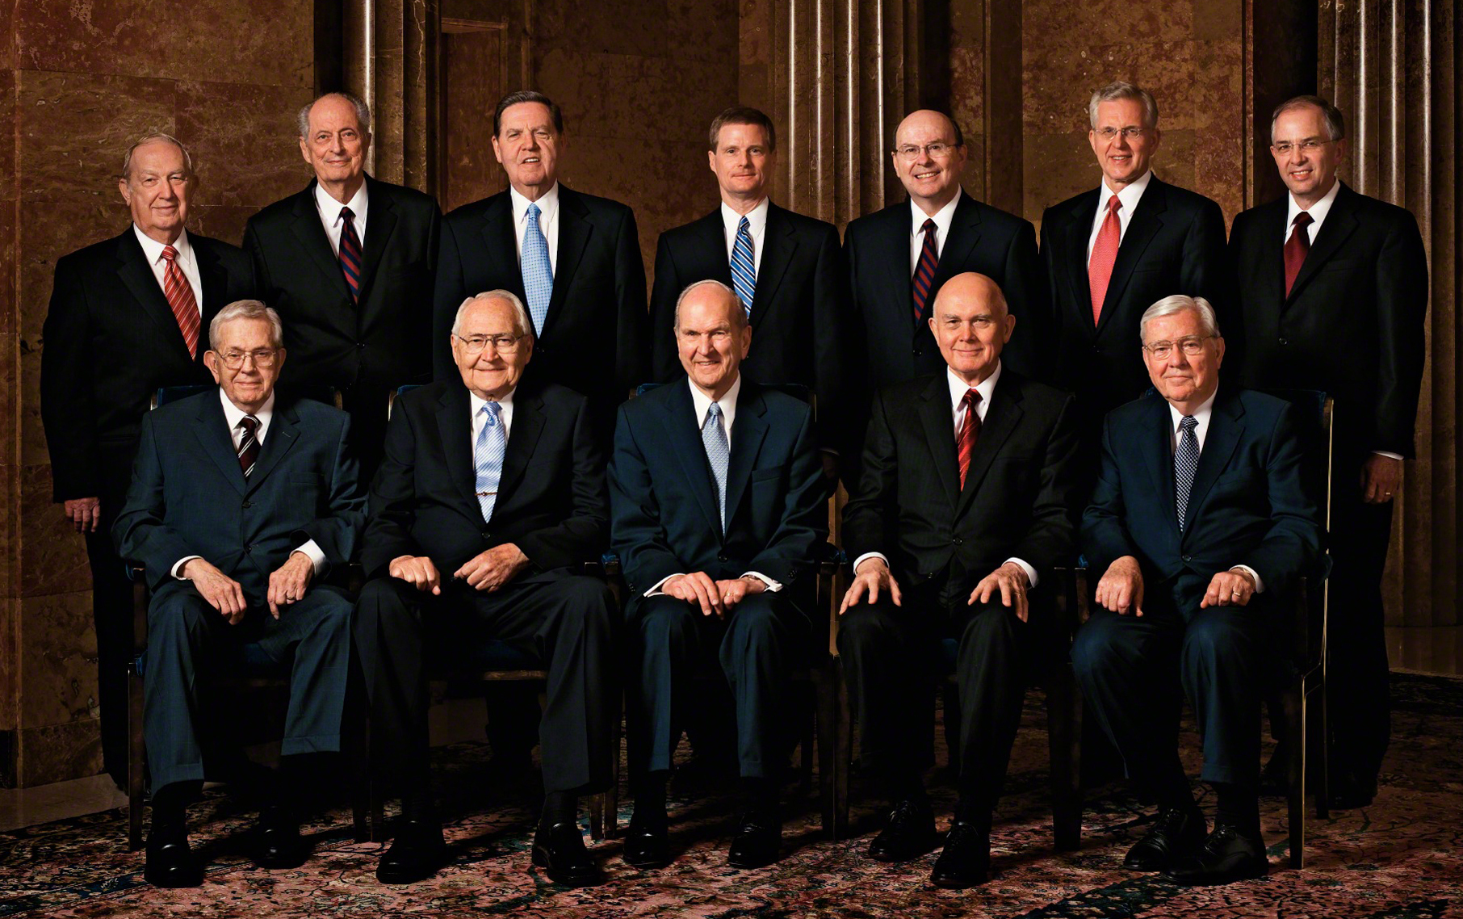
Modern Apostles
Called to be special witnesses to all the world.
They officiate in the name of the Lord.
Sent to proclaim the gospel to the gentiles first, then the Jews.

Slide 31
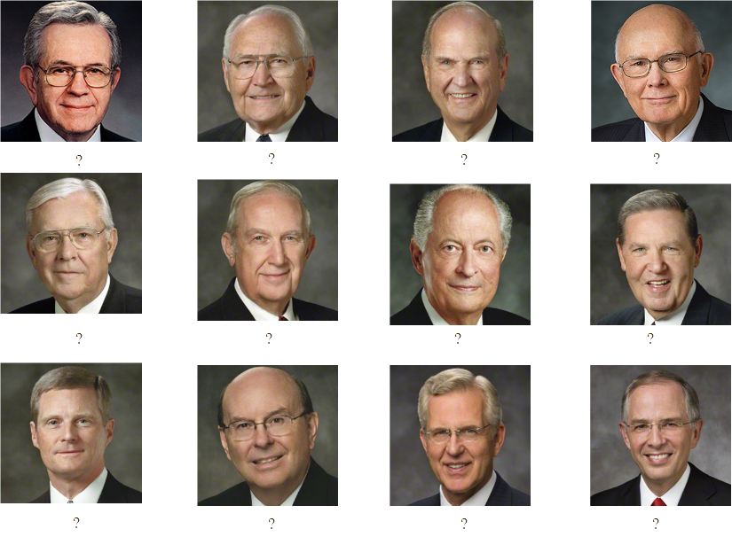

Slide 32
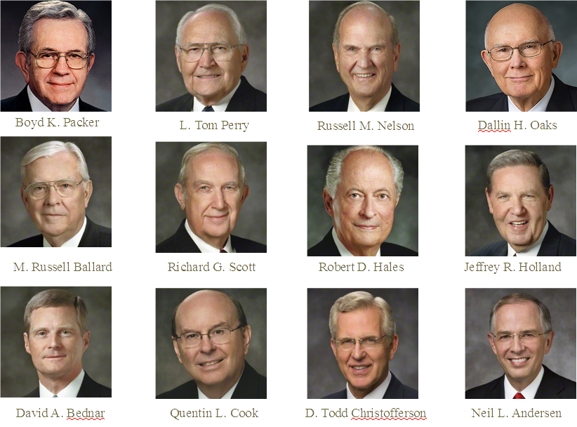

Slide 33
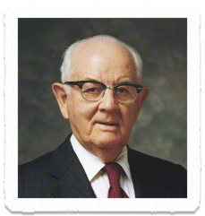
Follow the Apostles
“No one in this Church will ever go far astray who ties himself securely to the Church Authorities whom the Lord has placed in His Church. This Church will never go astray; the Quorum of the Twelve will never lead you into bypaths; it never has and never will”
-Spencer W. Kimball

Slide 36
Authored by Dan Oakey
This work is licensed under a Creative Commons Attribution-NonCommercial-ShareAlike 4.0 International License.
Royalty free Images were used from the LDS media library

