Slide 1
Gospel Doctrine
Lesson 7: “[He] Took Our Infirmities, and Bare Our Sicknesses”

Slide 2
Purpose
Help class members understand some of the reasons the Savior performed miracles.

Slide 3
Summary
Jesus performed many miracles
  Casting out devils
  Healing the sick and afflicted
  Forgiving sins
  Calming the stormy sea
  Raising the dead.

Slide 4
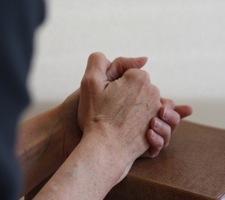
Miracles
An extraordinary event caused by divine or spiritual power.
“They were never wrought without prayer, felt need, and faith.”
  Bible Dictionary

Slide 5
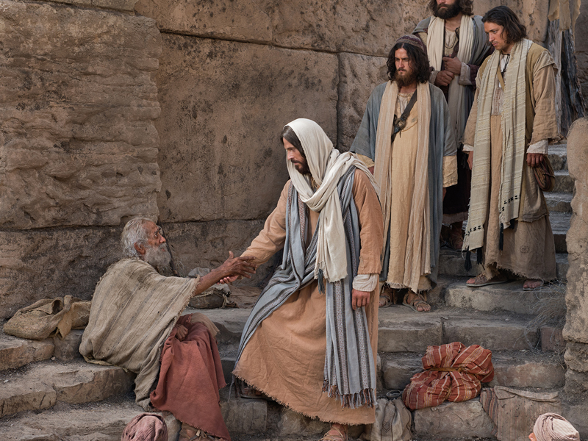
What is one of the Savior’s miracles that you would like to have witnessed?
Why?

Slide 6
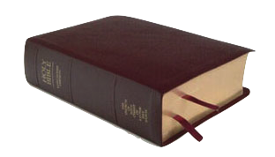
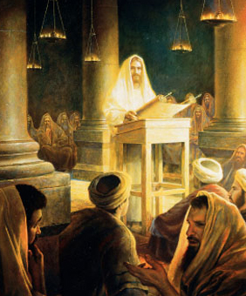
Mark 1:21-22
“And they went into Capernaum; and straightway on the sabbath day he entered into the synagogue, and taught.
And they were astonished at his doctrine: for he taught them as one that had authority, and not as the scribes.”

Slide 7
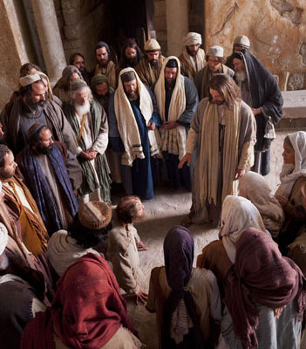
Unclean Spirit
In the synagogue, a man with an unclean spirit speaks.
Man - “Let us alone; what have we to do with thee, thou Jesus
of Nazareth? art thou come to destroy us? I know thee who thou art; the Holy One of God.”
Jesus – “Hold thy peace, and come out of him.” see Mark 1:23-27
The people marveled because of his authority.

Slide 8
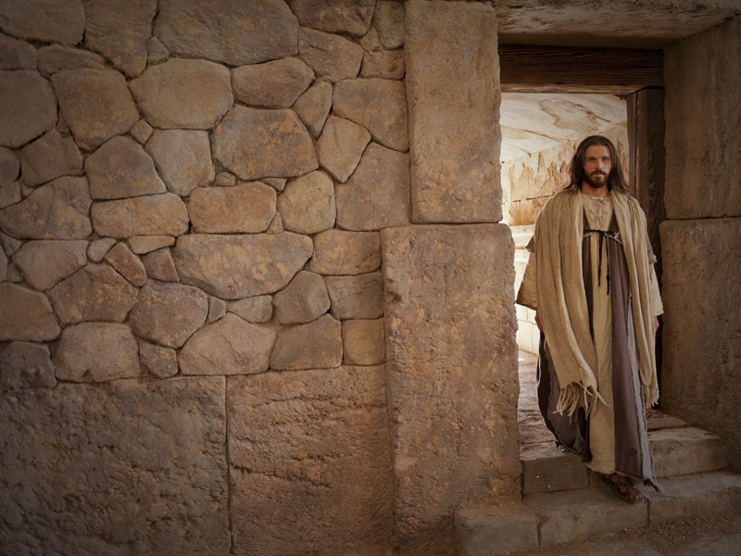

Jesus taught and performed miracles through priesthood authority.

Slide 9
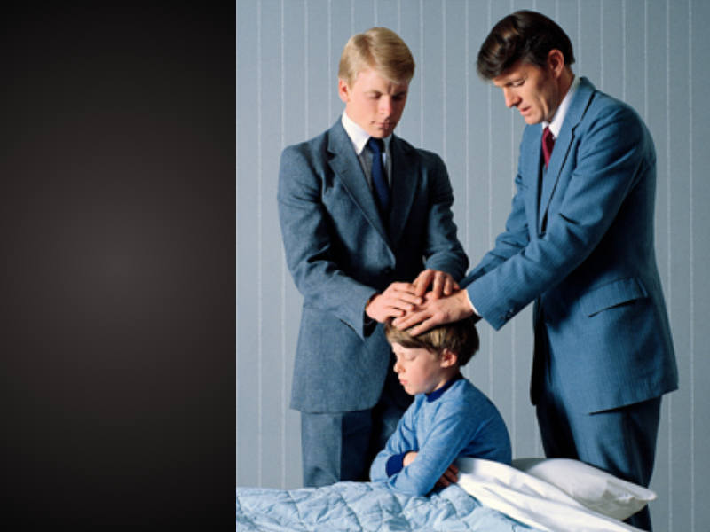
How do we have access to this power and authority today?

Slide 10
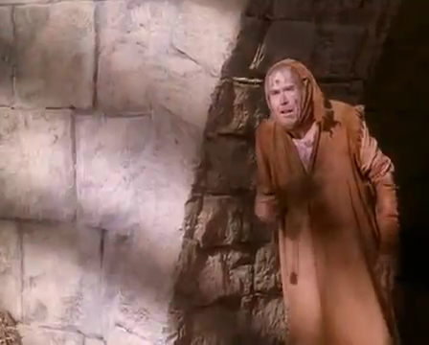
Mark 1:40-41
“And there came a leper to him, beseeching him, and kneeling down to him, and saying unto him, If thou wilt, thou canst make me clean.
And Jesus, moved with compassion, put forth his hand, and touched him, and saith unto him, I will; be thou clean.”

Slide 11
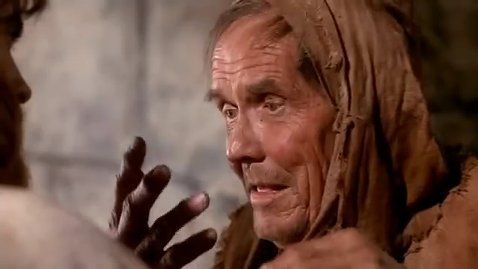
The Individual
Jesus performed many miracles that directly blessed just one person.

Slide 12

How can we show Christlike love and compassion for others?

Slide 13
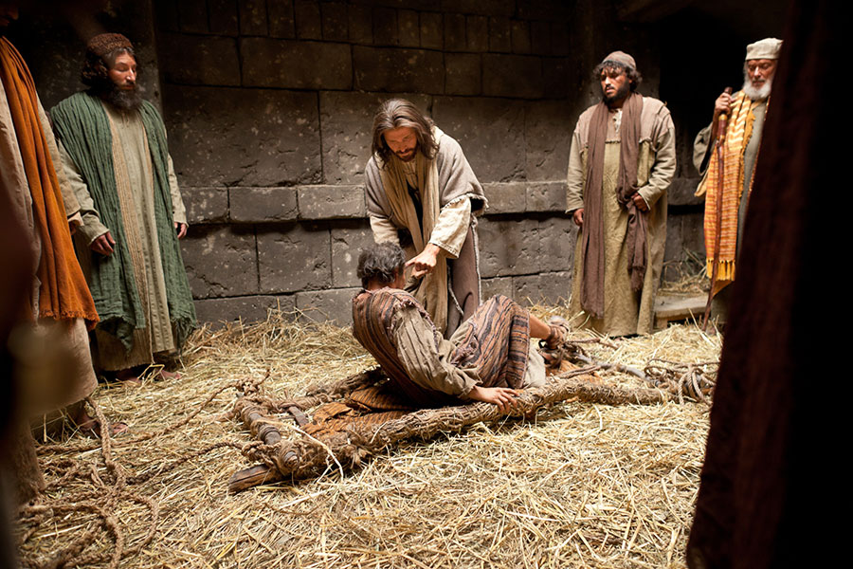
Stricken with Palsy
Video Presentation

Slide 14



Slide 15
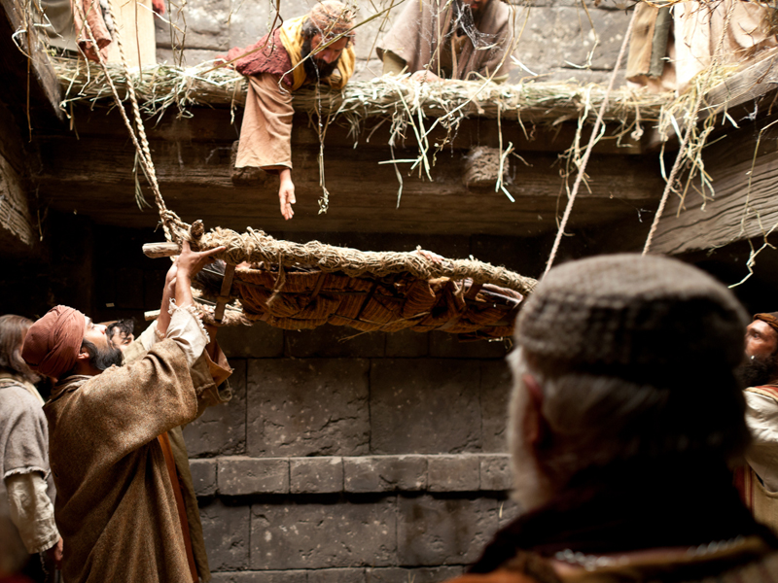

How can we exercise faith in behalf of others?

Slide 16

Forgiveness
Just as it was a miracle for the man to be healed of palsy, it was also a miracle for him to be forgiven of his sins.
This miracle is available to each of us as we repent.

Slide 17
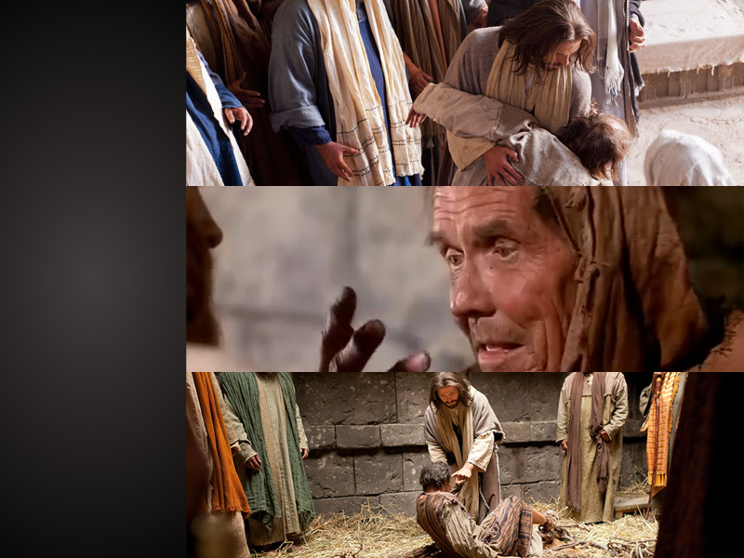
Why did Jesus perform these and other miracles during his ministry?

Slide 18
Miracles
To show love and compassion.
  “And Jesus, moved with compassion, put forth his hand, and touched him”
To build and confirm faith.
  “When Jesus saw their faith, he said unto the sick of the palsy, Son, thy sins be forgiven thee.”
To prove his divinity and power.
  “for he taught them as one that had authority”

Slide 19
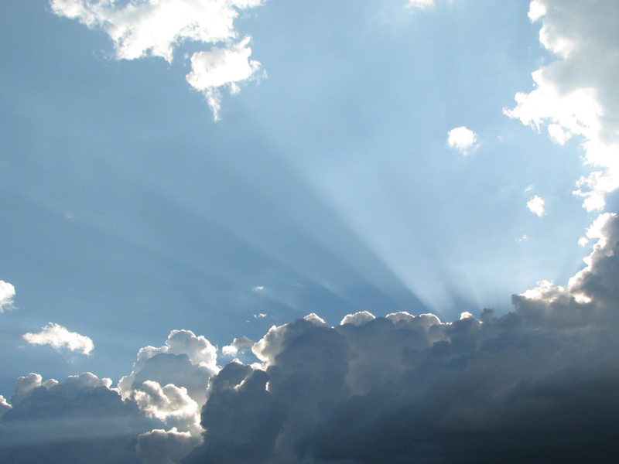
The physical aspects of the Savior’s miracles often symbolized spiritual truths.

Slide 20
Calming the Sea
While crossing the sea, a
great storm arose.
Disciples – “Master,
carest thou not that we
perish?”
Jesus rebuked the wind,
“Peace, be still.” He asked
his disciples, “Why are ye so fearful? How is it that ye have no faith?”
The disciples feared exceedingly, “What manner of man is this, that even the wind and the sea obey him?” – See Mark 4:35-41

Slide 21
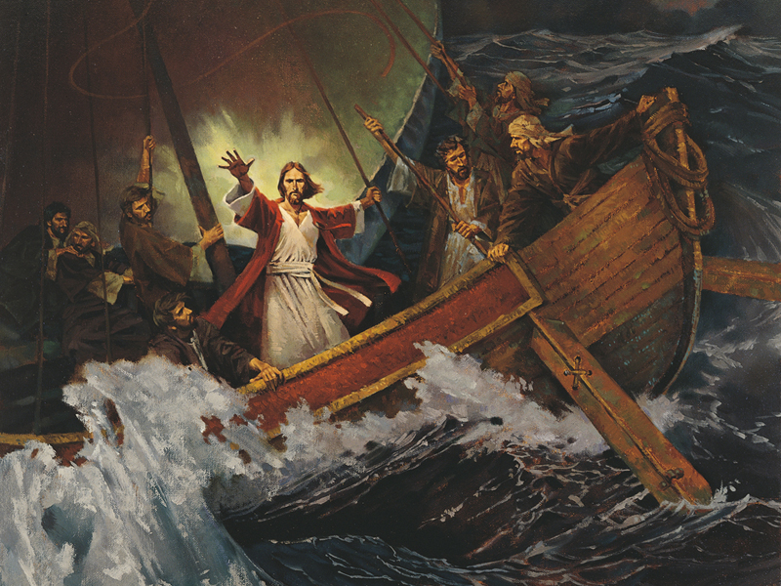
Jesus calmed the sea.
He can calm the storms of our lives.

Slide 22
Legion
There was a man with an unclean spirit whom no man could bind, not even with chains.
He dwelt in the tombs, crying and cutting himself with stones.
“My name is Legion: for we are many”

Slide 23
Legion
Jesus commanded the spirit to the leave the man.
Legion left the man and entered a nearby herd of swine. The pigs drowned themselves in the sea.
Similarly, Christ can cast Satan’s influence out of our lives.

Slide 24
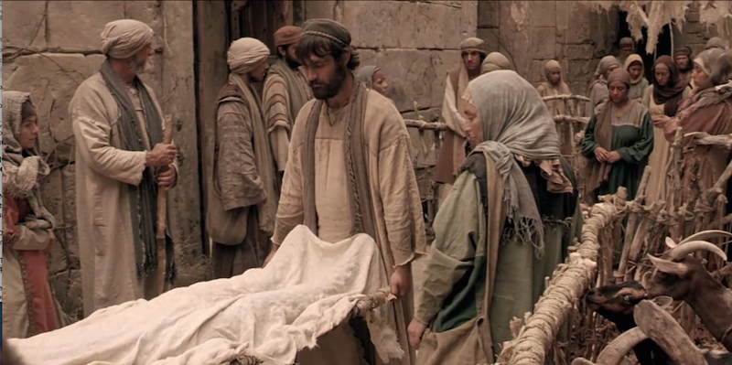
Widow of Nain
While traveling through Nain, Jesus revived a widow’s only son.
Video Presentation

Slide 25


Slide 26
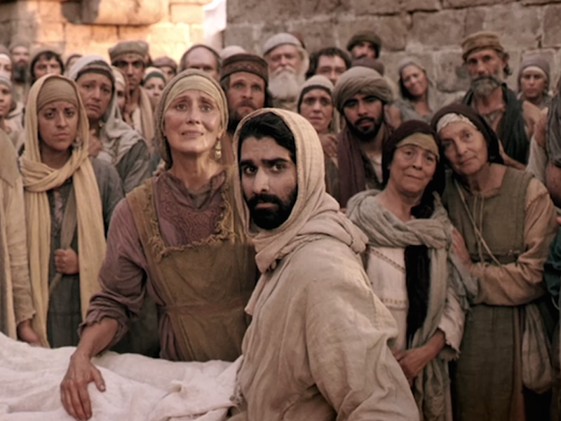
Because of Christ’s Atonement, we will rise from the dead in the Resurrection.

Slide 27

What other insights have you gained from studying these three miracles?

Slide 28
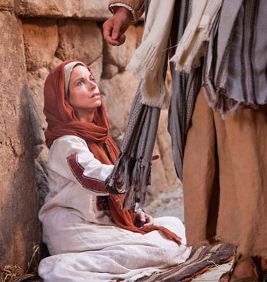
Woman of Faith
There was a woman with and issue of blood for 12 years.
No physician could heal her.
When Jesus passed by she reached out to touch his clothes.

Slide 29
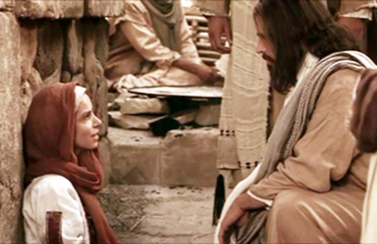
Woman of Faith
Feeling virtue leave
him, Jesus asked,
“Who touched my
clothes?”
Disciples, “Thou
seest the multitude
thronging thee, and
sayest thou, Who
touched me?”
The Woman confessed she had touched him.
Jesus said to her, “thy faith hath made thee whole; go in peace, and be whole of thy plague.”
See Mark 5:25-34

Slide 30
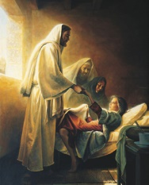
Jairus
A man came to Jesus for help. Some told him not to try because his daughter was already dead.
Jesus said, “Be not afraid, only believe.”
Jesus entered the man’s house. He told most of the people there to leave and revived the girl saying, “Damsel, I say unto thee, arise.” see Mark 5:35-43

Slide 31
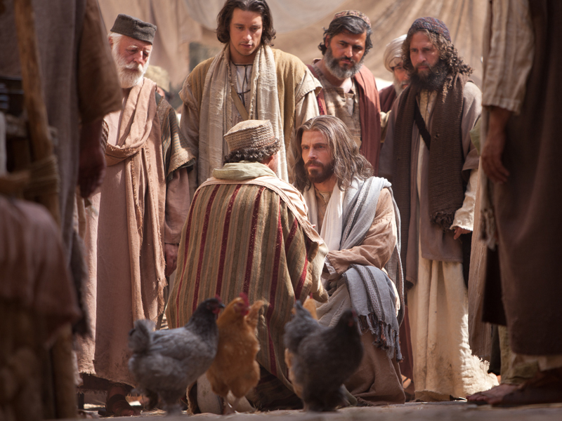
“Be not afraid, only believe” -Mark 5:36

Slide 32
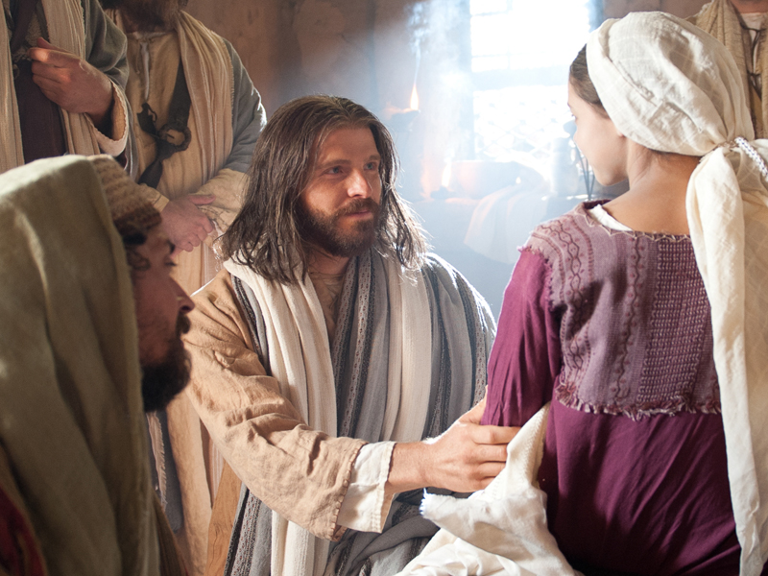
Why do you think faith must precede miracles?

Slide 33
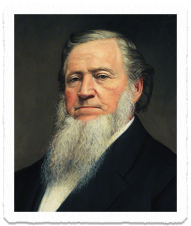
Miracles
“Miracles, or these extraordinary manifestations of the power of God, are not for the unbeliever; they are to console the Saints, and to strengthen and confirm the faith of those who love, fear, and serve God”
-Brigham Young

Slide 34
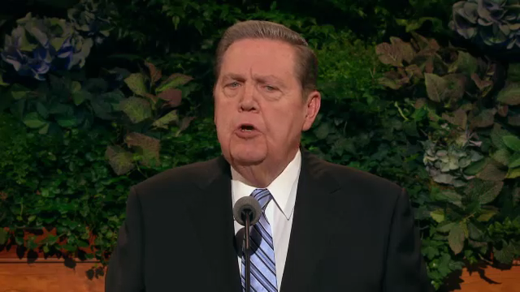
Seeing Miracles
What should we do when life is challenging?
Elder Jeffrey R. Holland

Slide 35

Seeing Miracles
What should we do when life is challenging?
Elder Jeffrey R. Holland

Slide 36
Seeing Miracles
Never lose faith in heavenly father.
Invite the spirit into your life.
Seek priesthood council and blessings.
Take the sacrament.
Believe in miracles.
If the bitter cup does not pass, drink it.

Slide 37
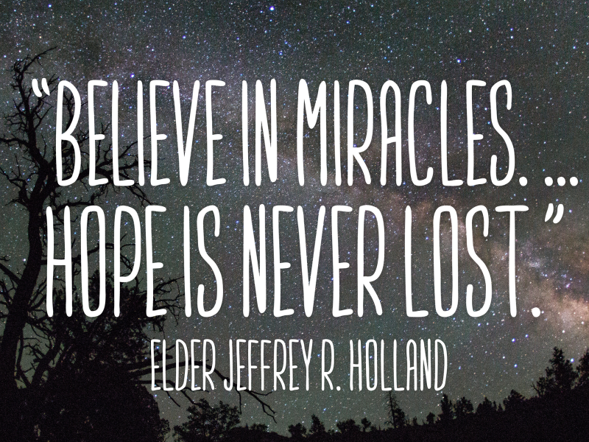

Slide 39


Authored by Dan Oakey
This work is licensed under a Creative Commons Attribution-NonCommercial-ShareAlike 4.0 International License.
Royalty free Images were used from the LDS media library

