Slide 1
Gospel Doctrine
Lesson 8: “A More Excellent Way”

Slide 2
Purpose
Encourage class members to come unto Christ by applying the principles he taught in the Sermon on the Mount.

Slide 3
Summary
Jesus teaches the Beatitudes to his disciples.
Jesus declares that his disciples are “the salt of the earth” and “the light of the world.”
Jesus declares that he has come to fulfill the law of Moses, and he teaches a higher law.

Slide 4
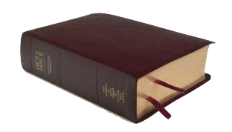
Invitations
“Come unto me, all ye that labour and are heavy laden, and I will give you rest.
Take my yoke upon you, and learn of me; for I am meek and lowly in heart: and ye shall find rest unto your souls.”
-Matthew 11:28-29

Slide 5
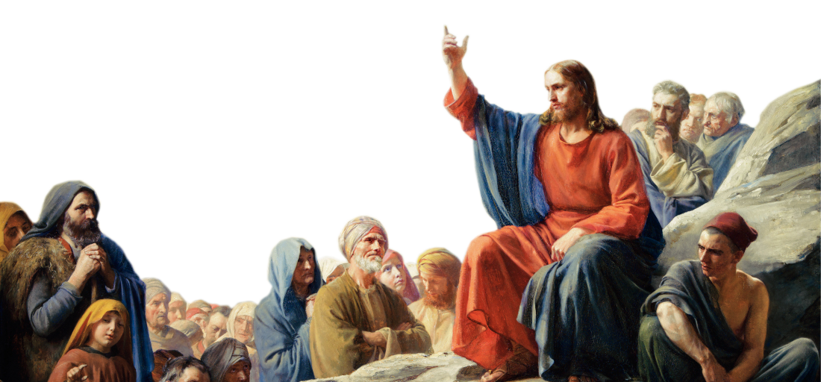
The Beatitudes
Jesus taught a sermon atop a mountain.
He began with the beatitudes.
‘Beatitude’ – From the Latin word ‘beatus’ for fortunate, happy, or blessed.

Slide 6
Matthew 5:3
“Blessed are the poor in spirit: for theirs is the kingdom of heaven.”
-‘Poor in spirit’ means to be humble.

Slide 7
Why is it important that we be humble?
How can we be more humble?

Slide 8
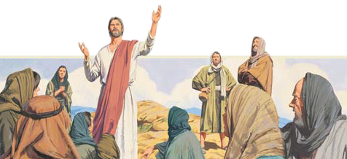
Matthew 5:4
“Blessed are they that mourn: for they shall be comforted.”

Slide 9
What are some ways the Lord provides for us to be comforted?

Slide 10
Matthew 5:5
“Blessed are the meek: for they shall inherit the earth.”
-See footnote 5a. Meekness is to be gentle, forgiving, or benevolent.

Slide 11
How can we develop meekness?

Slide 12
Matthew 5:6
“Blessed are they which do hunger and thirst after righteousness: for they shall be filled.”
“…they shall be filled with the Holy Ghost”
– See 3 Nephi 12:6

Slide 13
What can we do to lift our appetites from the things of the world to things of righteousness?

Slide 14
Matthew 5:7
“Blessed are the merciful: for they shall obtain mercy.”
The plan of redemption depends on Christ’s atonement allowing mercy on those who repent.
-See Alma 42:13-15

Slide 15
How can we show mercy to others?

Slide 16
Matthew 5:8
“Blessed are the pure in heart: for they shall see God.”

Slide 17
How can we purify our hearts?

Slide 18
Matthew 5:9
“Blessed are the peacemakers: for they shall be called the children of God.”

Slide 19
How can we be peacemakers in our homes and communities?

Slide 20
Matthew 5:10-12
“Blessed are they which are persecuted for righteousness’ sake: for theirs is the kingdom of heaven.
Blessed are ye, when men shall revile you, and persecute you, and shall say all manner of evil against you falsely, for my sake.
Rejoice, and be exceeding glad: for great is your reward in heaven: for so persecuted they the prophets which were before you.”

Slide 21
How should we respond to persecution?

Slide 22
Matthew 5:13
“Ye are the salt of the earth: but if the salt have lost his savour, wherewith shall it be salted? it is thenceforth good for nothing, but to be cast out, and to be trodden under foot of men.”

Slide 23
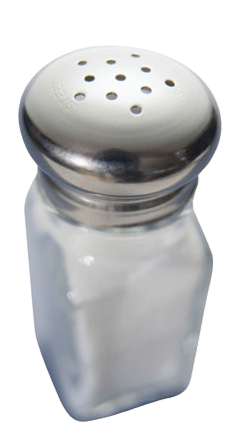
What are some uses for salt?
How can Latter-day Saints be “the salt of the earth”?

Slide 24
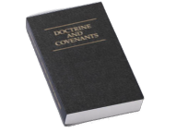
D&C 103:9-10
“For they were set to be a light unto the world, and to be the saviors of men;
And inasmuch as they are not the saviors of men, they are as salt that has lost its savor, and is thenceforth good for nothing but to be cast out and trodden under foot of men.”

Slide 25
How can we be “the saviors of men”?

Slide 26
Matthew 5:14-16
“Ye are the light of the world. A city that is set on an hill cannot be hid.
Neither do men light a candle, and put it under a bushel, but on a candlestick; and it giveth light unto all that are in the house.
Let your light so shine before men, that they may see your good works, and glorify your Father which is in heaven.”

Slide 27
How can we let our light shine in a way that will lead others to “glorify [our] Father … in heaven”?

Slide 28
The Law
“Think not that I am come to destroy the law, or the prophets: I am not come to destroy, but to fulfil.”
Matthew 5:17
The law of Moses was a group of performances and ordinances given to help people look forward to the Atonement of Christ.

Slide 29
Broken Hearts
After Christ fulfilled the law of Moses, people were no longer commanded to offer animal sacrifices.
Instead, the people were commanded to “offer for a sacrifice … a broken heart and a contrite spirit”
3 Nephi 9:20

Slide 30
Appearances
Jesus said that his disciples’ righteousness should “exceed the righteousness of the scribes and Pharisees”
Matthew 5:20
The scribes and the Pharisees focused only on outward appearances of the law and ignored the importance of inner faithfulness.

Slide 31
The Higher Law
Jesus introduced a higher law, replacing the law of Moses.

Slide 32
Matthew 5:21-22
“Ye have heard that it was said by them of old time, Thou shalt not kill...
But I say unto you, That whosoever is angry with his brother shall be in danger of the judgment.”
-See JST

Slide 33
What can we do to control feelings of anger and seek to eliminate them from our lives?

Slide 34
The Higher Law
Ye have heard that it was said | But I say unto you
Thou shalt not kill | Do not get angry

Slide 35
Matthew 5:23
“Therefore if thou bring thy gift to the altar, and there rememberest that thy brother hath ought against thee;
Leave there thy gift before the altar, and go thy way; first be reconciled to thy brother, and then come and offer thy gift.”

Slide 36
What are the dangers of waiting for a person who has offended us to ask for our forgiveness?

Slide 37
Matthew 5:27
“Ye have heard that it was said by them of old time, Thou shalt not commit adultery
But I say unto you, That whosoever looketh on a woman to lust after her hath committed adultery with her already in his heart.”

Slide 38
What are some results of unclean thoughts?
What can we do to keep our thoughts pure?

Slide 39
For as [a man] thinketh in his heart, so is he.
-Proverbs 23:7

Slide 40
The Higher Law
Ye have heard that it was said | But I say unto you
Thou shalt not kill | Do not get angry
Thou shalt not commit adultery | Avoid lustful thoughts

Slide 41
Matthew 5:29-30
“And if thy right eye offend thee, pluck it out, and cast it from thee…. And if thy right hand offend thee, cut it off, and cast it from thee: for it is profitable for thee that one of thy members should perish, and not that thy whole body should be cast into hell. -Note: JST says the eye and hand in this verse represents sins.

Slide 42
What do these verses teach us about how we should deal with our sins?
Notes:
The Gourd is called a ‘Cumbuca.’ Trappers carve a hole in a gourd, just big enough so that the hand of the monkey can squeeze in. Then they stake the gourd to the ground, and inside the gourd they place something that attracts the monkey, usually a fruit such as a banana. The foolish monkey grabs the banana, but with his hand closed, he cannot take it out. And he will not let the banana go, so he is trapped.
See “Caught in a Cumbuca“ by Elder Marcos A. Aidukaitis, Liahona March 2010

Slide 43
Matt. 5:33-34, 37
“Again, ye have heard that it hath been said by them of old time, Thou shalt not forswear thyself, but shalt perform unto the Lord thine oaths:
But I say unto you, Swear not at all…. let your communication be, Yea, yea; Nay, nay: for whatsoever is more than these cometh of evil.”

Slide 44
Oaths
“Under the Mosaic law the taking of oaths was so common and covered such a variety of circumstances that, in practice, little verity attended statements that were not made with an oath. … Under the perfect law of Christ every man’s word is his bond, and all spoken statements are as true as though an oath attended each spoken word”
-Bruce R. McConkie

Slide 45
The Higher Law
Ye have heard that it was said | But I say unto you
Thou shalt not kill | Do not get angry
Thou shalt not commit adultery | Avoid lustful thoughts
Perform oaths to the Lord | Keep your word

Slide 46
Matthew 5:38-39
“Ye have heard that it hath been said, An eye for an eye, and a tooth for a tooth.
But I say unto you, That ye resist not evil: but whosoever shall smite thee on thy right cheek, turn to him the other also.”

Slide 47
What principles did Jesus teach when he spoke of turning the other cheek to someone who hits us?

Slide 48
The Higher Law
Ye have heard that it was said | But I say unto you
Thou shalt not kill | Do not get angry
Thou shalt not commit adultery | Avoid lustful thoughts
Perform oaths to the Lord | Keep your word
An eye for an eye | Turn the other cheek

Slide 49
Matt. 5:43-44
“Ye have heard that it hath been said, Thou shalt love thy neighbour, and hate thine enemy. But I say unto you, Love your enemies, bless them that curse you, do good to them that hate you, and pray for them which despitefully use you, and persecute you.”

Slide 50
How will our lives change when we love our enemies? How might their lives change?

Slide 52
The Higher Law
Ye have heard that it was said | But I say unto you
Thou shalt not kill | Do not get angry
Thou shalt not commit adultery | Avoid lustful thoughts
Perform oaths to the Lord | Keep your word
An eye for an eye | Turn the other cheek
Love thy neighbor and hate thine enemy | Love your enemies

Slide 53
Matthew 5:48
“Be ye therefore perfect, even as your Father which is in heaven is perfect.”

Slide 54
Perfection
“I believe the Lord meant just what he said: that we should be perfect, as our Father in heaven is perfect. That will not come all at once, but line upon line, and precept upon precept, example upon example, and even then not as long as we live in this mortal life, for we will have to go even beyond the grave before we reach that perfection and shall be like God.”
-Joseph Fielding Smith

Slide 55
Perfection
“But here we lay the foundation. Here is where we are taught these simple truths of the gospel of Jesus Christ, in this probationary state, to prepare us for that perfection. It is our duty to be better today than we were yesterday, and better tomorrow than we are today. … If we are keeping the commandments of the Lord, we are on that road to perfection”
-Joseph Fielding Smith

Slide 58
Authored by Dan Oakey
This work is licensed under a Creative Commons Attribution-NonCommercial-ShareAlike 4.0 International License.
Royalty free Images were used from the LDS media library

