Slide 1
Gospel Doctrine
Lesson 9: “Seek Ye First the Kingdom of God”

Slide 2
Purpose
Encourage class members to become more dedicated disciples of Jesus Christ.

Slide 3
Summary
Jesus performed many miracles
  Casting out devils
  Healing the sick and afflicted
  Forgiving sins
  Calming the stormy sea
  Raising the dead.

Slide 4

Youth Donation
Once there were some youth
who had raised money for an
activity.
They donated the money to the
general missionary fund instead.
They asked if Elder William R.
Bradford would take a picture with them.
The youth wanted the story published in the local newspaper.
Elder Bradford said “No.”

Slide 5
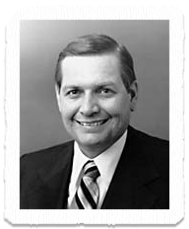
Selfless Service
He told the bishop, “You might
consider helping your young
people learn a higher law of
recognition. Recognition from on
high is silent. It is carefully and
quietly recorded there. Let them
feel the joy and gain the treasure
in their heart and soul that come from silent, selfless service”
-Elder William R. Bradford, Seventy

Slide 6
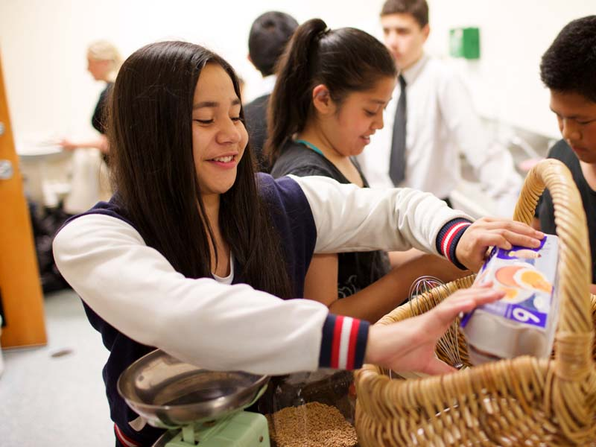

What lessons can we learn from Elder Bradford’s response to the youth?

Slide 7
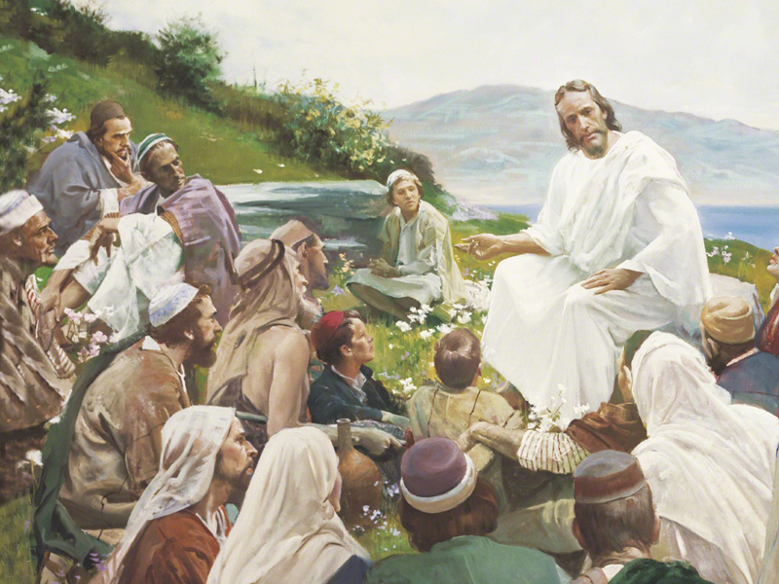

In the Sermon on the Mount, Jesus taught of true discipleship.

Slide 8
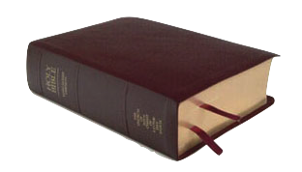
Matthew 6:1, 3
“Take heed that ye do not your alms before men, to be seen of them: otherwise ye have no reward of your Father which is in heaven…
But when thou doest alms, let not thy left hand know what thy right hand doeth”

Slide 9
Matthew 6:5-6
“And when thou prayest, thou
shalt not be as the hypocrites are:
for they love to pray standing in
the synagogues and in the corners
of the streets, that they may be
seen of men. Verily I say unto you,
They have their reward.
But thou, when thou prayest, enter into thy closet, and when thou hast shut thy door, pray to thy Father which is in secret; and thy Father which seeth in secret shall reward thee openly.”

Slide 10
Matthew 6:17-18
“Moreover when ye fast, be
not, as the hypocrites, of a sad
countenance: for they disfigure
their faces, that they may appear
unto men to fast. Verily I say
unto you, They have their
reward. But thou, when thou
fastest, anoint thine head, and wash thy face; That thou appear not unto men to fast, but unto thy Father which is in secret: and thy Father, which seeth in secret, shall reward thee openly.”

Slide 11
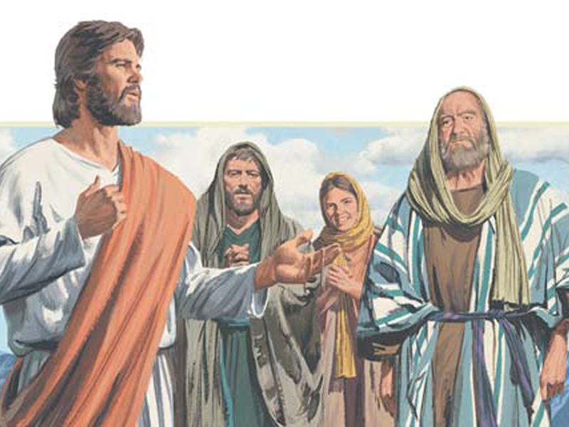
How can we purify our motives for serving and performing other good works?

Slide 12
True disciples do right things for right reasons.

Slide 13
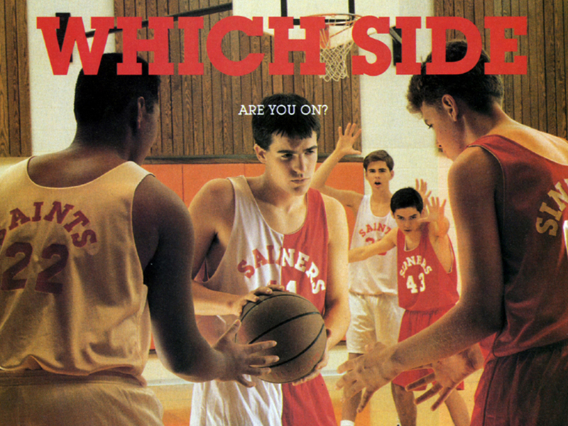
What is a hypocrite?

Slide 14

Hypocrite -
“One who pretends to be religious when he is not”
-Bible Dictionary

Slide 15
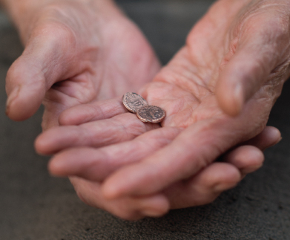
Matthew 6:19-21
“Lay not up for yourselves
treasures upon earth, where
moth and rust doth corrupt,
and where thieves break
through and steal:
But lay up for yourselves
treasures in heaven, where
neither moth nor rust doth
corrupt, and where thieves do not break through nor steal:
For where your treasure is, there will your heart be also.”

Slide 16
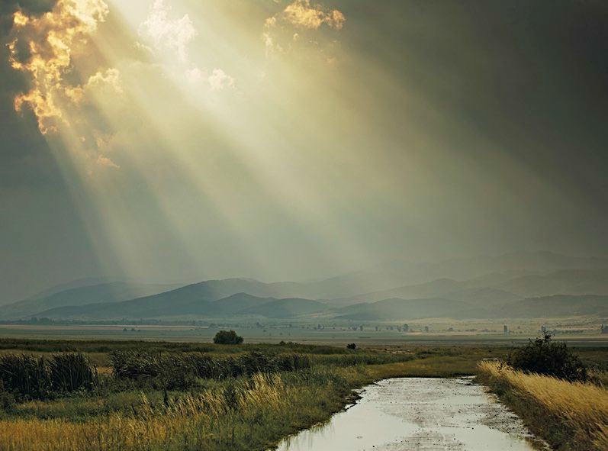
What are some heavenly treasures we can seek?

Slide 17
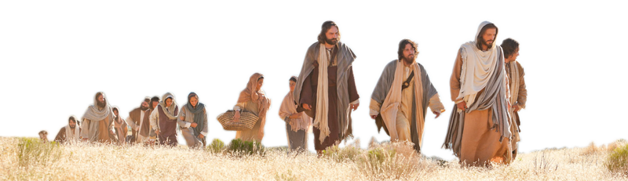
Matthew 6:7-8
“But when ye pray, use not vain repetitions, as the heathen do: for they think that they shall be heard for their much speaking.
Be not ye therefore like unto them: for your Father knoweth what things ye have need of, before ye ask him.”

Slide 18
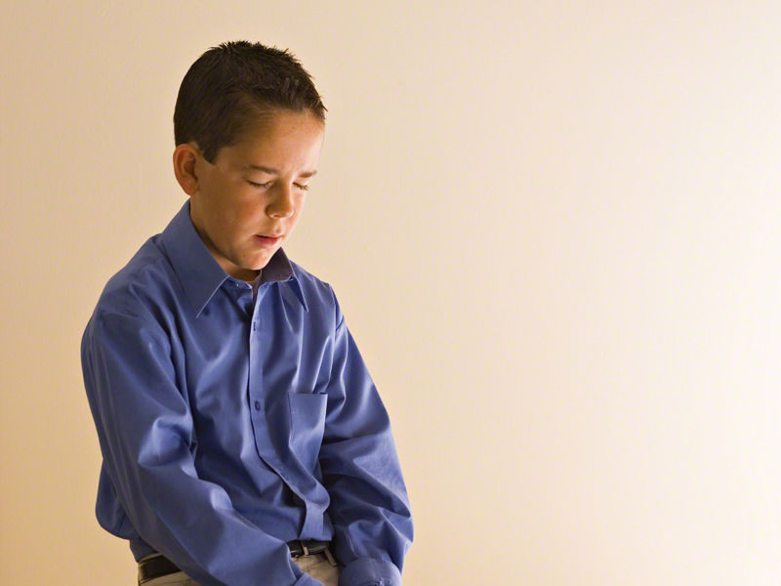
How can we avoid using
“vain repetitions” when we
pray?

Slide 19
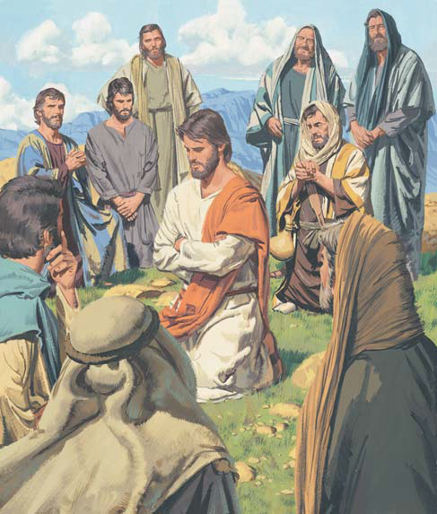
The Lord’s Prayer
“After this manner therefore pray
ye: Our Father which art in heaven,
Hallowed be thy name. Thy
kingdom come. Thy will be done in
earth, as it is in heaven. Give us this
day our daily bread. And forgive us
our debts, as we forgive our debtors.
And lead us not into temptation, but
deliver us from evil: For thine is the kingdom, and the power, and the glory, for ever. Amen.”
-Matthew 6:9-13

Slide 20
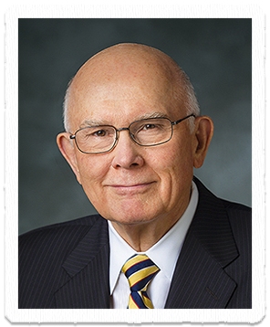
Language of Prayer
“The special language of prayer
follows different forms in different
languages, but the principle is
always the same. We should address
prayers to our Heavenly Father in
words which speakers of that
language associate with love and respect and reverence and closeness. … Men and women who wish to show respect will take the time to learn the special language of prayer”

Slide 21
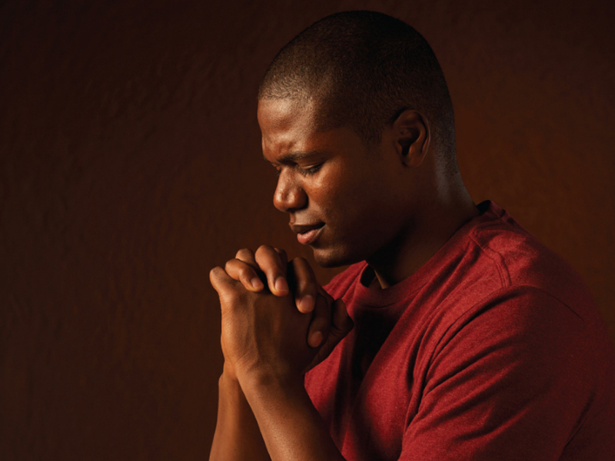
Since Heavenly Father knows what we need before we pray, why do we need to pray?

Slide 22
True disciples follow the Savior’s example of prayer.

Slide 23

Matthew 6:14-15
“For if ye forgive men their trespasses, your heavenly Father will also forgive you:
But if ye forgive not men their trespasses, neither will your Father forgive your trespasses.”

Slide 24
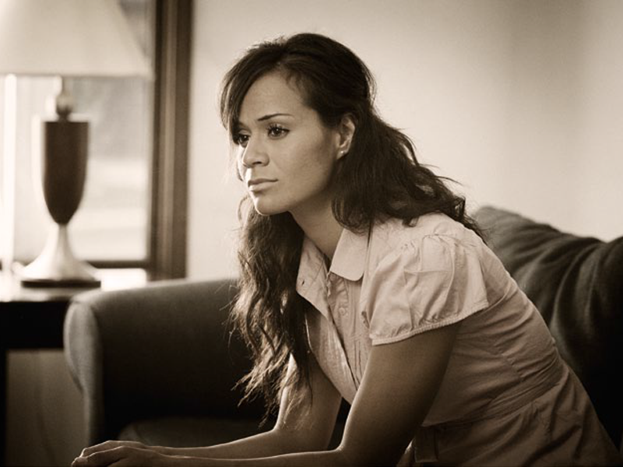
Why do you think the Savior commands us to forgive others? How can we become more forgiving?

Slide 25
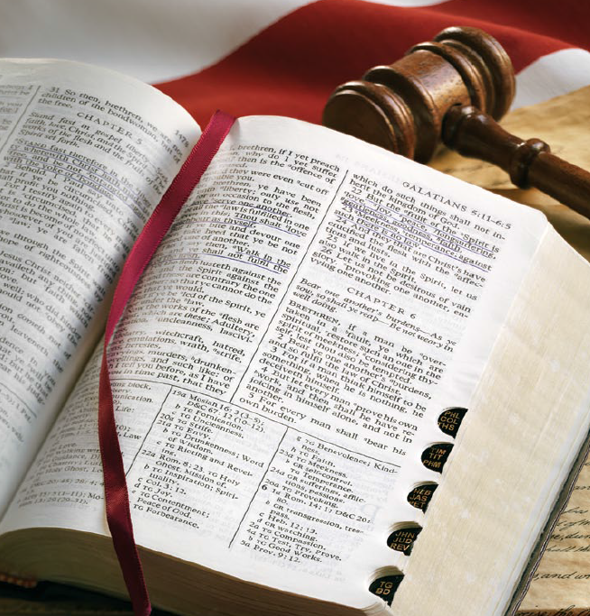
Matthew 7:1, 4
“Judge not unrighteously, that ye be not judged; but judge righteous judgment… (see JST)
Or how wilt thou say to thy brother, Let me pull out the mote out of thine eye; and, behold, a beam is in thine own eye?”

Slide 26

What harm can come to us and to those we judge if we judge unrighteously? How can we ensure that we judge righteously?

Slide 27

The Golden Rule
“Therefore all things whatsoever ye would that men should do to you, do ye even so to them: for this is the law and the prophets.”
-Matthew 7:12

Slide 28
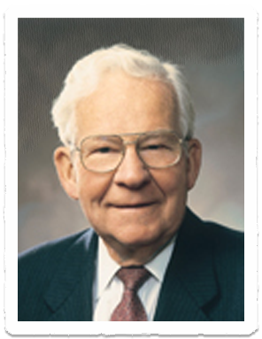
The Golden Rule
“The best and most clear indicator that we are progressing spiritually and coming unto Christ is the way we treat other people.”
-Elder Marvin J. Ashton

Slide 29
True disciples treat others kindly and fairly.

Slide 30

Matthew 6:22-23
“The light of the body is the eye: if therefore thine eye be single, thy whole body shall be full of light.
But if thine eye be evil, thy whole body shall be full of darkness. If therefore the light that is in thee be darkness, how great is that darkness!”

Slide 31
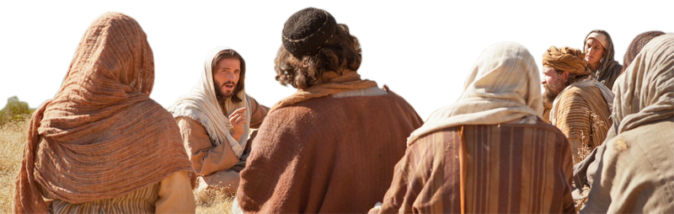
Matthew 6:24
“No man can serve two masters: for either he will hate the one, and love the other; or else he will hold to the one, and despise the other. Ye cannot serve God and mammon.”

Slide 32
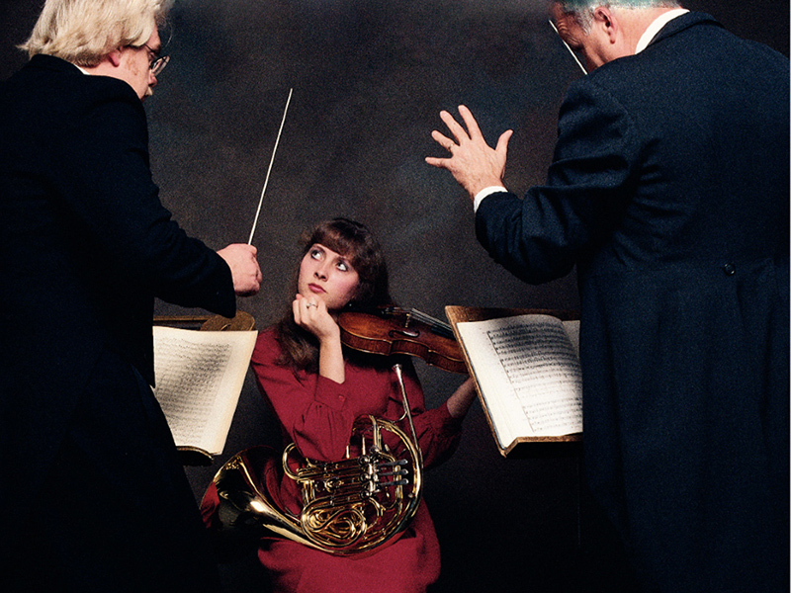
Why is it impossible to serve both God and mammon, or worldliness?

Slide 33
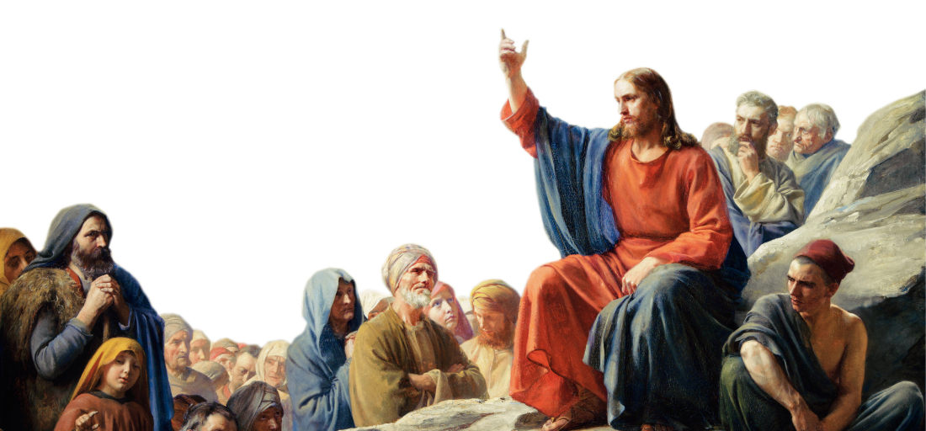
Matthew 7:14
“Strait is the gate, and narrow is the way, which leadeth unto life, and few there be that find it”

Slide 34

Why is it significant that the way to eternal life is narrow, while the way to destruction is broad?

Slide 35
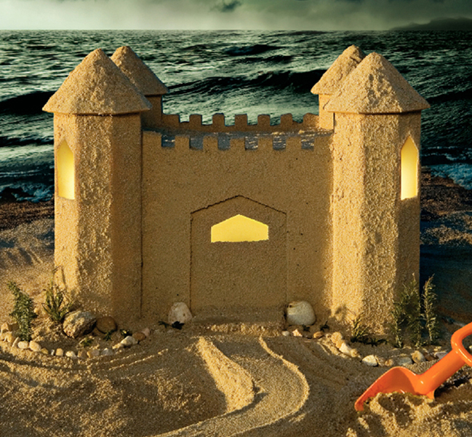
Matthew 7:26-27
“And every one that heareth
these sayings of mine, and
doeth them not, shall be
likened unto a foolish man,
which built his house upon
the sand:
And the rain descended, and
the floods came, and the winds blew, and beat upon that house; and it fell: and great was the fall of it.”

Slide 36
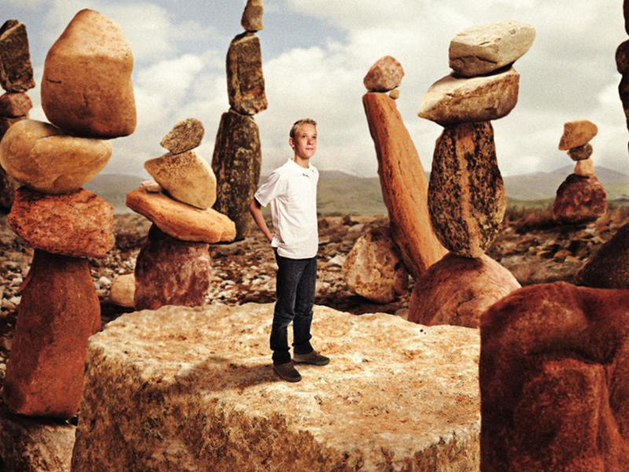
What are some examples of unstable foundations people build their lives on?

Slide 37
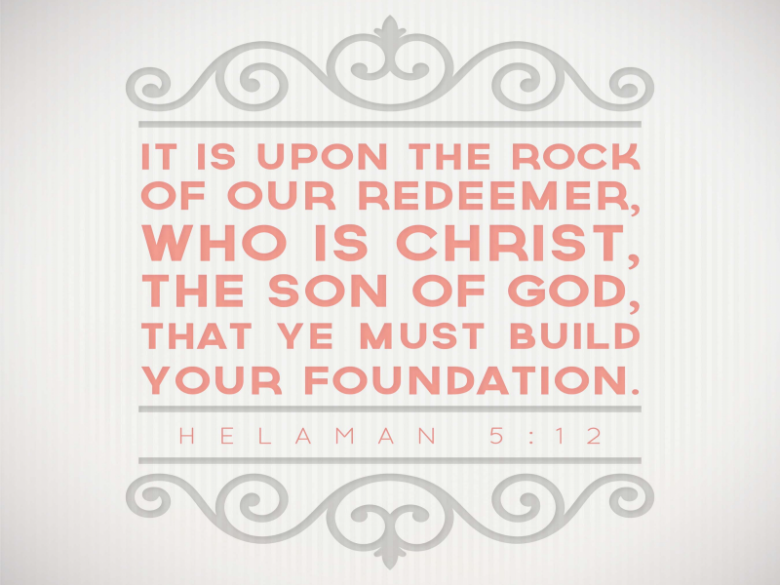

Slide 39


Authored by Dan Oakey
This work is licensed under a Creative Commons Attribution-NonCommercial-ShareAlike 4.0 International License.
Royalty free Images were used from the LDS media library

